Slide 2
ACT ASSESSMENT
Sarah Lane
Antonia Slater

Slide 3
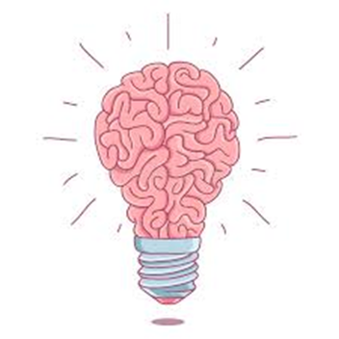
“Not that everything that can be counted counts, and not everything that counts, can be counted”
What does this mean in education?
Have you ever collected data that was never used?

Slide 4
ACT ASSESSMENT
If there is no ACT(ion), then what really is the point?
Actionable: Assessment should lead to a decision or action.
Creative: We can assess students in a variety of different ways to allow them to reach their full potential.
Time-Efficient: Assessment needs to consider staff well-being and how we can best impact our students in a timely manner.

Slide 5
ACT ASSESSMENT
Why?
For students to close gaps in knowledge, they must have a clear understanding of the intended learning outcomes. Therefore, assessment needs to be actionable and forward-looking.
We have developed our use of creative assessment to reflect a shift in focus from what they know to how they can apply their learning. This is also aligned with the focus on building social capital, which is a key element of our whole school approach to inclusion.

Slide 6
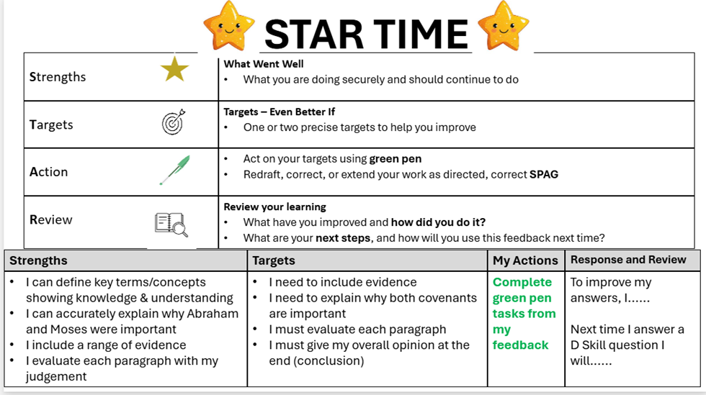
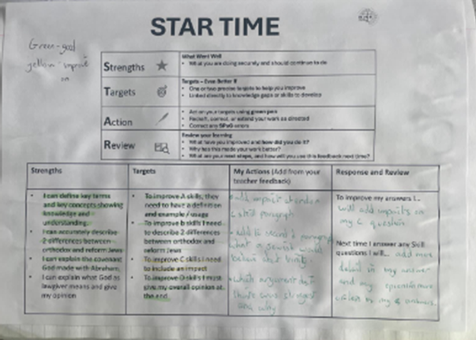
ACT ASSESSMENT: ACTIONABLE
In RE we have begun to embed a new strategy for improving students responses to feedback. As shown, students are given clear and accessible targets/instructions to gave them the power to improve their own work and take autonomy for their own learning.

Slide 7
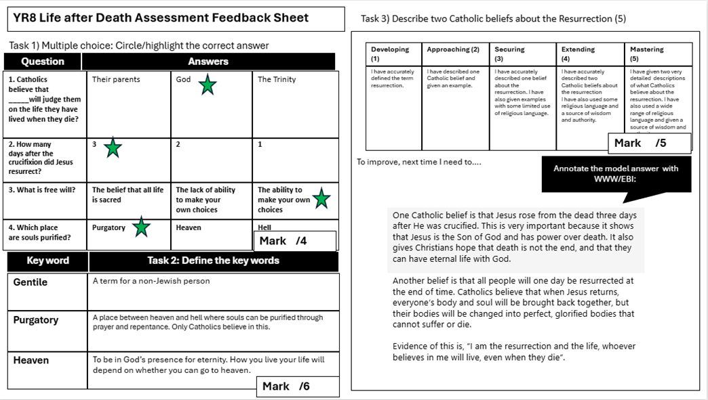
ACT ASSESSMENT: ACTIONABLE
We have also developed our use of low stakes testing within summative assessments to empower our lower ability students.

Slide 8
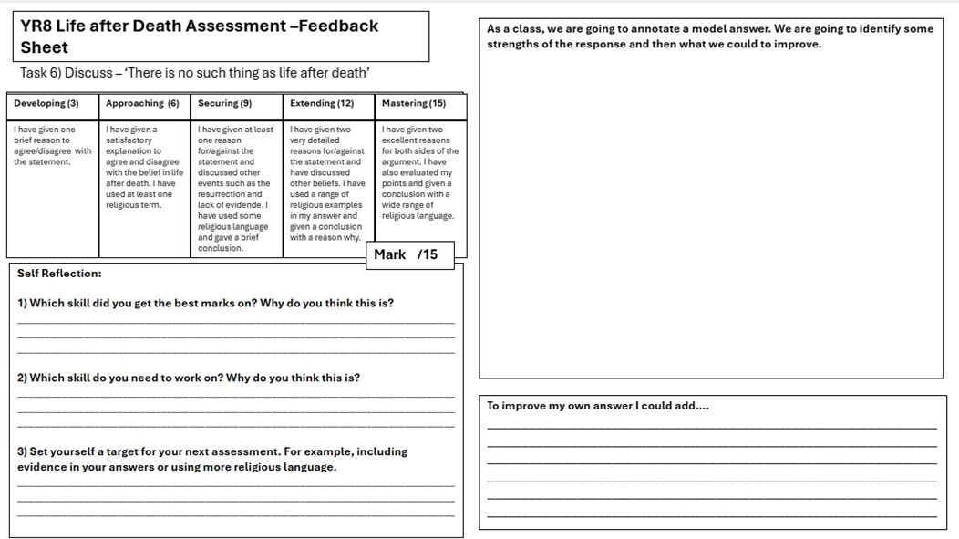
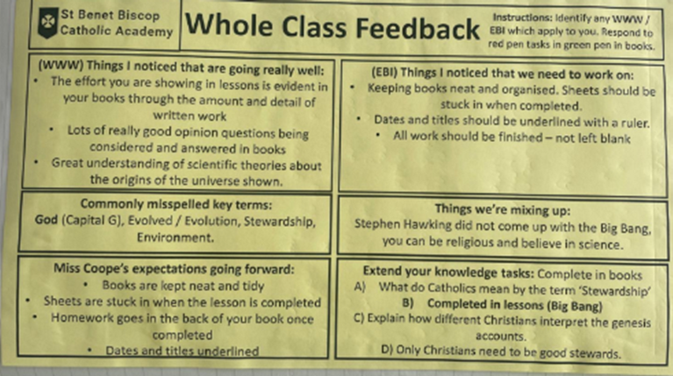
ACT ASSESSMENT: ACTIONABLE
Here are some other examples of how we are ‘actioning’ feedback in RE

Slide 9
ACT ASSESSMENT: CREATIVE
As educators, we understand that measuring progress goes beyond quantitative data such as grades.
Following the redesign of our RE curriculum, we have sought to embed more creative approaches to assessment. This involves a deliberate shift from focusing on what students know towards evaluating what they can do with their knowledge. Within RE and comparable disciplines, this application of knowledge is central to demonstrating progress.
In a meta-analysis conducted by Zhang and Ma (2023), it was found that project-based (creative) learning significantly improves students’ academic achievement and enhances their thinking skills when compared to traditional teaching methods.
In a study by Aris Redo, Millan Gutiérrez and Vargas Cano (2021), it was found that high‑ability students scored significantly higher on measures of creativity, including fluency, flexibility and originality.

Slide 10
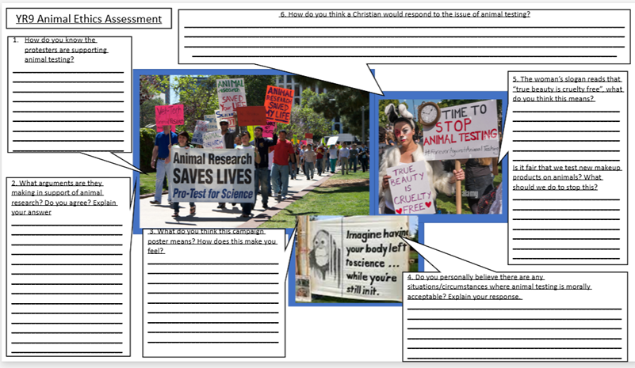
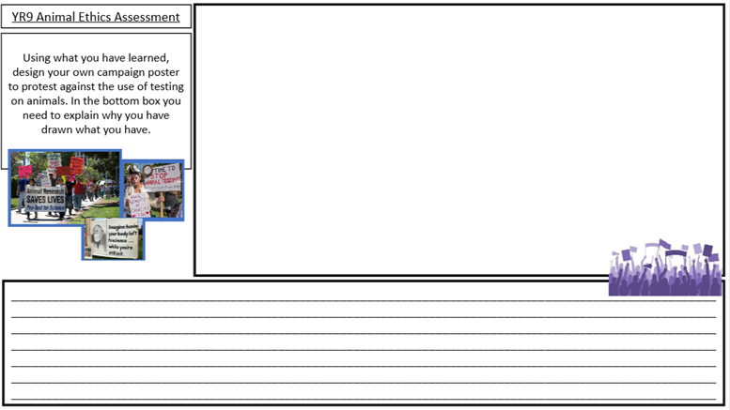
ACT ASSESSMENT: CREATIVE
Assessments do not have to consist solely of extended written work. Within our KS3 curriculum, we have been exploring a range of alternative assessment approaches.
In this particular example, students were given case studies of peaceful protests to analyse from a religious perspective. They were then asked to create their own protest, allowing them to demonstrate their understanding through a creative, artistic medium rather than relying purely on written responses.
This approach enabled students to engage with the content in a more meaningful and varied way.
This formed the basis for a classroom debate, giving students the opportunity to develop their analytical and oracy skills.

Slide 11
ACT ASSESSMENT: CREATIVE
From student voice, we found that our more reluctant learners accessed this type of assessment much better, and our HA students really enjoyed the opportunity to demonstrate their knowledge in a more creative way.

Slide 12
ACT ASSESSMENT: CREATIVE
From student voice, we found that our more reluctant learners accessed this type of assessment much better, and our HA students really enjoyed the opportunity to demonstrate their knowledge in a more creative way.

Slide 13
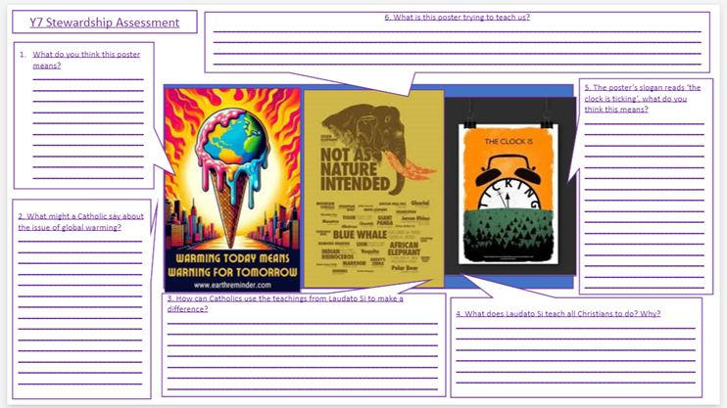
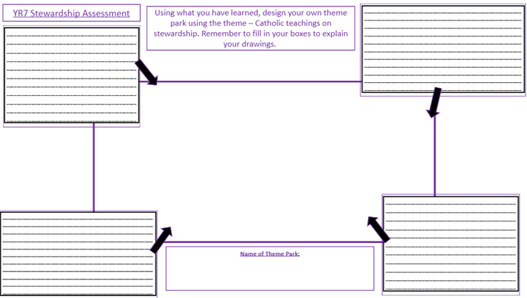
ACT ASSESSMENT: CREATIVE
Another example comes from Year 7, where our aim was for students to confidently articulate Catholic beliefs about stewardship.
To support this, we provided examples of global warming and climate change posters before setting students the task of designing their own environmentally friendly theme park.
Students engaged far more positively with this approach to assessment, compared to simply writing paragraphs to demonstrate their understanding.

Slide 14
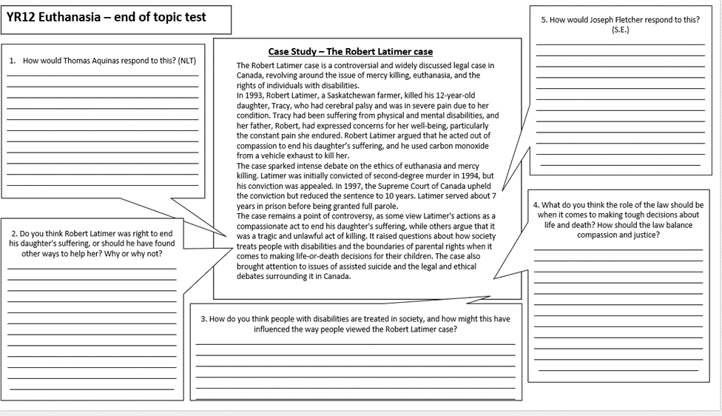
ACT ASSESSMENT: CREATIVE
Another example comes from Year 12, students were given a case study to analyse to help prepare them for an upcoming mock.
This task enabled students to consolidate their A01 knowledge of this particular unit, which then aided them to access a summative assessment.

Slide 15
ACT ASSESSMENT: CREATIVE
Redesign the assessment
We are going to start with a traditional assessment task:
“Write an essay explaining the causes of World War One.”
In your pairs or groups, redesign this task to incorporate more creative approaches to assessing student progress and understanding.
As you do this, consider:
•What skills are now being assessed?
•What evidence of understanding will students provide?

Slide 16
ACT ASSESSMENT: CREATIVE
Redesign the assessment
We are going to start with a traditional assessment task:
“Write an essay explaining the causes of World War One.”
What could you have done?
-Newspaper article
-Debate
-Court Room
-Domino Effect Display
-Museum Exhibit
-Social Media Profiles

Slide 17
ACT ASSESSMENT: TIME-EFFICIENT
•The amount of time spent marking is a reliable indicator of the impact it will have on student learning.
•If students do not act on feedback, the time spent providing it may have little value.
•Teachers can accurately assess learning without collecting or marking books.
•More detailed feedback always leads to greater student progress.
•A teacher can spend hours giving feedback that has little impact on learning.
•Whole-class feedback is a compromise used when teachers do not have time for individual feedback.
•The effectiveness of feedback should be judged by what students do next, not by what teachers write.
•Reducing marking workload can improve the quality of assessment.

Slide 18


ACT ASSESSMENT: TIME-EFFICIENT
•The amount of time spent marking is a reliable indicator of the impact it will have on student learning.
•If students do not act on feedback, the time spent providing it may have little value.
•Teachers can accurately assess learning without collecting or marking books.
•More detailed feedback always leads to greater student progress.
•A teacher can spend hours giving feedback that has little impact on learning.
•Whole-class feedback is a compromise used when teachers do not have time for individual feedback.
•The effectiveness of feedback should be judged by what students do next, not by what teachers write.
•Reducing marking workload can improve the quality of assessment.

Slide 19
ACT ASSESSMENT: TIME-EFFICIENT
As part of department CPD, we made a list of strategies that we use to assess and put them into the relevant sections.
The goal is to utilise the strategies that are low time/high impact the most.
In your groups/pairs can you organise the strategies on the next slide:
High Impact/High Time
High Time/Low Impact
What we want to avoid!
What we want more of!
Low Time/Low Impact
Low Time/ High Impact

Slide 20
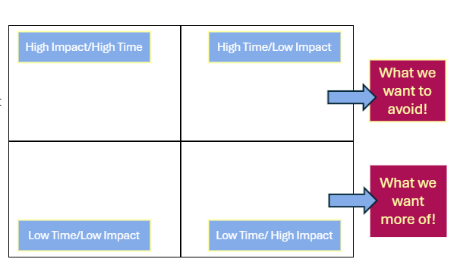
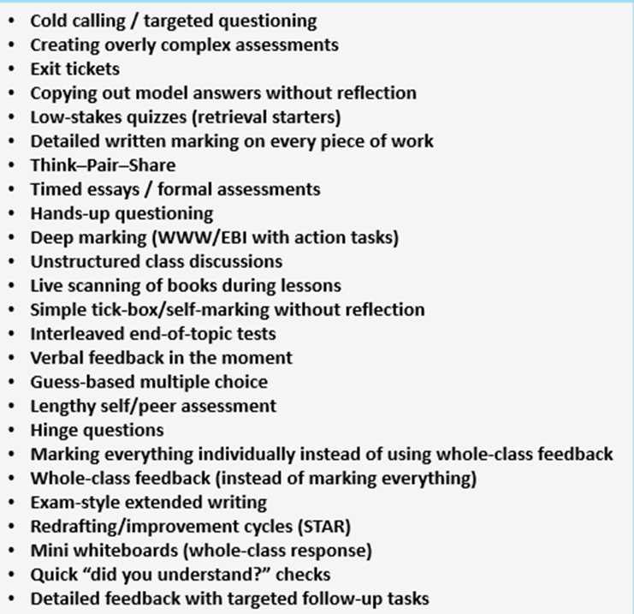
ACT ASSESSMENT: TIME-EFFICIENT

Slide 21
ACT ASSESSMENT: TIME-EFFICIENT
This is what we decided as a department:
High Time/Low Impact
Exam-style extended writing Timed essays / formal assessments Deep marking (WWW/EBI with action tasks) Redrafting/improvement cycles (STAR) Interleaved end-of-topic tests Detailed feedback with targeted follow-up tasks | Detailed written marking on every piece of work Lengthy self/peer assessment Copying out model answers without reflection Creating overly complex assessments Marking everything individually instead of using whole-class feedback
Hands-up questioning Quick “did you understand?” checks Unstructured class discussions Simple tick-box/self-marking without reflection Guess-based multiple choice | Low-stakes quizzes (retrieval starters) Hinge questions Cold calling / targeted questioning Mini whiteboards (whole-class response) Think–Pair–Share Verbal feedback in the moment Live scanning of books during lessons Whole-class feedback (instead of marking everything) Exit tickets
High Impact/High Time
Low Time/Low Impact
Low Time/ High Impact

Slide 22
How can we use what we have learned to ACT now?
In a nutshell, the goal is not more assessment. It is better assessment:
Improves Teaching
Ultimately improves students learning

