Slide 2
Barriers to learning
Think about your school, what do you think are the main barriers for children with Special Education Needs?

Slide 3
Main Barriers: SENCos report
Rising levels of individual needs
Increasing mismatch between needs and the mainstream environment
Speech and Language needs

Slide 4
Overarching Strategies
Close working partnerships with parents/carers
Collaborative working with other schools
Collaborative working with external partners
Being honest and asking for help!

Slide 5
Main Barriers: SENCos report
Rising levels of individual needs
Increasing mismatch between needs and the mainstream environment
Speech and Language needs

Slide 6
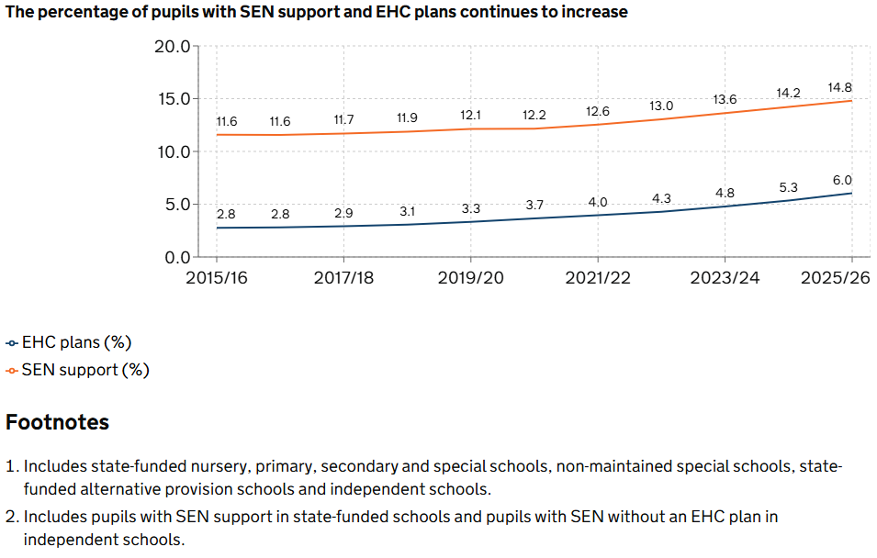
National Overview

Slide 7
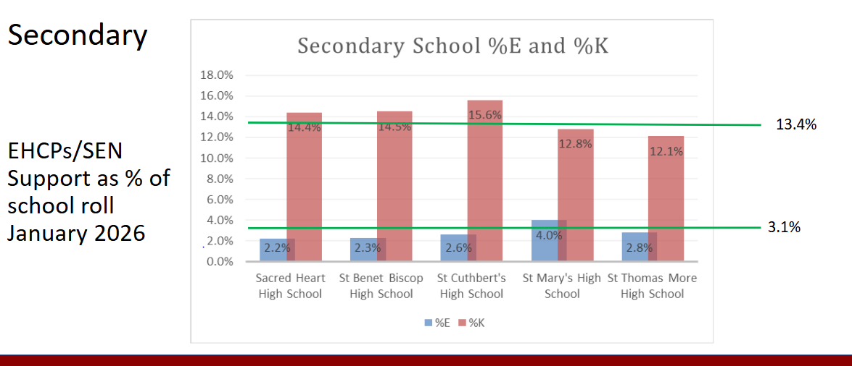
BBCET Secondary

Slide 8
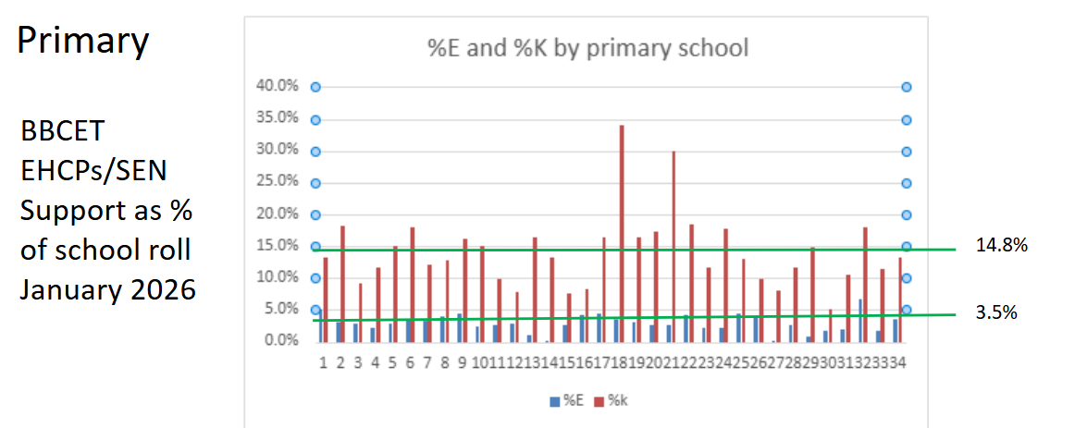
BBCET Primary

Slide 9
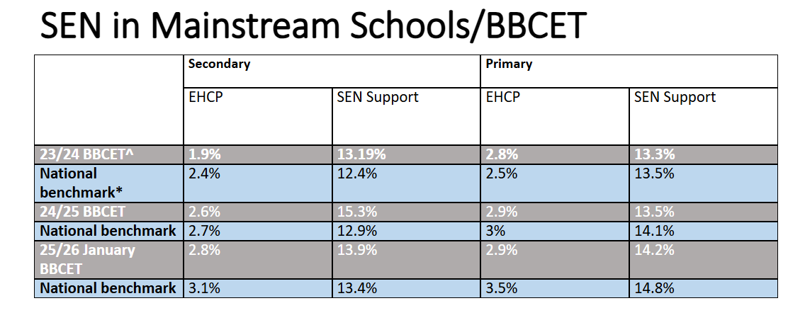
BBCET Schools

Slide 10
Presentation of need:
There are more children requiring a more individualized approach to their learning
The role of TAs/ LSAs has changed drastically over recent years.
Staff report feeling less confident in meeting changing SEN needs
Increased demand on resources e.g. equipment, staff time, space, specialist support services.
More dysregulated children

Slide 11
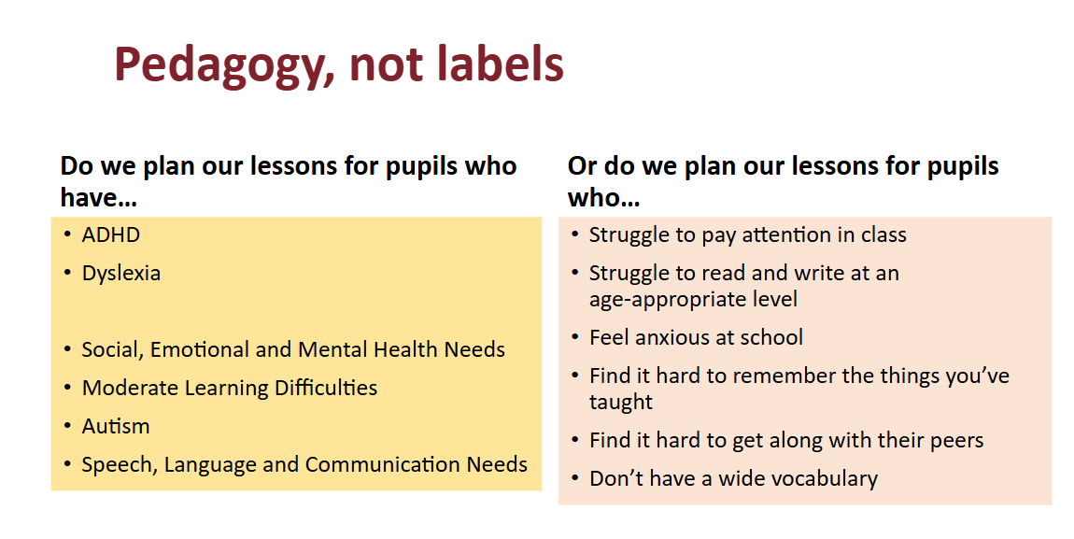
Stratgies

Slide 12
Strategies - Trust & School:
Adaptive teaching : "5 per Day"
Development of Inclusion Bases and Enhanced provision
Trust Experts at Hand
Trust SENDCo support
Ongoing CPD
MITA project
Interventions
Screening tools
Alignment for Excellence document (Trust Website)
Use of AI to adapt and differentiate resources

Slide 13
Main Barriers: SENCos report
Rising levels of individual needs
Increasing mismatch between needs and the mainstream environment
Speech and Language needs

Slide 14
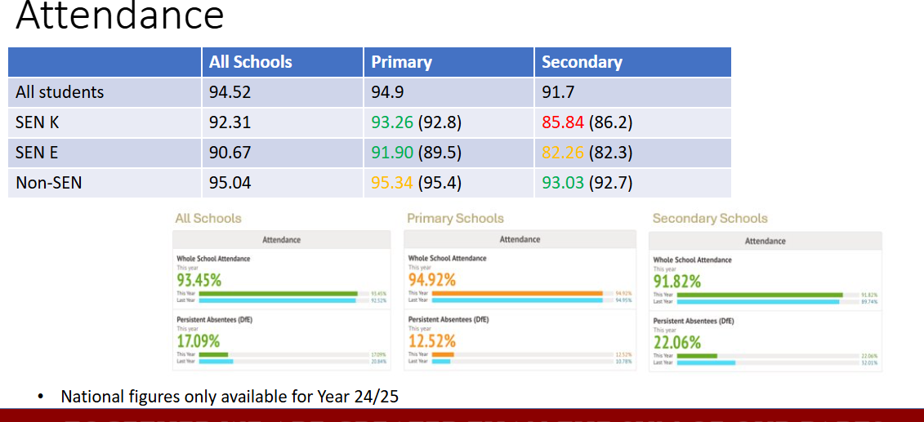
Attendance

Slide 15
Presentation of need:
Students experience sensory overwhelm.
Reduced engagement in lessons
Increased risk in school absence/ PA.
Socially isolated
Increased levels of anxiety/ becoming withdrawn
Escalating behaviour
Students need more co-regulation

Slide 16
Strategies - Trust & School
Wellbeing Hub
Flexi-timetable
EP support
AV1 Robots
EBSNA Workshops
Collaboration with parents
Consideration of Push and Pull factors
Working with LA
CSCOT (primary only)

Slide 17
Task
Using the student profile provided, identify areas of the school environment and day that you feel this child may struggle with, what might you do to support them?

Slide 18
Main Barriers: SENCos report
Rising levels of individual needs
Increasingly challenging environment
Speech and Language and Communication needs

Slide 19
Research suggests:
Over 60% of young people in contact with the youth justice system have difficulties with speech, language or communication
Between 40% and 54% of children with behaviour problems have language difficulties
81% of children with emotional and behavioural disorders have significant language difficulties.
People who have communication difficulties are more at risk of having anxiety and depression.
Reference: mental-health-fact-sheet.pdf (rcslt.org)
Notes:
Research shows that 60-90% of young offenders have communication difficulties.The Youth Justice Board found that in one year, 71% of children sentenced had speech, language and communication concerns. However, studies suggest that only around 5% of young people with communication needs have their needs identified before entering the youth justice system. Evidence suggests there is a close link between language difficulties, challenging behaviour & risk of involvement in criminal activity.
Research featured in the reference from 2005 found that 100% of pupils excluded from school in the study had an undiagnosed communication and interaction difficulty, another study from 2009 found over 65% of pupils excluded had an undiagnosed C&I difficulty
The link between language difficulties and behaviour is well evidenced – it has been found that 54% of children and young people with behaviour problems have a language impairment (Maggio et al, 2014). Young offenders with DLD are more than twice as likely to reoffend than their unaffected offending peers (Winstanley, Webb and Conti-Ramsden, 2020).
Research also suggests that 65% of all children and young people in the care system have SLCN. One service for Children in Care found 62% of its young people had communication needs. Only 2 of the children had previously seen an SLT.

Slide 20
Presentation of need
Unable access some or most of learning
Can be silent or try to avoid engaging in lessons
Struggle to identify emotions and communicate their needs
Disruptive in the classroom
May copy peers to mask their needs
Can be chatty about areas of interest/confidence (areas they have the language for)
Notes:
Vocabulary:
Emotion vocabulary is harder to learn than a noun because it is harder to picture and describe. It is more abstract and often is based on the experiences you have.
Young people need to hear a word being used lots and in a range of contexts to learn a new word, this is even more important for emotion vocabulary because it is linked to a feeling and can be experienced in lots of different situations.
Adults find it hard to identify their emotions, think about how much harder this would be for a young person or someone with SLCN
Emotional Regulation
Experiencing strong emotions impacts on listening, understanding and how easily we can access our language skills. Consider how well do you communicate when you feel a strong emotion?
Emotional regulation relies on us being able to recognise the emotion we are feeling, understand what it means and then plan what to do to change this if needed. This is a complex process which children need support to develop

Slide 21
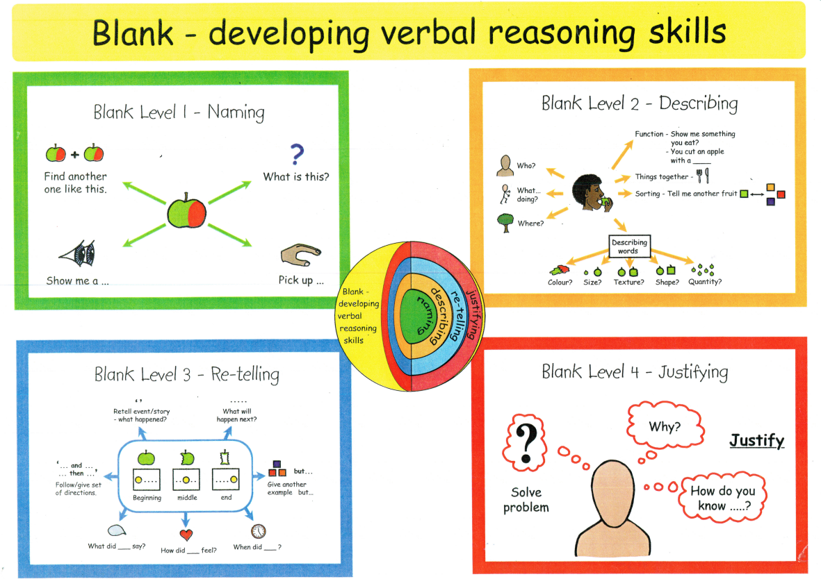
What are the Blank Levels of Questions?

Slide 22
What are the Blank Levels of Questions?
Level 1 ​ | Naming​ | 'What's this?' 'What can you see?' 'Find another one like this’. ‘where is the…/pick up / show me/ give me the…..’
Level 2​ | Describing things | ' Find something that can cut', 'What is happening in this picture?’ concepts e.g. which one is big? Answering who, what and where about a picture or information that has just been given, Identifying things that go together. ​
Level 3​ | Stories and events​ | What might happen next, how might a character feel? what might a character say? sequencing, tell a story or describe an event, summarise a story, following a set of directions. ​
Level 4 ​ | Justifying, solving problems and inference​ | How and why questions. How do you know the ice will melt? What will happen if we add water? Why is the lady feeling sad? ​Solve a problem – what could you do? What should she do? How do you know…?
Reference: Elklan Language Builders

Slide 23
Asking questions – activity
Which level would you put each of these questions at? ​
Why did you do this?
Tell me what happened
What should you have done?
Who has been involved?
Where did this happen?
Point to what you wanted
What do you think needs
to happen next?
4
3
4
2
2
1
4

Slide 24
Strategies
Screen all pupils in EYFS, Y3 and Year 7
Central team of SaLT to support universal provision
Each LA has the NHS SaLT team
Individual schools are becoming more aware of the importance of adaptive language and curriculums to reduce cognitive load.
Best practice networking

Slide 25
SEN Reforms
Phase 1 2026-2028
Workforce training for staff September 2026
Schools publish Inclusion Strategy by Christmas 2026
Phase 2 2028-2029
Phase 3 29/30 onwards
Schools receive IMF to support improved whole school provision
Experts @Hand model introduced 2026/27
National Standards published September 2028
EHCP, National Standards and ISP legislation enacted
First Specialist Provision Packages in operation
60,000 new school places created in special schools, specialist support bases and inclusion bases
SEND Reform Bill drafted and put forward for approval, Statutory Guidance published
Likely to include duty to work to national inclusion standards, ISPs, reform of EHCP framework and cap on ISS pricing
New legislation and amended Code of Practice in operation from September 2029. Becomes legal duty
First EHC needs assessments under new system
Improved support
Investment and building system
Future system

Slide 26



Key Documents

Slide 27
4 key themes from these policy shifts:
Mainstream settings meeting more needs
Children’s needs being understood holistically, including when they have SEND
Teaching and learning being at the heart of how to meet those needs
Everyone as a part of the solution

