Slide 2
Developing Number Sense in EYFS and Year 1
St Aidan's Catholic Primary School

Slide 3
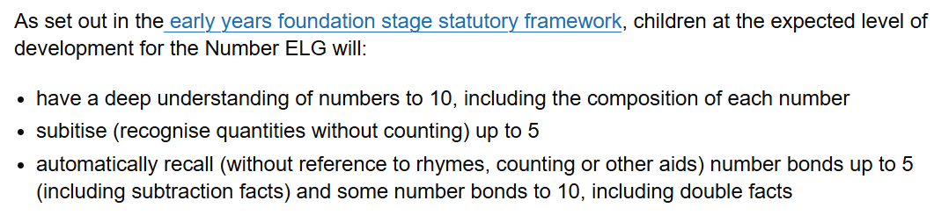
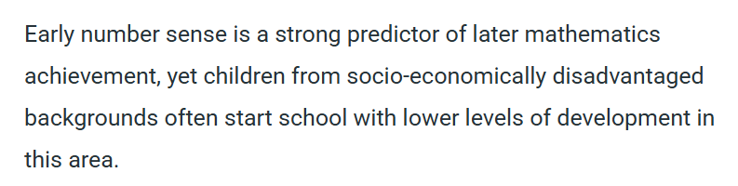

Slide 4
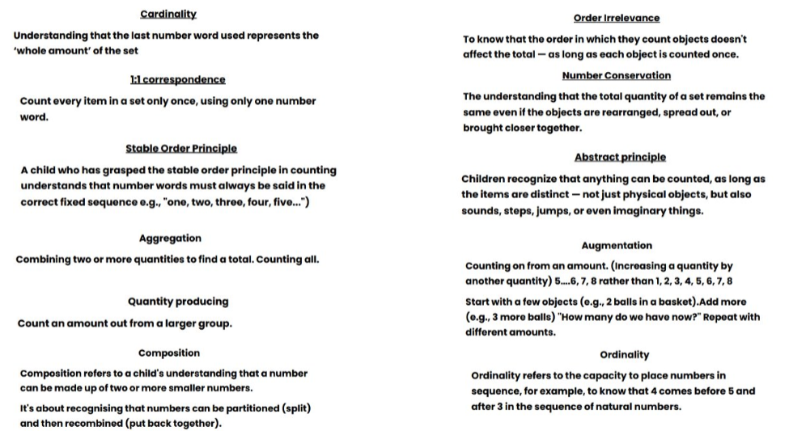
What is Number Sense?

Slide 5
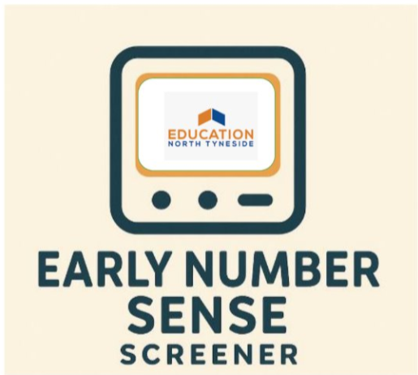
The Number Sense Screener

Slide 6
What Next?
Who?
Review of current provision
Small changes in EYFS
GLD Data
Parent Involvement

Slide 7
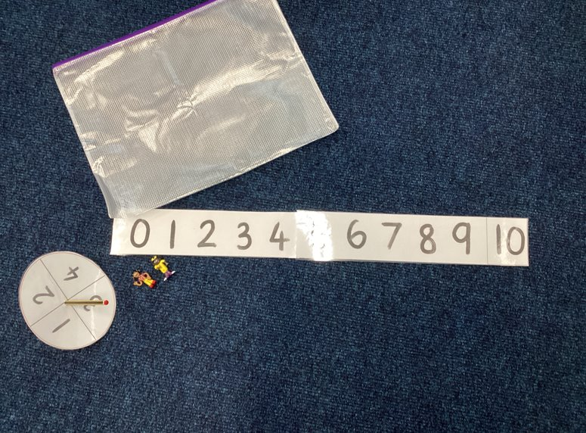
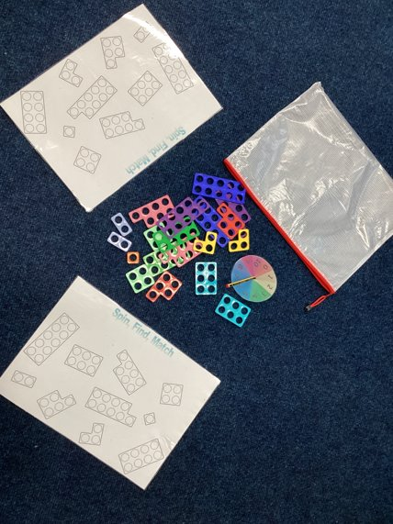
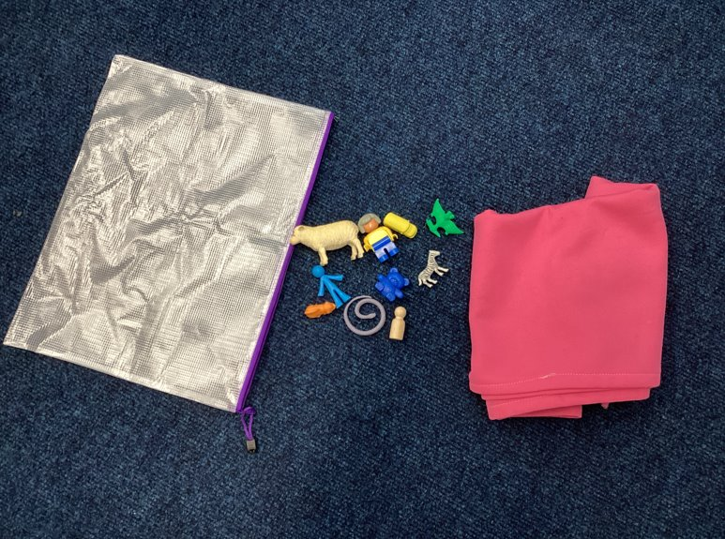
Number Sense Games

Slide 8
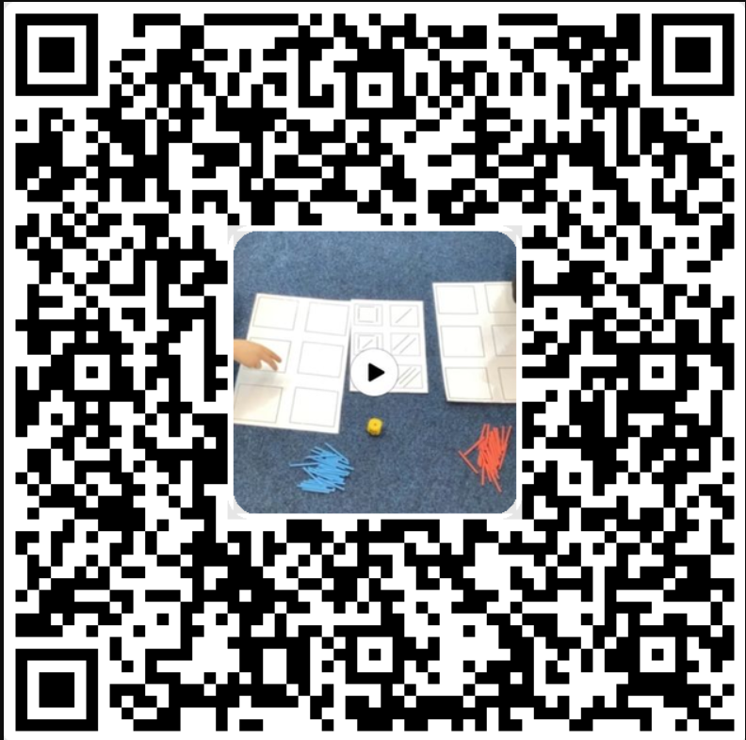

Slide 9
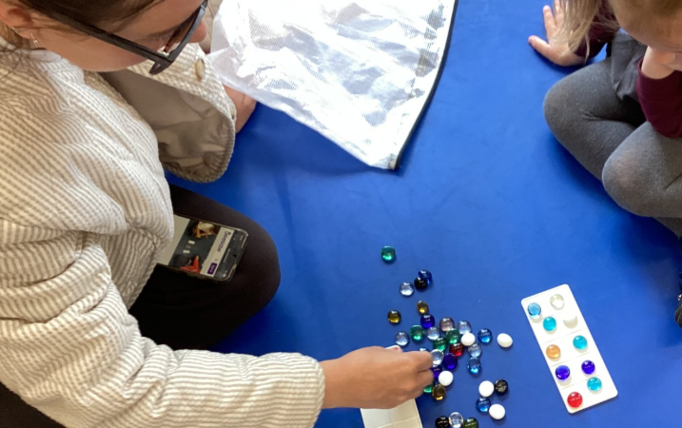
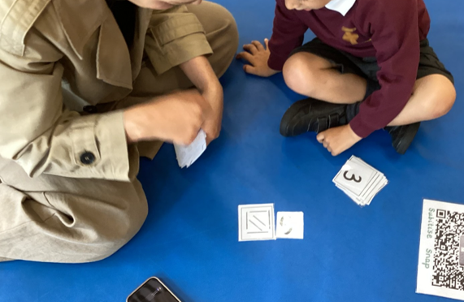
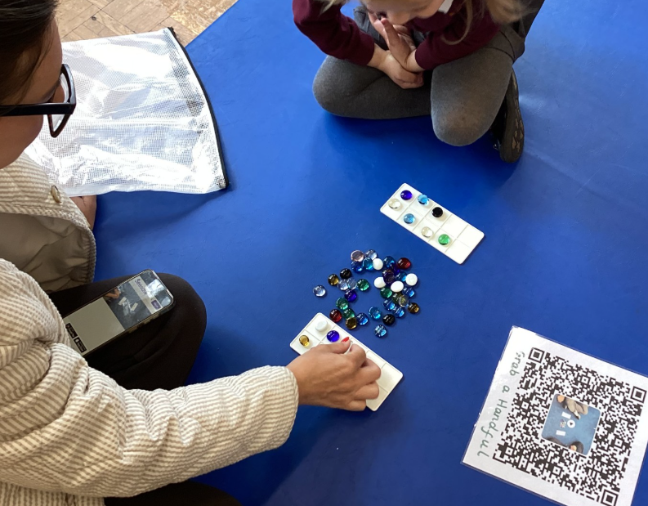

Slide 10
'He has really enjoyed the games, it's nice to have some Maths to do at home in such a fun way as he loves Maths! '
'He loves the games and really looks forward to playing them! His older sister is really enjoying playing them too and it is lovely to see them playing them together'
These are really helping her to develop mathematical thinking skills. I am so pleased that this is incorporated into the curriculum.'
'We have found the games simple to use but with really deep learning of the concepts. Repeating them throughout the week has hugely improved her confidence.'
'We’ve loved all the games, and we are in awe at how quickly he learns the Maths after a few plays.'

Slide 11


