Slide 2
Debate Project
Louisa Harris
St Benet Biscop Catholic Academy

Slide 3
Why Oracy? Why Debate?
ORACY
DEBATE
Physical
Linguistic
Cognitive
Social
Emotional
Content
Skills
Engagement
Interaction
Introducing new content
Revising previous topics

Slide 4
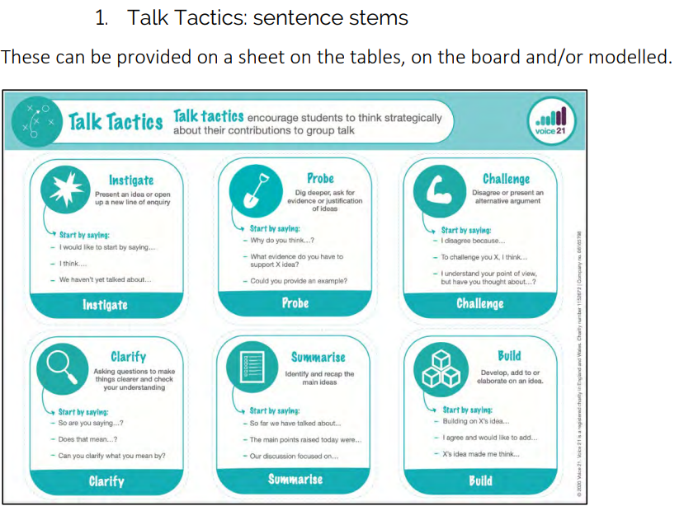
Voice 21 - Strategies

Slide 5
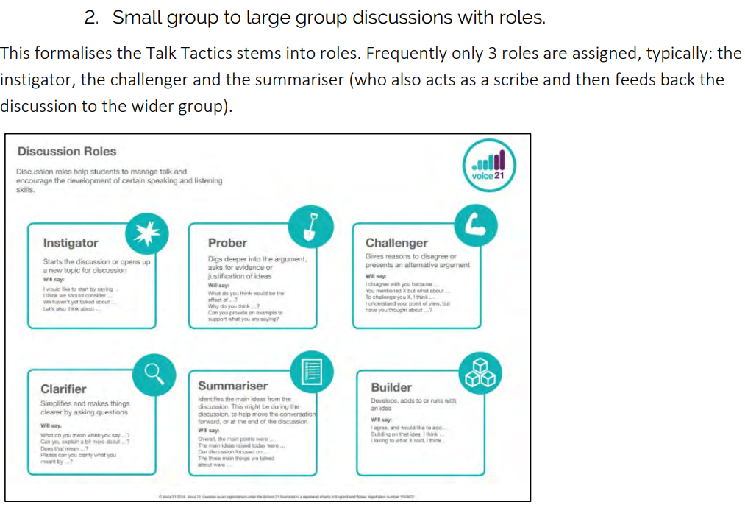
Voice 21 - Strategies

Slide 6
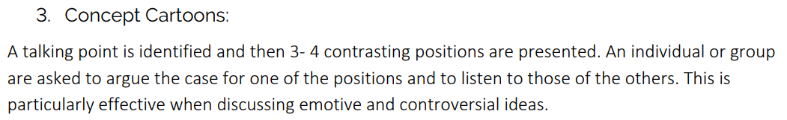
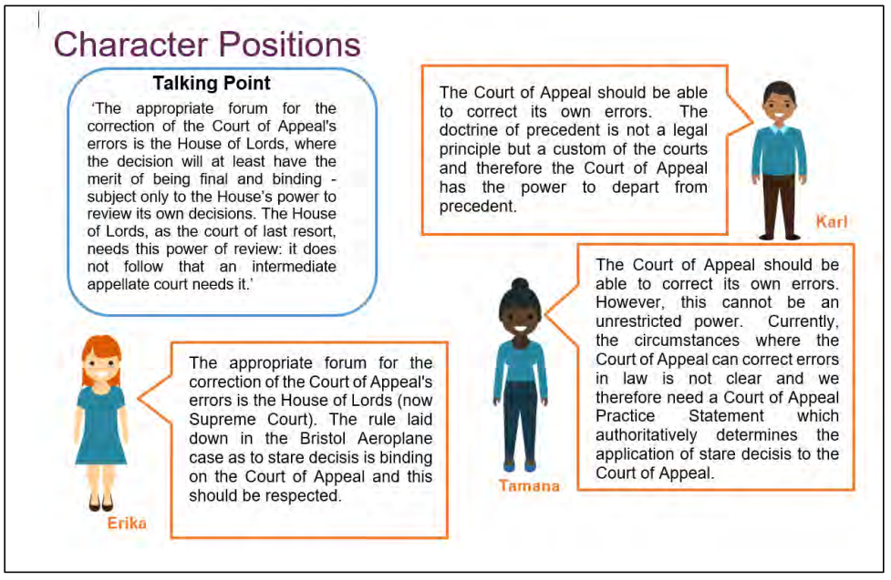
Voice 21 - Strategies

Slide 7
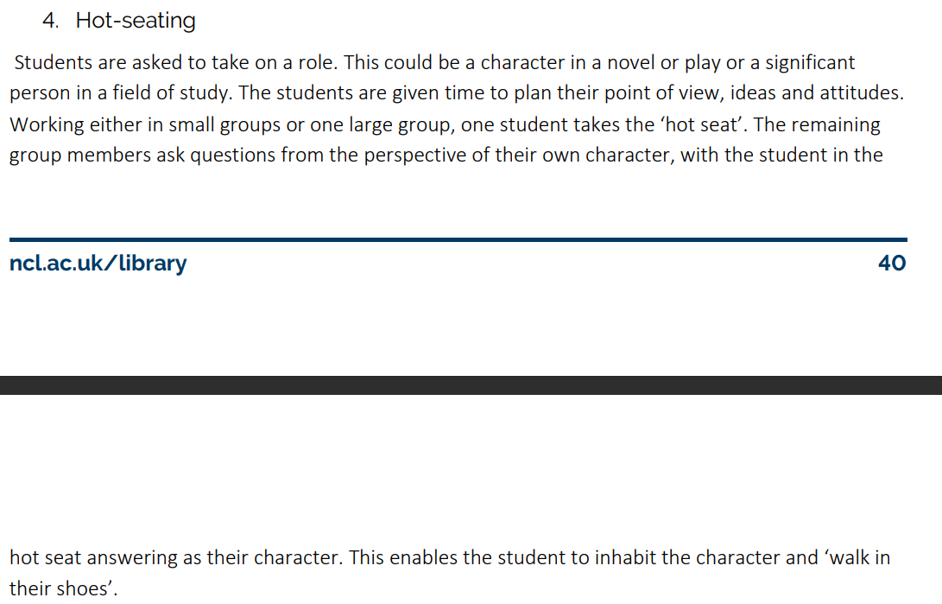
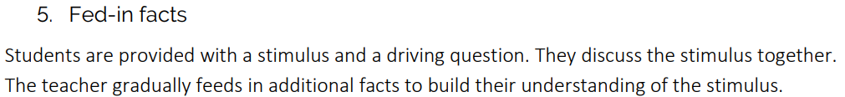
Voice 21 - Strategies

Slide 8
Debate – Build up skills
Difference between argument and debate.
Key Rules:
  Convince
  Listen
  Respond
Convince me continuum.
Countering.
Talking point.
Language – Bingo!

Slide 9
Debate
Given statement.
Form ideas – ideally write them down.
Arrange – divide into for / against.
Consensus – strongest points closest to the middle, similar points grouped together, to form 3 main point of argument. Decide on a ‘golden thread’.
Research – collect evidence to build on 3 main points.
Write – create speeches.
Rehearsal – time to practice and improve.
Deliver – Allocated roles:
  1st – introduce argument and speak on 1st point.
  2nd and 3rd – speak on 2nd and 3rd points.
  Summariser – Summarise key points and outline key argument again. Can also bring in rebuttals to opposing points.
Points of Interest – opportunity after each speech to counter / rebut. If there’s an audience then can open to them after 3rd speech.
Preparation is everything.
Best with secure knowledge.
Encourages deeper thought of content.
Encourages prioritising of information.
Encourages group work.
Opportunity for formal delivery.

