Slide 2
Policies, Regulations and AI
26th June 2026
Notes:
Welcome everyone and introduce the purpose of the session: to give staff a shared, practical understanding of how AI can be used safely in school.
Emphasise that this is not an anti-AI session. The aim is to support confident, careful and consistent use.
Explain that the session will connect classroom practice with policy expectations, particularly around safeguarding, data protection and assessment integrity.
If needed, add the date and name of the presenter before delivery.

Slide 3






Common AI Platforms
What are the main AI platforms that are used within schools?
Notes:
Use this as a quick starter. Ask staff to call out or discuss in pairs which AI platforms they recognise or have used.
Draw attention to the fact that AI is no longer limited to ChatGPT. It is built into tools students and staff already use, such as search engines, Office tools, Canva, revision apps, image generators and mobile apps.
Make the point that because AI is becoming embedded into everyday tools, staff need a shared language and shared expectations.

Slide 4
Aims of the CPD
Understand current use of AI by staff and Students
Explore policies that are affected and involved in AI
Provide staff guidance around using AI
Provide student guidance around using AI
Discuss example cases of using AI in the classroom
Notes:
Outline the aims of the CPD. By the end of the session, staff should understand how AI is currently being used, which policies are affected, and what guidance is available for both staff and students.
Stress that the session is designed to provide clarity rather than create extra workload.
Explain that the key question throughout is: how can we use AI helpfully while protecting students, staff and the integrity of learning?

Slide 5
AI Use by Staff & Students
Results of Staff Surveys on the use of AI within Education
  Average staff usage reported between occasionally and weekly.
  Average confidence around “some use but not confident to train others”.
Current Staff Use
  Updating outdated case studies and subject materials
  Creating worksheets and quizzes
  Generating revision materials
  Supporting marking and feedback processes
  Assisting with adapted teaching materials at KS5
  Reducing administrative workload
Notes:
Explain that staff surveys, at Sacred Heart, over the last two years show that AI is already being used across school, but confidence varies.
Highlight the main pattern: staff are using AI occasionally or weekly, mainly for workload reduction and resource creation.
Point out that many uses are sensible and helpful, such as creating quizzes, updating examples, generating revision material and supporting differentiation.
Transition by saying that useful use still needs clear boundaries, which is why the next slide focuses on staff concerns.

Slide 6
Staff Feedback
Accuracy and reliability
  AI can introduce mistakes, often ‘sounding confident’
  Requires quality assurance from teachers
Academic integrity
  Confidence in authenticity of homework responses
  Students utilising AI for coursework/NEA
  Some staff already limiting homework types
Access and limitations
  Limitations of free versions – prompting limits and use of input for training of models
  Some staff frustrated by additional time required to proof and amend output.
Confidence
  Some staff unsure on a practical level, but more over staff would like clarity on what they are allowed to do

Slide 7
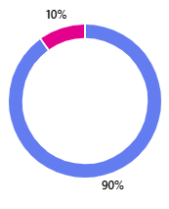
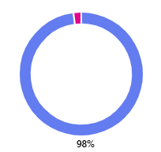
AI Use by Staff & Students
Results of recent student survey.
Original survey was conducted in January/February 2024.
New survey conducted in January 2026.
Same questions.
Key findings:
Do you know what AI means?
 | Yes
 | No
2024
2026
Notes:
Presenter notes:
Sacred Heart High School have also conducted school wide surveys of their students experience and understanding.
The following set of slides show these results.
Can be useful to set context for AI policy.

Slide 8
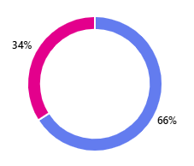

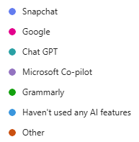
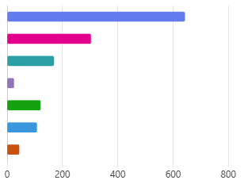
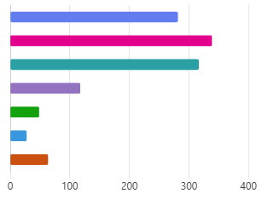
AI Use by Staff & Students
Have you heard of Chat GPT?
 | Yes
 | No
Have you used the AI features on any of the following apps:
Notes:
Presenter notes:
Sacred Heart High School have also conducted school wide surveys of their students experience and understanding.
The following set of slides show these results.
Can be useful to set context for AI policy.

Slide 9
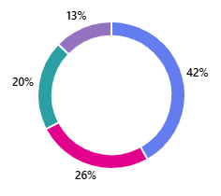
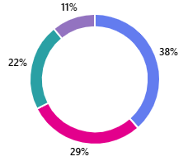
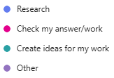
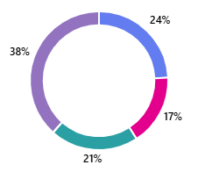
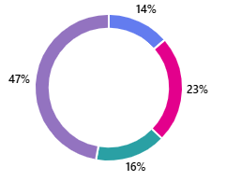
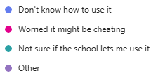
AI Use by Staff & Students
What did you use the AI feature for?
2024
2026
Don’t trust it
Don’t need it
2024
Scared it might hack me!
2026
Notes:
Presenter notes:
Sacred Heart High School have also conducted school wide surveys of their students experience and understanding.
The following set of slides show these results.
Can be useful to set context for AI policy.

Slide 10
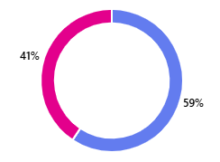
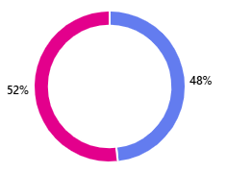
AI Use by Staff & Students
Would you want to know how to use AI in school?
 | Yes
 | No
2024
2026
Notes:
Presenter notes:
Sacred Heart High School have also conducted school wide surveys of their students experience and understanding.
The following set of slides show these results.
Can be useful to set context for AI policy.

Slide 11
AI Use by Staff & Students
Survey Findings:
  Awareness of AI tools has increased significantly
  Student use of AI has broadened
  Barriers to AI use have reduced, but misconceptions remain
  Strong need for guidance on using AI in school
  Students are already using external learning and revision apps
Suggested Actions:
  Rollout a clear, student-friendly AI use policy
  Support staff with students’ expectations on the use of AI
  Align recommended revision tools
  Position AI as a learning aid, not a shortcut
Notes:
Summarise the survey findings. Awareness has increased, use has broadened, and misconceptions still exist.
The important conclusion is that AI is already part of the learning landscape, so ignoring it is not realistic.
Explain the suggested actions: clear student guidance, clear staff expectations, consistency around revision tools, and positioning AI as a learning aid rather than a shortcut.
Use this slide as the bridge from survey evidence into policy and guidance.

Slide 12



Relevant Policies & Guidance
Aim of the Policy Training for the Trust
With the new AI policy, we identified a need for clarity and guidance against policies and regulations.
Following policies and regulations were identified:
  DfE AI Guidance
  JCQ AI Use in Assessments 2025
  BBCET Generative AI Policy
  Safeguarding Policy
  Online Safety Policy
  Acceptable Use Policy
  Data Protection Policy
  Behaviour Policy
Notes:
Introduce the policy section. Explain that AI is not a single-policy issue; it cuts across teaching and learning, safeguarding, online safety, data protection, assessment, behaviour and acceptable use.
Make clear that staff do not need to memorise every policy, but they do need to understand the key principles.
The rest of the session condenses these policies into practical 'can do' and 'cannot do' guidance.

Slide 13
What AI Can Do in Teaching (Allowed Uses)
Creating resources (worksheets, quizzes, images)
Adapting texts for reading ages
Generating exemplars / model answers (when not used for assessed work)
Improving admin efficiency (emails, scheduling)
Supporting differentiation
Analysing large bodies of curriculum content
DfE notes that AI can improve workload and support teachers, but teachers remain accountable for accuracy and appropriateness.
Notes:
Start with the positive message: AI can support teaching and reduce workload when used carefully.
Give practical examples: resource creation, simplifying text, generating quizzes, suggesting model answers for teaching, drafting emails, and adapting content for different learners.
Stress the important boundary: teachers remain accountable for what they use. AI output must be checked for accuracy, bias, appropriateness and relevance to the class.
A useful phrase is: AI can draft, but the professional decides.

Slide 14
What AI Cannot Do (Trust, DfE & JCQ Restrictions)
Internal School Policies (BBCET Acceptable Use & Data Protection)
Must not upload personal data, including:
  Names
  Contact details
  Assessment records
  Behavioural/safeguarding information
Must not use AI to generate or store sensitive information on external platforms (GDPR/data security requirement)
Must ensure any AI output is checked for accuracy, bias, or harmful content.
Notes:
Start with the positive message: AI can support teaching and reduce workload when used carefully.
Give practical examples: resource creation, simplifying text, generating quizzes, suggesting model answers for teaching, drafting emails, and adapting content for different learners.
Stress the important boundary: teachers remain accountable for what they use. AI output must be checked for accuracy, bias, appropriateness and relevance to the class.
A useful phrase is: AI can draft, but the professional decides.

Slide 15
What AI Cannot Do (Trust, DfE & JCQ Restrictions)
Safeguarding Requirements
Staff must not create or share AI content that could expose pupils to harmful content, contact, or conduct (Online Safety Policy categories).
  e.g., inappropriate images, harmful stereotypes, deepfakes, unsafe scenarios
Staff must supervise any AI use by pupils to prevent exposure to harmful material.
Staff must ensure AI outputs do not reveal sensitive pupil characteristics (SEND, health, safeguarding info).
Notes:
Connect AI use to safeguarding and online safety. Explain that AI can generate content quickly, but that content may be inappropriate, biased, unsafe or misleading.
Staff should not create or share content that could expose pupils to harmful content, contact or conduct.
If pupils are using AI in lessons, staff must structure and supervise the activity carefully.
Also remind staff not to enter sensitive pupil characteristics or safeguarding information into AI tools.

Slide 16
What AI Cannot Do (Trust, DfE & JCQ Restrictions)
JCQ Assessment Rules
Students may not use AI to generate work for non-examined assessments, coursework or any marked component unless explicitly permitted.
Students must acknowledge any AI support used in allowed contexts.
Teachers must:
  Teach students how to use AI ethically
  Identify AI misuse
  Ensure submitted work is the student’s own
Notes:
Introduce the JCQ assessment rules. This is especially relevant for coursework, NEA and any marked component submitted for qualification assessment.
The core message is simple: students must not submit AI-generated work as their own.
If AI is allowed in a particular context, it must be acknowledged properly, and staff must follow the qualification rules.
Teachers have a role in teaching ethical use, spotting possible misuse, and checking that submitted work is authentically the student's own.

Slide 17
What AI Cannot Do (Trust, DfE & JCQ Restrictions)
JCQ Assessment Rules
AI may not be used to:
  Paraphrase or rewrite assessed work
  Generate ideas for assessed work
  Analyse data on behalf of a student
  Produce images or artefacts used directly in assessment
  Correct grammar or restructure text (counted as an unfair advantage)
Notes:
Make this slide very clear and direct. For assessed work, AI must not be used to do the intellectual work for the student.
Highlight the examples: paraphrasing, rewriting, generating ideas, analysing data, producing images or artefacts, correcting grammar or restructuring text where this gives an unfair advantage.
Explain that some of these examples may seem minor, but in assessment contexts they can affect authenticity.
The safest message for students is: do not use AI for coursework or assessed submissions unless your teacher has explicitly said it is allowed under the rules.

Slide 18

Know your school or college’s approach to managing AI in assessments
1
Know what AI is and how it can be used
Familiarise yourself with the JCQ AI Use in Assessments guidance
Know what the risks are and how your school or college is managing them
Understand how the approach applies to your subject
REMEMBER
Your malpractice policy
MUST include the use of AI
What AI is
The risks of
using AI
What AI
misuse is
How AI misuse will be treated
as malpractice
When AI may
be used
How AI should be acknowledged
Notes:
Presenter notes:
The following slides are more specific guidance from JCQ for teachers.
They can be hidden or shown, depending on the needs of the school and/or time.

Slide 19


Plan how to prevent AI misuse in assessments
2
If possible, find time for students to complete work under exam-like conditions/in class to help you understand the standard they are currently working at
Talk to students about their work to check their understanding on an ongoing basis – before you start marking
You’re
responsible for confirming the authenticity of students’
work!
Notes:
Presenter notes:
The following slides are more specific guidance from JCQ for teachers.
They can be hidden or shown, depending on the needs of the school and/or time.

Slide 20

Communicate the approach to students and parents/carers
3
Be clear about when and if students can use AI tools
If the qualification rules allow the use of AI tools, make sure students know how to reference clearly
Remind students that any content produced using AI must be referenced and cannot be given marks – and a failure to reference use of AI is malpractice
Make sure students and parents know that misusing AI is cheating and a form of malpractice. The consequences are severe – they could lose the marks for the assessment or even be disqualified from the subject
Stress the importance of the candidate declaration (which references AI use) when they submit their work for assessment
Notes:
Presenter notes:
The following slides are more specific guidance from JCQ for teachers.
They can be hidden or shown, depending on the needs of the school and/or time.

Slide 21

If you suspect AI misuse…
4
Only accept work for assessment you consider to be the student’s own:
Compare with previous work for differences in quality, formatting, spelling, punctuation, grammar, vocabulary and tone
Look out for AI indicators, for example, language style, lack of local knowledge, confidently wrong statements
Consider the use of AI detection tools and discussing the work with the student as part of a holistic approach
IF YOU
FIND AI MISUSE
If the student hasn’t signed the
declaration form, follow your school
or college’s malpractice policy
If the declaration form has
already been signed, report
to the awarding body
Notes:
Presenter notes:
The following slides are more specific guidance from JCQ for teachers.
They can be hidden or shown, depending on the needs of the school and/or time.

Slide 22
Data Protection & Privacy: What Staff Must Do
Based on the Data Protection & Acceptable Use policies:
Allowed
Use AI tools without uploading personal data
Use school-approved platforms that meet GDPR requirements
Store AI-generated teaching materials on school systems (Office 365)
Not Allowed
Uploading:
  Pupil names
  Grades and comments
  Behavioural logs
  Safeguarding notes (Safeguarding Policy p.24 requires secure storage and limited access)
Uploading staff information
Using AI on personal devices containing unprotected school data (Acceptable Use Policy)
Notes:
Move into data protection and privacy. Explain that the allowed examples all avoid personal data and use approved systems.
The not allowed examples are the red lines: pupil names, grades, comments, behaviour logs, safeguarding notes, staff information or unprotected school data.
Make this practical: if you would not put the information into a public website, do not put it into an external AI tool.
Staff should store AI-generated teaching materials on approved school systems such as Office 365.

Slide 23
Data Protection & Privacy: What Staff Must Do
Key Principles (from BBCET Data Protection Policy)
Minimise data
Protect confidentiality
Ensure accuracy
Use secure systems only
Do not transfer data outside approved locations
Notes:
Summarise the data protection principles. Minimise data means only use the information that is genuinely needed.
Protect confidentiality means keeping pupil and staff information secure.
Ensure accuracy means checking AI outputs before they are used.
Use secure systems only and do not transfer data outside approved locations.
A simple rule for staff: anonymise where possible, avoid personal data, and ask before using anything sensitive.

Slide 24
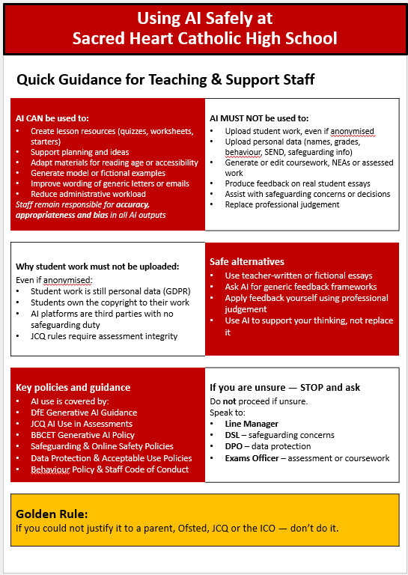
Staff Guidance
Aim of the Policy Training for the Trust
To help guide your daily use and condense all the information out there, the Trust has created a guidance sheet.
Notes:
Introduce the staff guidance sheet. Explain that the purpose of the sheet is to reduce the amount of policy staff need to hold in their heads during day-to-day work.
It should be used as a quick reference when planning lessons, creating resources, communicating with parents, or considering student use of AI.
Encourage staff to keep it accessible and to use it with colleagues when discussing grey areas.
Transition to the need for equivalent student guidance.

Slide 25
Student Guidance
Staff clearly need guidance on how AI should be used safely and appropriately.
However, our surveys show that students are also becoming increasingly confident and familiar with AI tools. Many are already using AI in their everyday lives, learning apps and revision platforms.
This means teachers need to have open conversations with students about AI use:
  What is helpful,
  What is risky
  Where the line is between support and academic dishonesty
Notes:
Explain why student guidance is needed. Staff need clarity, but students are also becoming confident and increasingly natural users of AI tools.
Many students already encounter AI through learning apps, revision platforms, mobile apps and search tools.
This means teachers should be having open conversations with students rather than only reacting when misuse occurs.
Frame the conversation around three questions: What is helpful? What is risky? Where is the line between support and academic dishonesty?

Slide 26
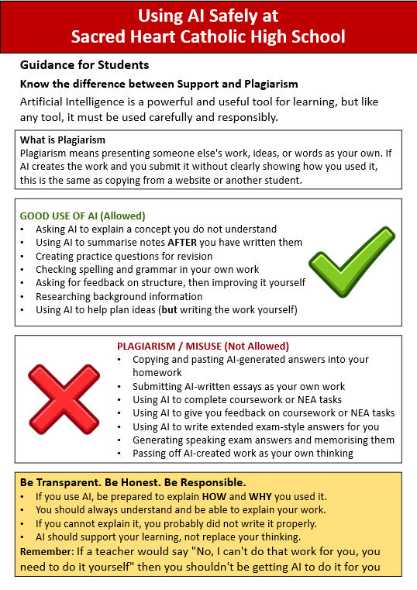
Student Guidance
To help with this conversation, a Student Guidance sheet has been created to how the correct ways to use AI, and what may constitute plagiarism.
Key message:
AI is a tool, not a replacement
AI use must be cited in work
AI cannot be used for coursework
AI outputs must be checked, never trusted blindly
Misuse falls under behaviour, online safety & academic honesty sanctions
Notes:
Introduce the student guidance sheet as a tool to support those classroom conversations.
Clarify the key message: AI can support learning, but it must not replace the student's own thinking.
Talk through the student-facing rules: AI is a tool, AI use must be acknowledged where required, AI cannot be used for coursework, outputs must be checked, and misuse may lead to behaviour, online safety or academic honesty sanctions.
Suggested wording for students: use AI to help you learn, not to produce work you hand in as your own.

Slide 27
Practical Examples of Safe Use
Acceptable Use Examples:
“Create 10 retrieval questions on photosynthesis.”
“Rewrite this text for a reading age of 12.”
“Generate ideas for a starter activity for Year 9 on Data Types.”
Notes:
Use these as examples of safe and useful staff prompts. They show AI being used to support planning, differentiation and resource creation rather than to replace professional judgement.
Point out that none of these examples require personal pupil data.
For the reading age example, remind staff not to paste in identifiable pupil work or sensitive details.
You can ask staff to adapt one of these examples to their own subject.

Slide 28
Practical Examples of Safe Use
Unacceptable Use Examples:
“Write a NEA paragraph for my student.” (JCQ breach)
“Generate a safeguarding report.” (confidentiality breach)
Uploading a student’s coursework draft (privacy + JCQ breach)

Slide 29


Scenario Training (5 mins)
A Teaching Assistant uses AI to rewrite a worksheet at a lower reading age.
Why
Supports accessibility
No pupil data uploaded
Policies involved
SEND support
Data minimisation (GDPR)
Notes:
Run this as a short discussion. Ask staff first: allowed, not allowed or depends?
Then reveal the reasoning: this is acceptable if the worksheet is generic, no pupil data is uploaded, and the final version is checked by staff.
Link it to accessibility and SEND support, while keeping data minimisation in mind.
Emphasise that the TA is using AI to adapt a resource, not to make a decision about a named pupil.

Slide 30

Scenario Training (5 mins)
A student submits coursework that includes AI-generated paragraphs.
Why
AI-generated content in assessed work
Malpractice under JCQ rules
Correct action
Investigate as potential malpractice
Follow exams officer guidance
Policies involved
JCQ AI Use in Assessments
Behaviour Policy

Slide 31
Scenario Training (5 mins)
A teacher allows students to use AI to generate ideas during a lesson.
Allowed if
Task is not assessed
Clear guidance is given
AI output is critiqued, not copied
Not allowed if
Used for homework or coursework
Used without supervision
Policies involved
JCQ rules
Behaviour Policy
Online Safety Policy
DEPENDS

Slide 32
Scenario Training (5 mins)
A member of support staff uses AI to improve the wording of a generic letter to parents.
Why
No pupil names or details included
Final version checked by staff
Policies involved
Acceptable Use Policy
Data Protection Policy

Slide 33
Key Messages
AI is powerful and useful
Staff can use AI for workload reduction
Safeguarding, data protection and JCQ integrity rules are non-negotiable
Only use paid accounts for uploading work
If unsure ask Line Manager, DSL or SLT
Golden Rule:
If you could not justify it to a parent, Ofsted, JCQ or the ICO — don’t do it.
Notes:
Close by returning to the balanced message: AI is powerful and useful, but safeguarding, data protection and assessment integrity are non-negotiable.
Emphasise that staff are encouraged to use AI where it supports workload and learning safely.
Be careful with the line about paid accounts: the safest wording when presenting is 'use Trust-approved tools/accounts and do not upload personal data unless the tool has been approved for that purpose'.
Finish with the golden rule. If you could not justify the use to a parent, Ofsted, JCQ or the ICO, stop and ask for advice.

