Slide 2
AI Implementation
Jonathan Powell (St Thomas More High School)
Amy Charlton (St Cuthberts)

Slide 3
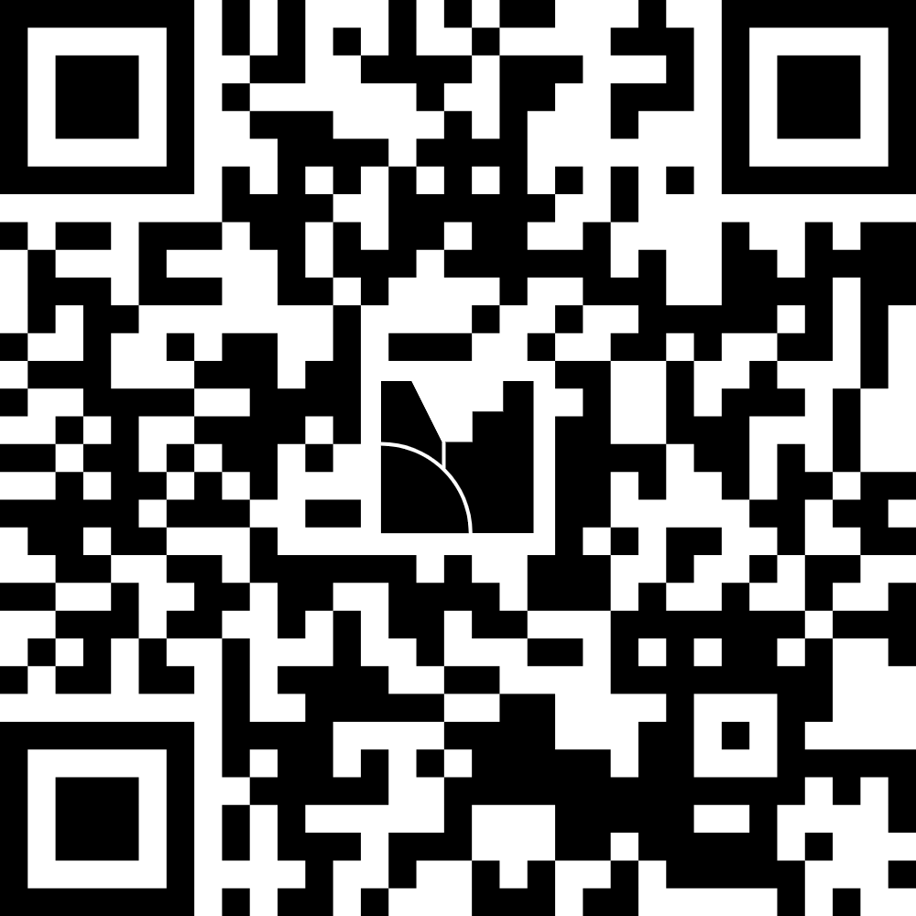
What tasks take time?
Gather ideas with Mentimeter

Slide 4
What have you used AI for?
Gather ideas with Mentimeter

Slide 5
BBCET AI Research Group
Adapting reading ages for worksheets and homework.
Creating worksheets.
Assessing critically the output of ChatGPT as a approach to learning about a topic.
Producing revision notes and knowledge organisers.
Assessing NEA coursework.
Creating homework booklets from YouTube transcripts.
Creating sentence starters for exam questions.
Providing students with feedback on written work.
Converting resources from one form to another.

Slide 6
Available Tools
NotebookLM
Teachmate AI
MathGPT
Eduaide
Chalkie
Khanmigo
Briskteaching
Magic school

Slide 7

I have been using TeachMate for the past two years with a specific focus on SEND provision.
It offers a user-friendly AI interface with structured prompts, making it particularly accessible for those new to AI.

Slide 8
Adaptive Teaching
Adjust reading ages
Vocabulary
Checklists

Slide 9
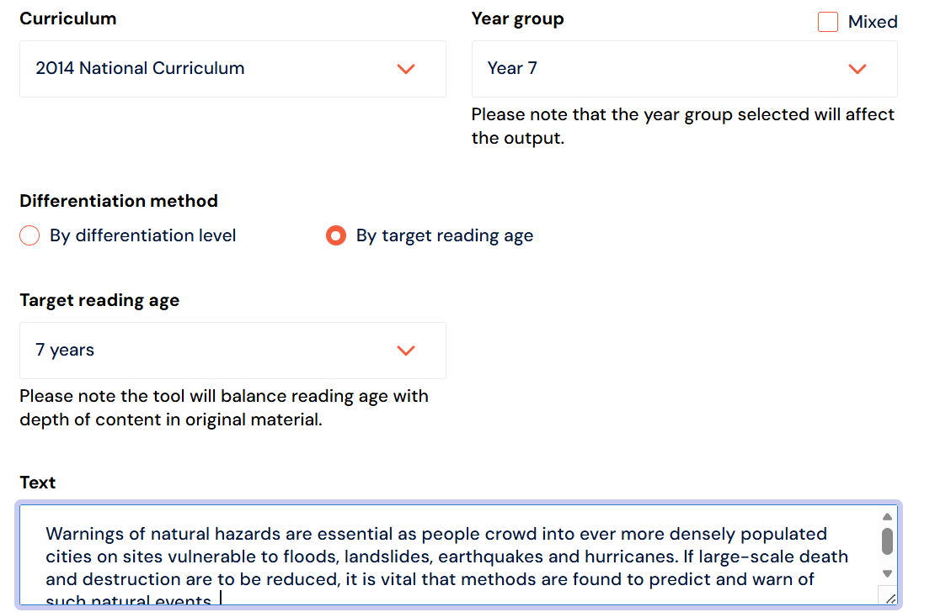
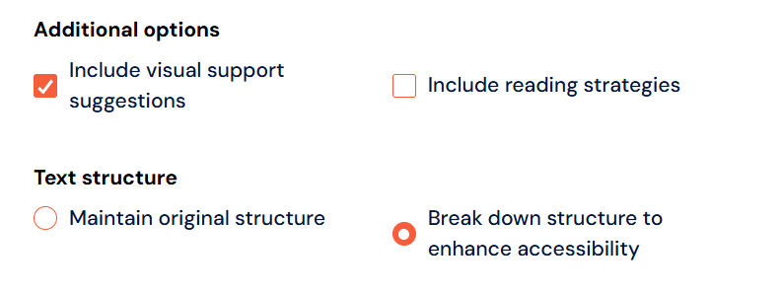
Reading Ages - TeachMate

Slide 10
Reading Ages - TeachMate
Warnings of natural hazards are essential as people crowd into ever more densely populated cities on sites vulnerable to floods, landslides, earthquakes and hurricanes. If large-scale death and destruction are to be reduced, it is vital that methods are found to predict and warn of such natural events.
Warnings of natural hazards are very important. Many people live in big cities. These cities are more crowded now. Some cities are on unsafe land. This land can flood. This land can slide.
This land can shake. This land can face hurricanes. If we want fewer deaths, we need warnings. If we want less damage, we need warnings. We must find ways to predict these events. We must also warn people early.

Slide 11
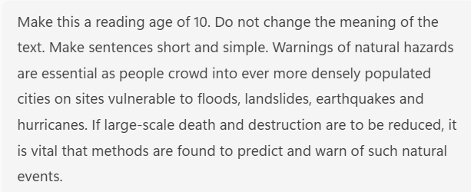
Reading Ages - ChatGPT
Warnings of natural hazards are essential as people crowd into ever more densely populated cities on sites vulnerable to floods, landslides, earthquakes and hurricanes. If large-scale death and destruction are to be reduced, it is vital that methods are found to predict and warn of such natural events.
Warnings about natural hazards are very important. More people now live in big, crowded cities. Some of these places can flood or have landslides, earthquakes, or hurricanes. To stop many deaths and lots of damage, we must find ways to predict these events. We also need to warn people before they happen.

Slide 12
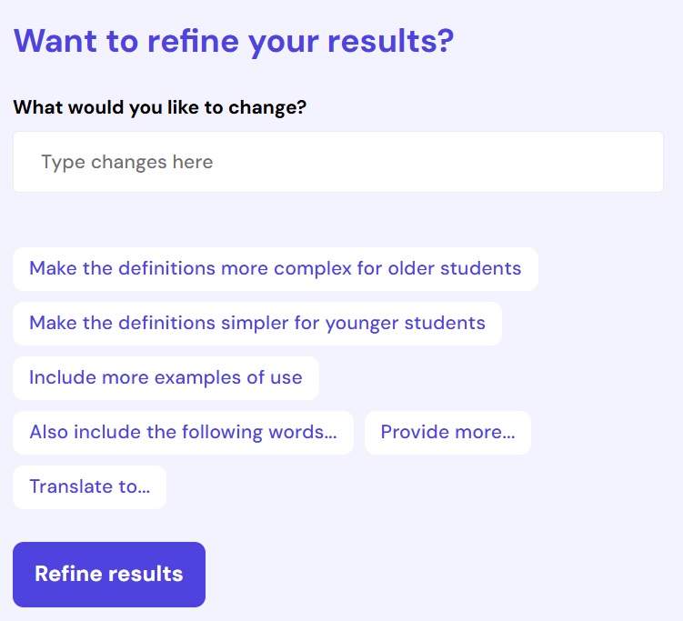
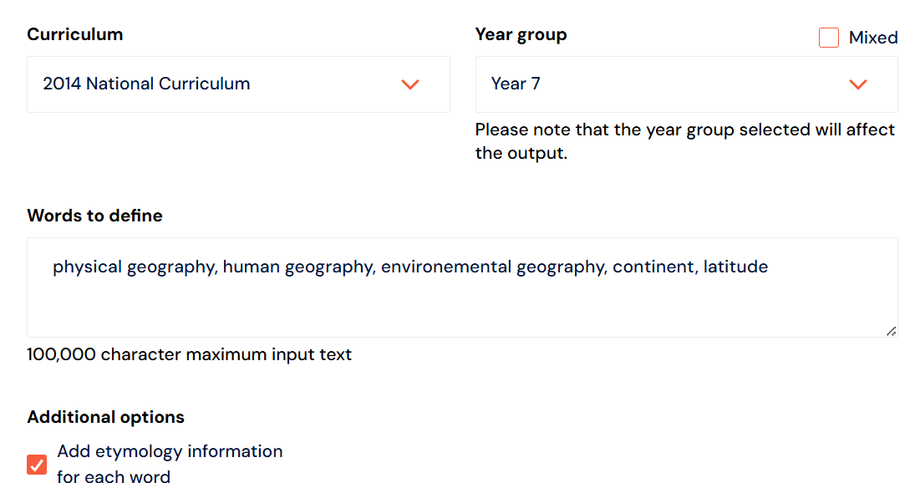
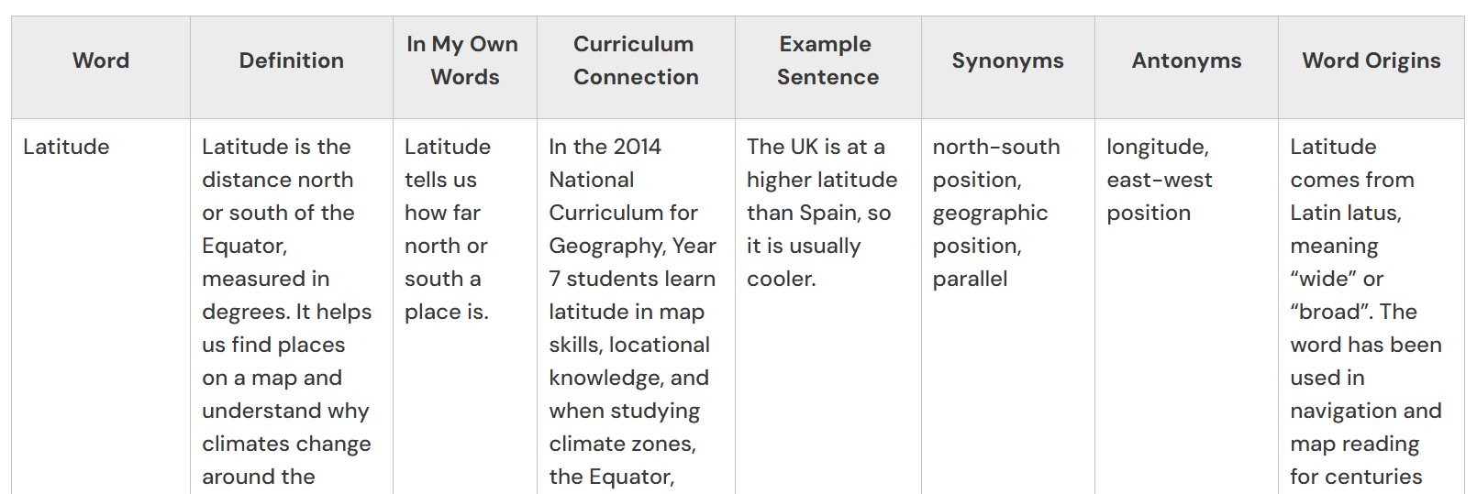
Vocabulary – Teach Mate

Slide 13
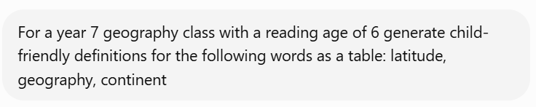
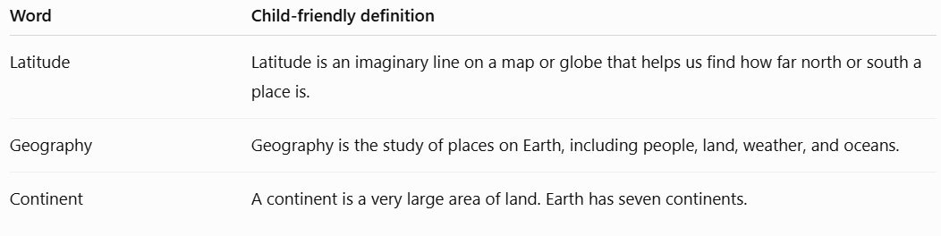
Vocabulary – ChatGPT

Slide 14
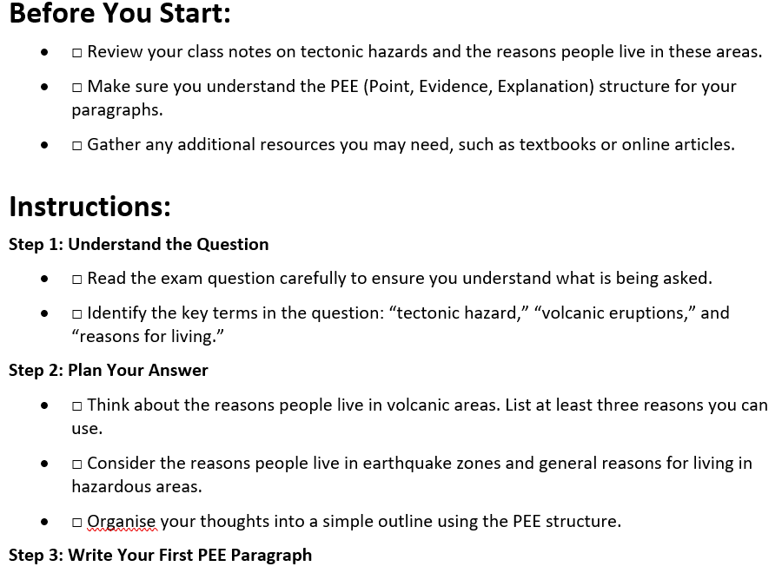
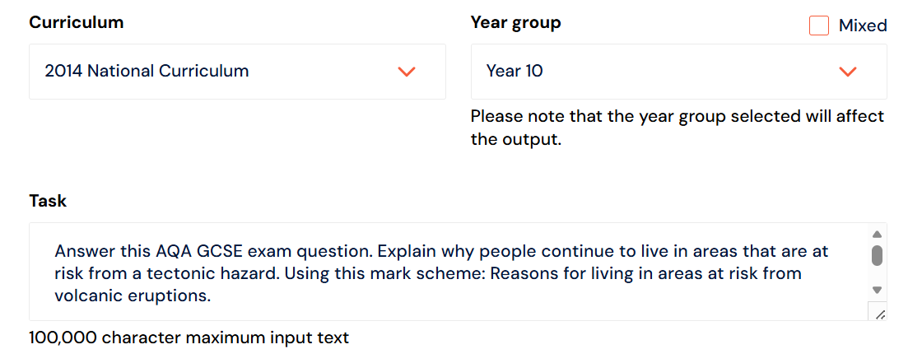

Checklists - TeachMate

Slide 15
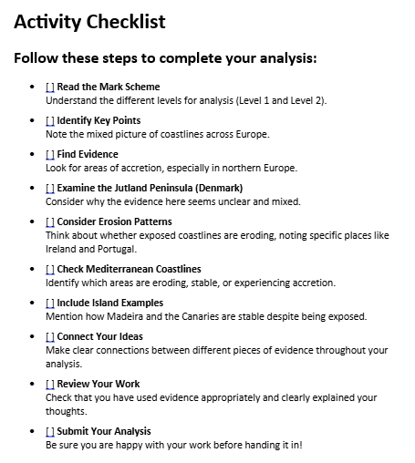
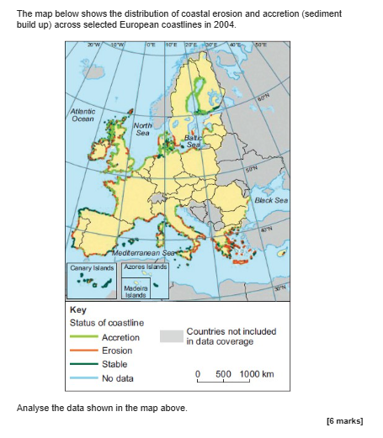
Checklists - ChatGPT
Input: Using this AQA A-Level Geography question and MS, create a checklist (success criteria) for students to assist them with answering the question.

Slide 16
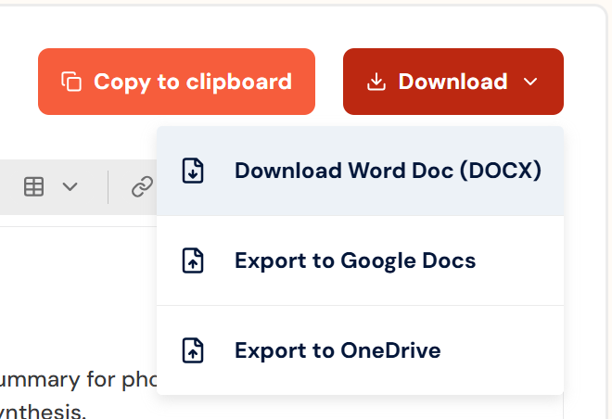
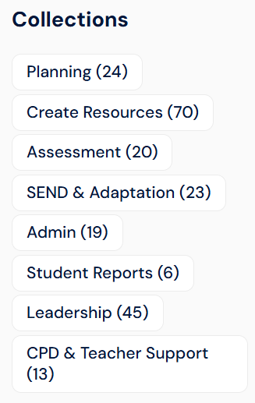
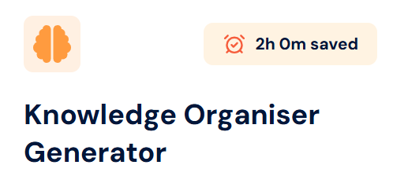
TeachMate – Key Features

Slide 17
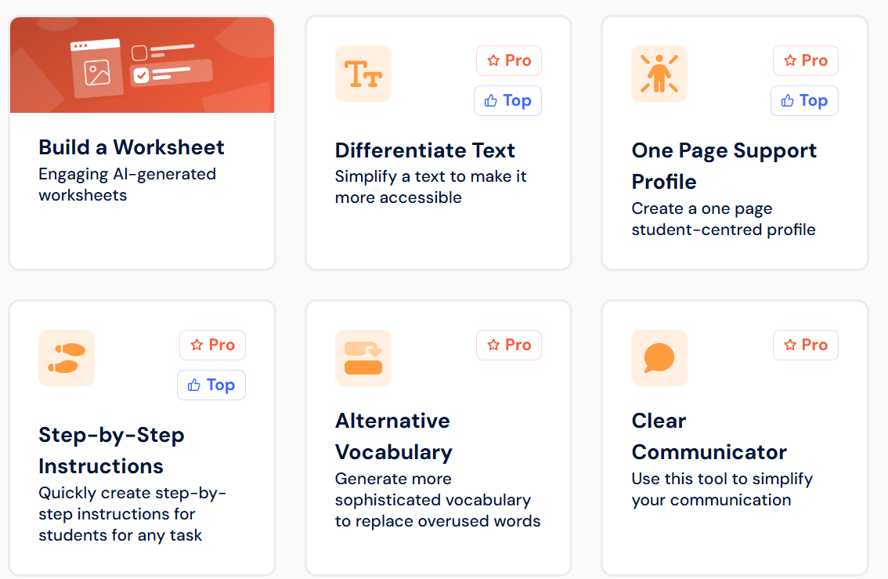
TeachMate – SEND

Slide 18
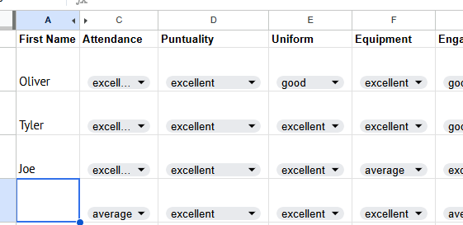
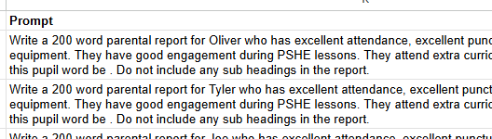
Writing Reports
Combining Excel with AI to build your own custom tools
Making it easier to generate prompts
Keeping control

Slide 19
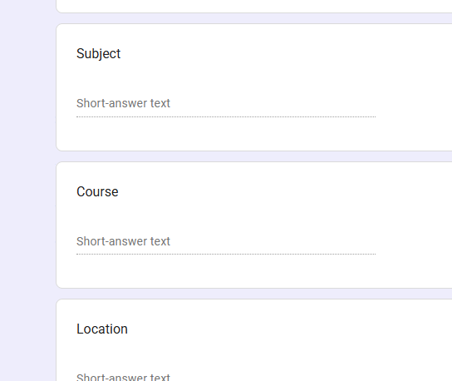
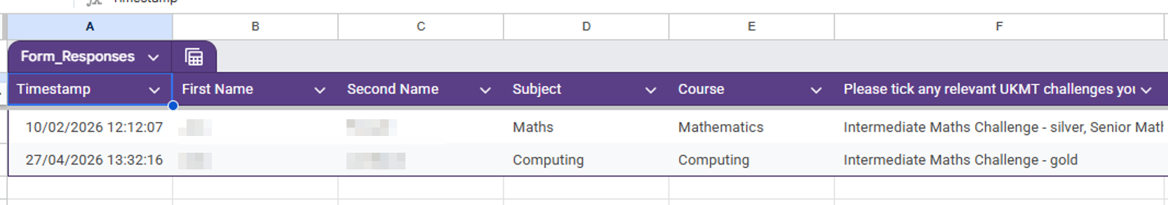
Writing References
Including a form to gather results
Creating the prompt by combining information from
pupils and teacher inputs.

Slide 20
The Ethics of AI
Unidentifiable data
Protecting intellectual property
Using subscription AI tools

