Slide 2
Maximising Participation
By Owen Miles and Caroline Kelly

Slide 3
Why is maximising participation important?
Notes:
The question seems obvious – we want ALL students to learn at ALL times as best as possible
Not only does it encourage a positive environment in the classroom but it also promotes better learning
So that the goal of making learning visible could be achieved and that you can see the way students process information

Slide 4
Why is maximising participation important?
Closest indicator we have for measuring thinking.
Improves the quality of formative assessment.
Prevents lessons being driven by the confident few.
More participation → more visible thinking → more responsive teaching → better learning
Notes:
Participation is the closest indicator we have for measuring thinking.
Max Part. Makes learning of all students visible
It improves the quality of formative assessment –
The more students participate / the more accurately we can identify understanding/misconceptions/next steps
Prevents lessons being driven by the confident few
We want to move away from this as it is not fair on all students to have those confident answer
By relying on this it alienates the quieter students/ gives the teacher a misconception of where the whole class is at
We want all students to feel like their answers are valuable - removes this ‘confidence gap’
More participation → more visible thinking → more responsive teaching → better learning

Slide 5



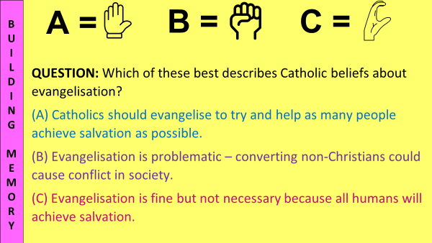
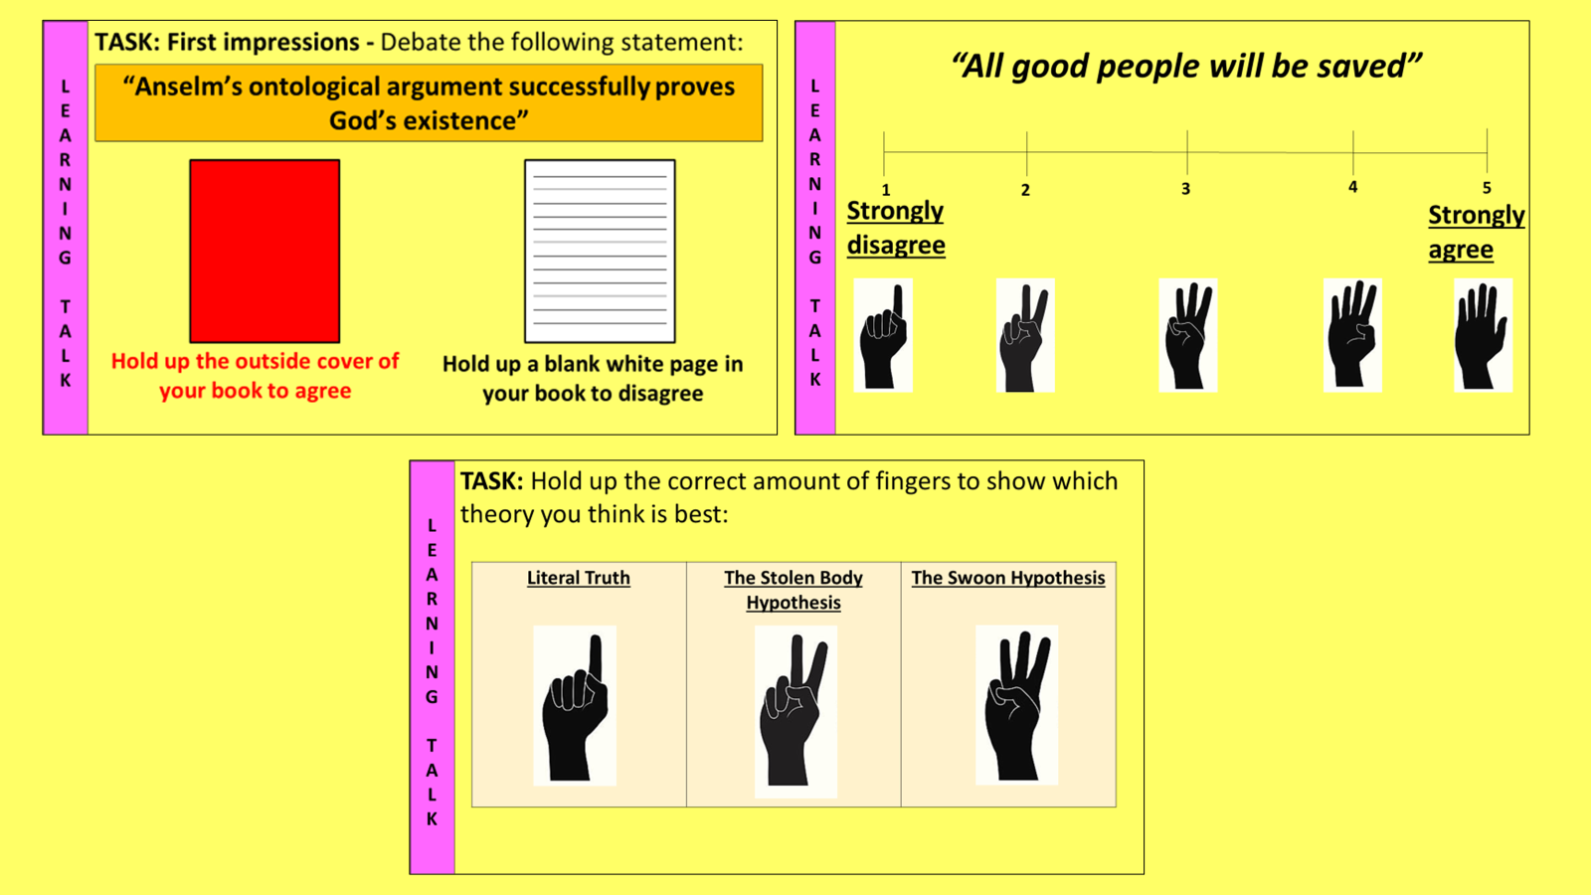
Accountability mechanisms
MWBs
Turn and talk + cold-calling
Voting signals for MCQs
Voting signals for discussion
Notes:
Getting the culture right – we would all love a class of self-motivated learners – accountability mechanisms help us get there. All are good for a varied diet, but particular methods have strengths in particular circumstances
MWBs – best weapon in the arsenal, whole-class CfU, ask yourself/staff “would this question be better asked using MWBs?”
Turn and talk – extended reasoning, exploratory dialogue
Voting signals for MCQs – checking for predicted misconceptions
Voting signals for discussion – accountability during debates

Slide 6




Which strategy would be most appropriate to maximise participation in this scenario?
Mr Miles is teaching Year 11 about religious attitudes to euthanasia. He wants to complete a pre-requisite knowledge check to see if students can remember what is meant by the term “sanctity of life”, as this will be key to accessing today’s learning. What should he do?
Turn and talk + cold-calling =
Voting signals + MCQ =
Voting signals for discussion =
MWBs =
Notes:
I would use MWBs – answer is short enough to work, voting signals would probably over-scaffold this, turn and talk could work but the accountability mechanism of cold-call only checks one. Here I’d want to check whole-class, so I’d use MWB

Slide 7
Which strategy would be most appropriate to maximise participation in this scenario?
Mrs Kelly is teaching Year 8 about the concept of salvation. She is reading a challenging text with the class and has planned to pause at numerous points to check comprehension. What should she do?
Turn and talk + cold-calling =
Voting signals + MCQ =
Voting signals for discussion =
MWBs =
Notes:
I’d probably use TnT w CC – helps flow, means student attention doesn’t shift too far away from the text, can keep the ruler on the line they were up to without having to change the screen from the visualiser

Slide 8
Sharing good practice

Slide 9
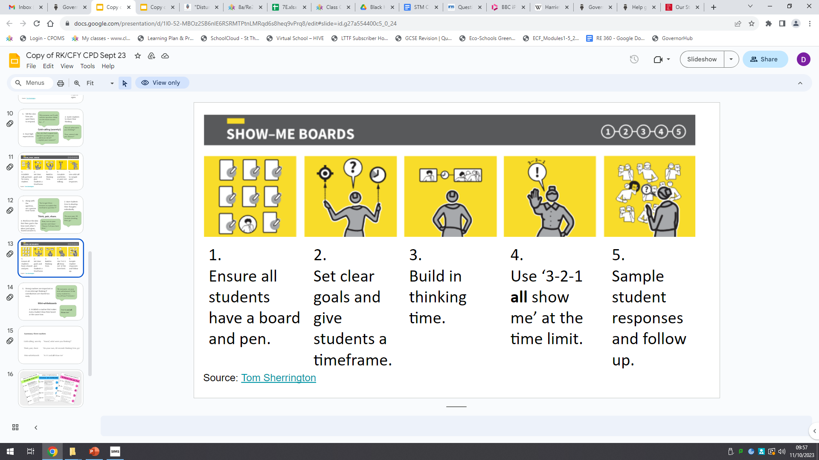
Mini Whiteboards
Notes:
A whole school policy we have implemented at St Thomas More are the use of mini whiteboards
They are in my opinion the best way to not only maximise participation, but to also allow the teacher to feedback in real time
Teachers are able to directly see all student learning/answers whereas with cold calling you may know that everyone is participating, but only receive a few answers
It allows you to find out about the thinking of all your students, as opposed to the only a few when you cold-call.

Slide 10

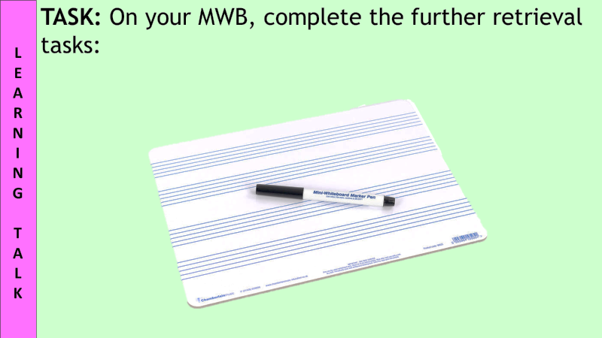
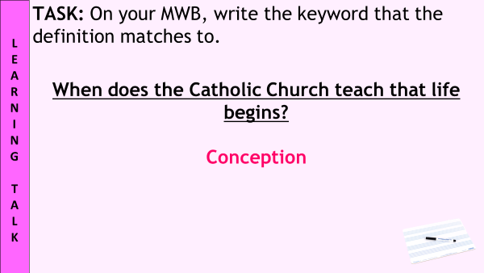
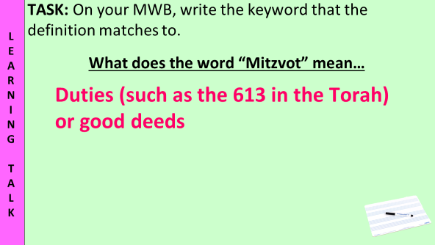
Mini Whiteboards
Build routines
Pose a question/independently write/ monitor and judge/“3…2…1… show”/ simultaneously show/ praise/ identify misconceptions/ model
Keeps pace fast / able to see ALL answers/ checks understanding + misconceptions/ lets you choose who to cold call next
Give specific feedback to students in real time, for example to get them to rethink a specific point they got wrong.
Notes:
It is really important to build whiteboards into the classroom routines from the start – students with practice will get used to them – this helps with the flow of the class/pace
So how would it work?
Teacher will pose a question like – what does the word mitzvot mean? Board/Verbally
Students will then independently write down their answer
Teacher monitors/judges the timing and when to decide when most students are ready
Teacher counts down 3,2,1 … show – students will then hold up answers when I say show
It is an expectation that students keep the MWB up the in air so that I can call upon multiple students to voice their answers
It is important that all whiteboards are simultaneous – avoid copying
From then can quickly circulate/scan answers – praise – identify misconceptions/model – LESS IS MORE – keeps pace/not as difficult to scan for answers/ quicker
I would also use a bit of cold calling after this – get students to read out their answer – ask students to build on previous answers – address a mistake someone has put on the MWB

Slide 11
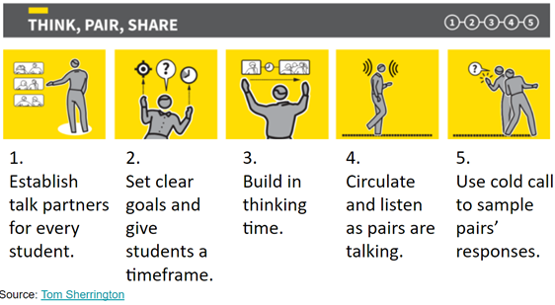
Turn and Talk/ Think Pair Share
Notes:
Boosts participation ratio - Everyone expected to participate at once, not just one at a time
Opportunity for exploratory dialogue - So long as oracy is scaffolded well enough and exploratory dialogue is built on a foundation of secure substantive knowledge, peer-to-peer talk can develop reasoning and explanation.
Rehearsal of answers - Reduction in anxiety, increase in confidence, the anonymity of the buzz facilitates this
Pace and energy - Interrupts the loss of attention, can employ TnT usefully in circumstances where some are getting it, and some aren’t

Slide 12
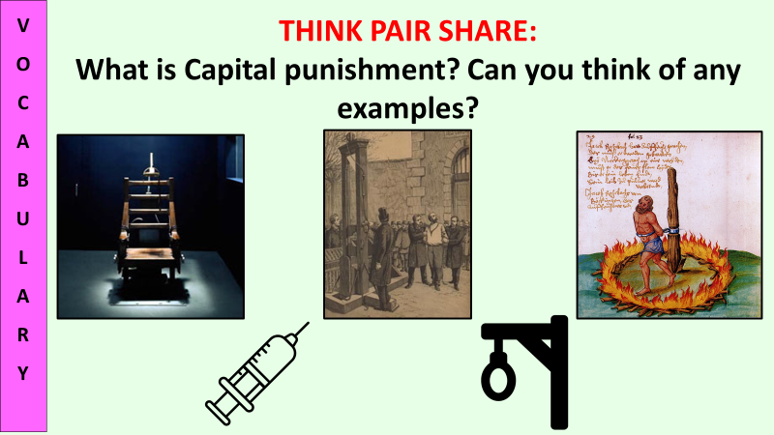
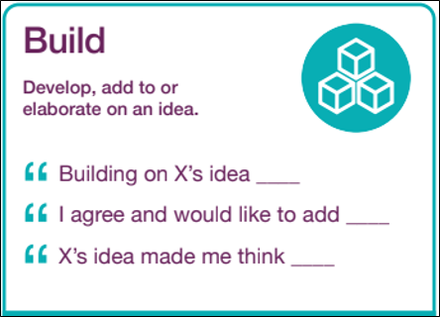
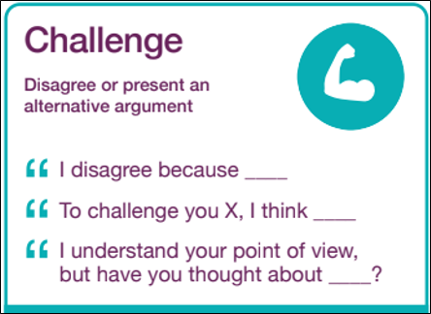
Turn and Talk routines
Seating plan
Nesting time and scaffolding
Flexible discussion times and “cresting the wave”
Always follow with some kind of check for understanding or accountability mechanism
Notes:
Seating plan – supportive learning partners
Nesting time and scaffolding – facilitate processing and a build up of tension to help with energy
Flexible discussion times and “cresting the wave” – avoid dragging it out but give them ample time
Always follow with some kind of check for understanding or accountability mechanism – voting is good for this

Slide 13
Challenges of Turn and Talk
Learning Talk with peers | Teacher-directed Learning Talk
“generative and exploratory” (Hogan et al, 2010) Can raise confidence and help “meaning-making” Issues: needs to be structured to ensure dialogue remains curriculum-focused | “efficient means of attaining higher levels of reasoning and higher quality explanations” (Hogan et al, 2010) Helps teacher identify misconceptions and correct them Issues: fewer opportunities for students to explore concepts with others at a similar level of understanding
Notes:
Direct the question back to the delegates – have you done Think Pair Share/ Any issues that have came from it?
Research suggests LT with peers and teacher-led LT are complementary, but this doesn’t mean they aren’t also in tension with each other.
Finding strategies to blend the 2 effectively are what I have found pertinent with LT.

Slide 14
Challenges of Think Pair Share
Challenge | Strategies to address It
Off-topic conversation | Provide a clear, focused prompt or question. Scaffold it properly Keep it snappy Circulate Accountability mechanisms
Poor listening | Front-load the task with the instruction that students may be asked to summarise their partner’s response Alternate who starts (“closest to the window starting… go!”)
Misconception spread | Circulate Accountability mechanisms Avoid rounding-up
Notes:
Direct the question back to the delegates – have you done Think Pair Share/ Any issues that have came from it?

Slide 15
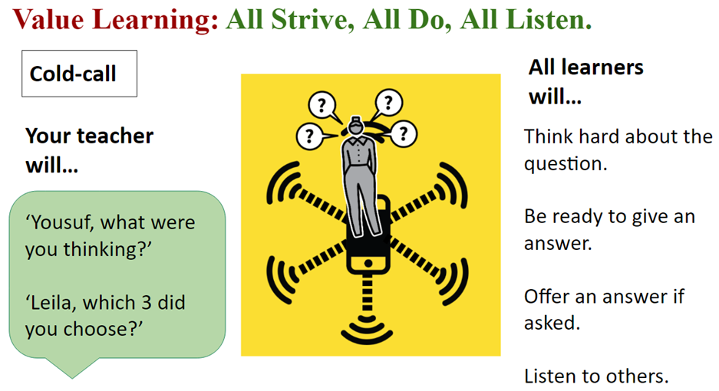
Cold Calling
What were you thinking … Yousuf?
Which 3 did you choose … Leila?

Slide 16
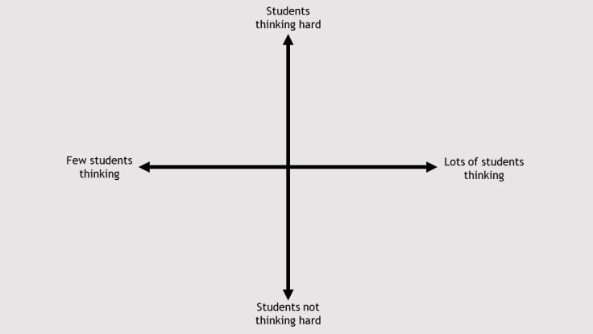
Cold Calling
Scenario: A teacher asks the question: ‘John…what is the sanctity of life?’
Notes:
Green X = Gold Zone top right – that is where you want all your students to be when thinking hard in lessons.
Scenario – Teacher asks the questions (cold-calls), but calls a name first
By calling a student’s name and then asking the question will automatically lower class participation.
Accountability of the students has shifted from the entire class who could be asked a question to just one student.
The rest of the class who were not named are almost guaranteed to not be thinking about the answer.

Slide 17
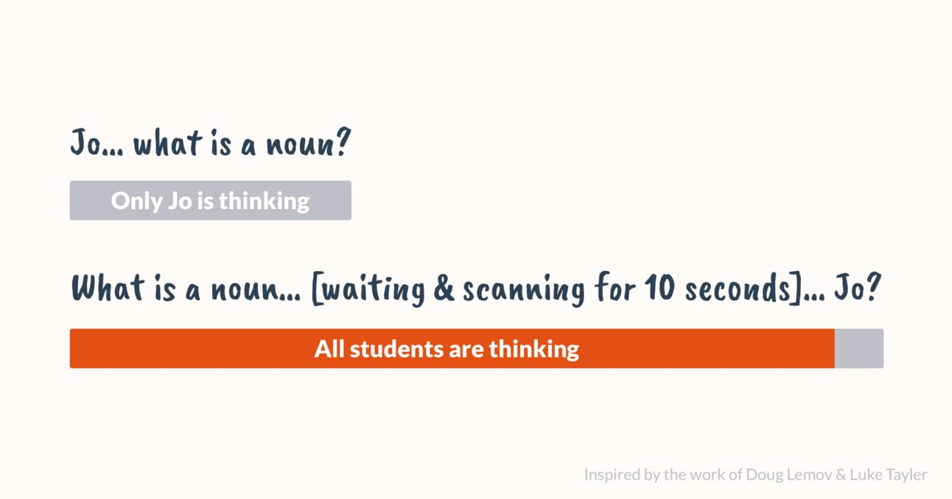
Cold Calling
Try this instead:
Notes:
Ask the question first, then call a student’s name.
Sounds easy/obvious; yet it’s very easy to forget.
It holds the entire class to account as the mystery of who will be asked the question still remains.
This is also where you can judge all the students body language/demeanour/facial expressions

Slide 18
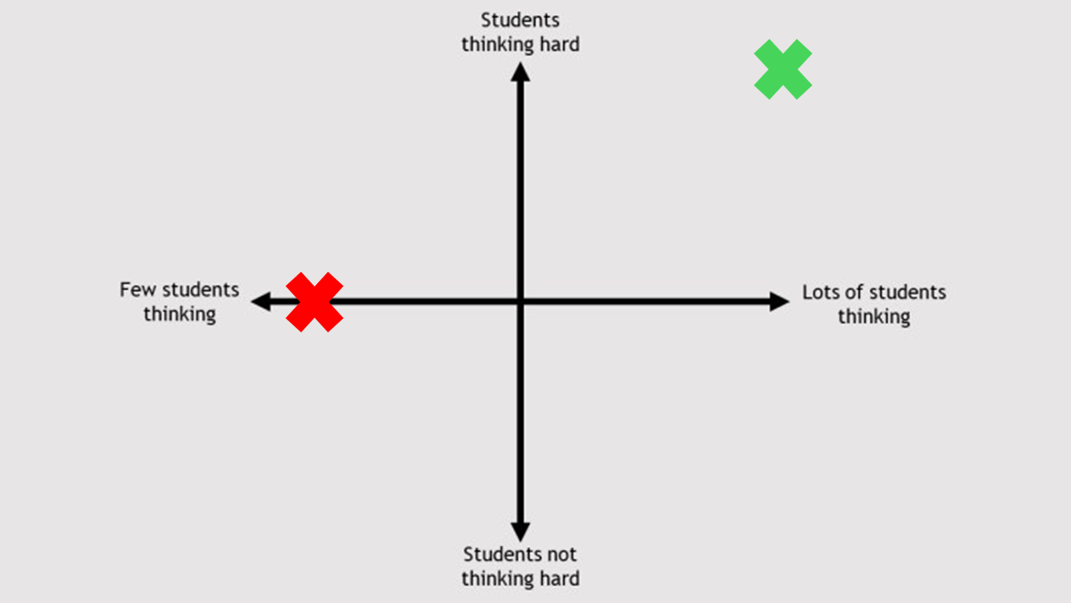
Cold Calling
Updated scenario: The teacher has now asked a specific student at the end of the question:
‘Can someone tell me what is meant by the Sanctity of Life, Anna?’
Where would this go on the axis?
Notes:
Building on the scenario:
Previously – the teacher asked question/ says name first

Slide 19
Cold Calling
Notes:
A bit better than our last one, but not a lot better. Why?
Because the Wait Time wasn’t long enough.
They posed the question, then asked a student, who then had to pause and think for quite a while before answering.
While that student was waiting and thinking, what were all the others doing?
They were confident that they wouldn’t need to answer the question, they switched off and waited for the other student to answer the question.
The whole point in doing the Cold Call flies out the window.
Ways to increase participation correctly:
Cold Call – Pose a question / Wait time / Call Student and Respond

Slide 20
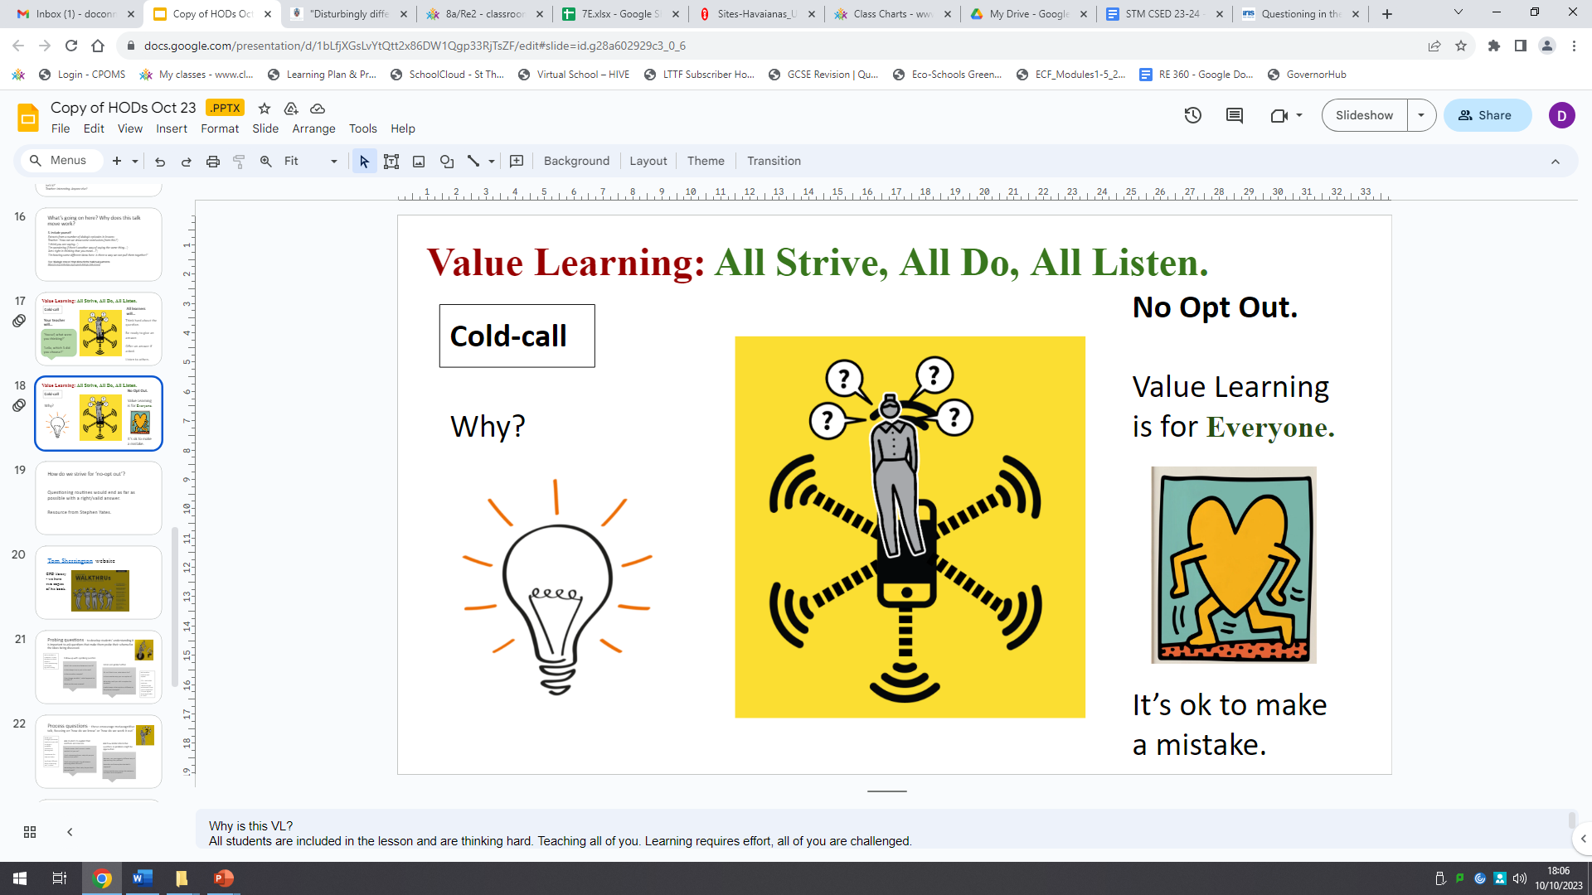
Cold Calling
Routes are important – need more experience
Creates a positive culture around errors or ‘giving it a go’
Nurture academic excellence – probe, challenge, extend, link etc
Allows other students to assist/ get involved
Using the students’ name… last
Motivate students and inspire curiosity
Notes:
Routes are important –
isn't just selecting random students.
plan different "routes" around the room to ensure all students are included over time.
Varying who is called on prevents the same confident students from dominating discussion.
improves with deliberate practice and reflection.
Encourage teachers to track participation and notice patterns in who they tend to call on.
Creates a positive culture around errors or "giving it a go“ -
helps normalise participation from everyone, not just those who are certain of the answer.
learn that mistakes are part of learning rather than something to avoid.
response to incorrect answers is crucial: probe, scaffold, and build on contributions rather than shutting them down or rounding up.
Over time, students become more willing to take academic risks.
Nurture academic excellence – probe, challenge, extend, link etc.
should be the start of thinking, not the end.
Follow up answers with questions "Why do you think that?" "Can you give evidence?"
This raises the level of classroom dialogue and pushes students beyond recall.
Cold calling becomes powerful when combined with high-quality questioning.
Allows other students to assist/get involved
One student's answer can become a springboard for wider discussion.
Teachers can use techniques such as: "Who agrees or disagrees and why?" "Can someone add to X answer … wait … jo?"
This keeps the whole class engaged because everyone knows they may be invited to contribute.
Cold calling promotes collective thinking, not individual performance.
Using the student's name… last
This ensures every student thinks about the question because nobody knows who will be asked.
It also provides valuable wait time before the response.
Motivate students and inspire curiosity
When done well, cold calling communicates that every student's thinking matters.
It increases accountability while also building confidence.
Students are more likely to stay focused because they know they may be invited into the discussion at any point.
Thought – provoking questions can spark curiosity and encourage deeper engagement with the subject.

Slide 21
“I dunno…”
Mr Miles is teaching about the internal features of a synagogue. He asks a lowball question to a student to check that he has been listening and interrupt the loss of attention. The student responds, “I don’t know”. What should Mr Miles do?

Slide 22
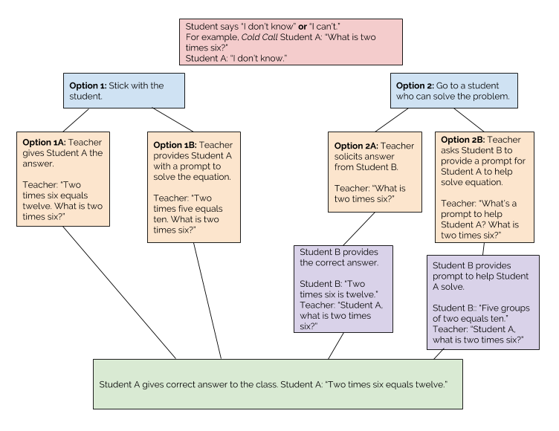
Looping
Credit: ww.teachlikeachampion.com
Notes:
Option 1A: good barometer to check for wilful disengagement – could establish a conflict with an audience
Option 1B: reduced potential for conflict, more time spent on one individual, could result in attention loss for the rest if it takes too long
Option 2A: included others, great option if the question is trickier, factual recall, or an answer for which a prompt may not be immediately called to mind (e.g. what is the capital city of France?)
Option 2B: brilliant at facilitating flow, remaining in control, opportunities for praise for more than 1 student

Slide 23
Looping
Factors to consider when looping:
Purpose – was I checking for listening or understanding?
Tone – how can I maximise the chance that this student re-engages?
Delay – how long between “I don’t know” and the loop back?
Pitch – was it a reasonably pitched question?

Slide 24
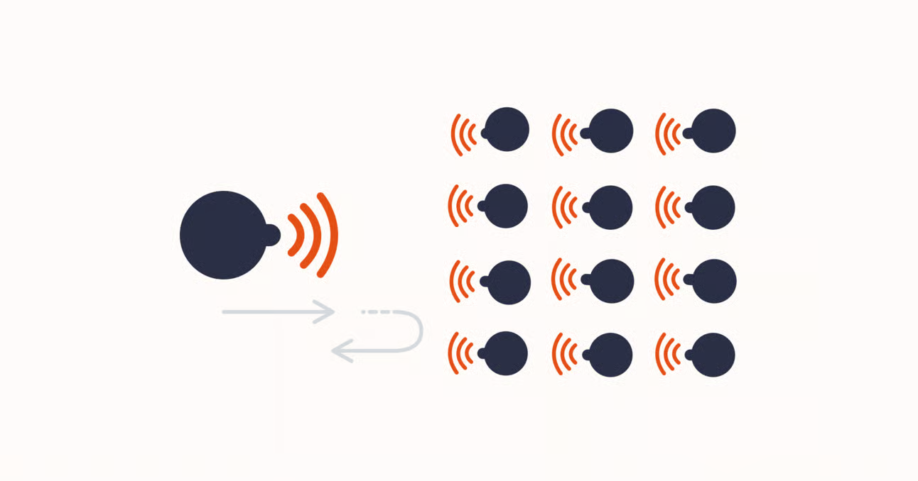
Choral Response and when to use it.
Notes:
Choral response is important and impactful to keep the class engaged in explanations from the teacher
The teacher will deliberately get all students to answer in unison to a prompt.
Example –
Teacher: “Moses received the Torah and Ten Commandments on Mount Sinai and the Torah is the first five books of Moses ”
→ What mountain did Moses receive the Torah?
→ 3, 2, 1… ALL Students: “Mount Sinai”
Or
How many books are in the Torah?
3…2…1… ALL students: “5”
Most impactful when embedded as a regular classroom norm rather than used intermittently or as a one off.
Builds a shared response culture where participation is the default expectation

Slide 25
Choral Response
Class routine where ALL students answer in unison to a teacher prompt.
Used for short, quick, precise, single-answer questions
Often structured with clear cues (e.g. “3, 2, 1…”) to synchronise response/ maintain pace.
Most effective during explicit instruction, where it interrupts passive listening and re-establishes focused attention.
Provides instant feedback on accuracy, misconceptions, and fluency
Builds disciplinary language and confidence with key terminology
Supports knowledge retention through frequent, low-stakes rehearsal
Acts as a gateway into deeper questioning
Notes:
It is used for short, precise, single-answer questions (vocabulary, definitions, facts, rules).
Designed to embed repetition, retrieval, and immediate participation within instruction.
Works well within structured retrieval sequences to consolidate learning.
Interrupts passive listening and re-establishes focused attention.
Reduces cognitive drift by keeping all students actively “on call”
Increases attentional accountability (anyone may be sampled or checked) –
Works as a “reset tool” when engagement drops or attention fragments – important after modelling/longer explanations of a concept
It holds everyone to account - 100% participation rather than selective engagement/ Removes opt-out: every student responds simultaneously
Normalises verbal participation even from less confident students (safety in group response)
Acts as a gateway into deeper questioning - follow up cold call – stretch and challenge questions e.g. why is the Torah important for Jews

Slide 26
Questions?

Slide 27
Resources:
https://bunsenblue.com/2023/04/08/achieving-100-student-attention-why/
https://www.innerdrive.co.uk/blog/cold-calling-vs-think-pair-share-whiteboards/
https://snacks.pepsmccrea.com/p/thinking-time
https://bunsenblue.com/2025/02/08/choral-response-and-i-say-you-say/
https://bunsenblue.com/2023/04/08/checks-for-listening-100-participation/
https://achemicalorthodoxy.co.uk/2020/06/23/how-do-i-engage-my-students-faqs-on-ratio/
https://teachlikeachampion.org/blog/tlac-3-0-using-turn-talk-to-make-your-classroom-crackle-to-life/
https://assets.publishing.service.gov.uk/media/5a7960b9ed915d0422067f01/11-1452-building-engagement-building-futures-maximise-participation-16-24.pdf
Hogan, K., Nastasi, B. K., & Pressley, M. (1999). Discourse Patterns and Collaborative Scientific Reasoning in Peer and Teacher-Guided Discussions. Cognition and Instruction, 17(4), 379–432. https://doi.org/10.1207/S1532690XCI1704_2

