Slide 2

Brainscape
Martin Edworthy

Slide 3

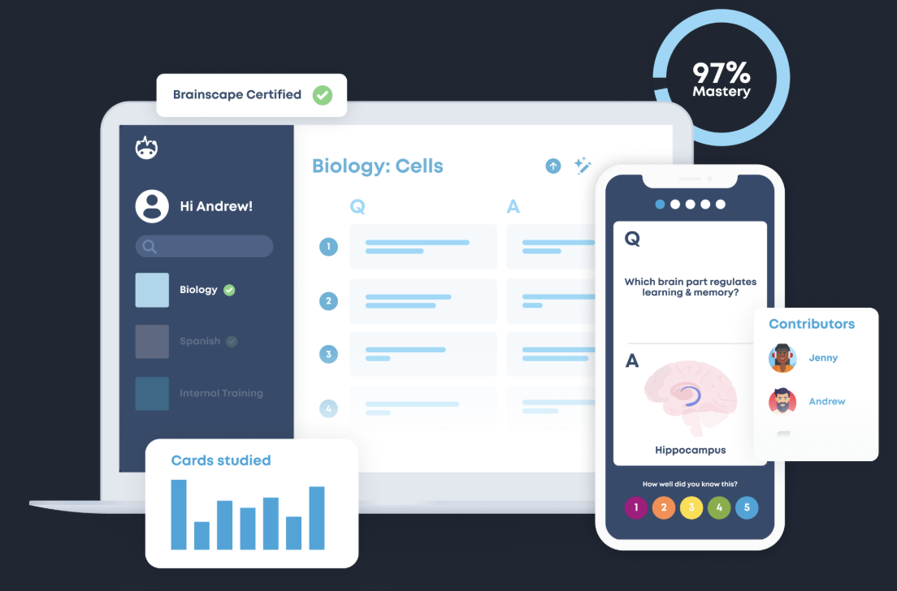
Brainscape
_{brainscape.com}

Slide 4
Aims
Understand Brainscape as a tool and how cognitive science make it effective
Consider Sacred Hearts Brainscape experience and use it to inform implementation
Try out studying with Brainscape and practice creating cards

Slide 5
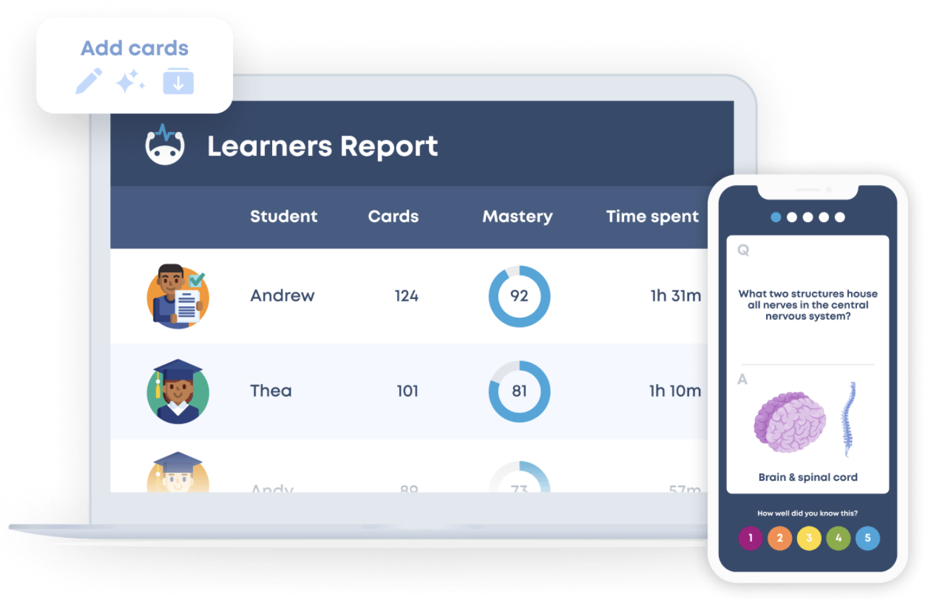
What is Brainscape?
Brainscape is a web & mobile study platform that uses proven retrieval practice methods to improve learning
On the surface, students study flashcards; but the frequency of those cards is carefully determined
Students can study adaptively on any device; all progress is securely synced in the cloud
Basic usage is free, you and your students can get a great deal from Brainscape without a subscription

Slide 6
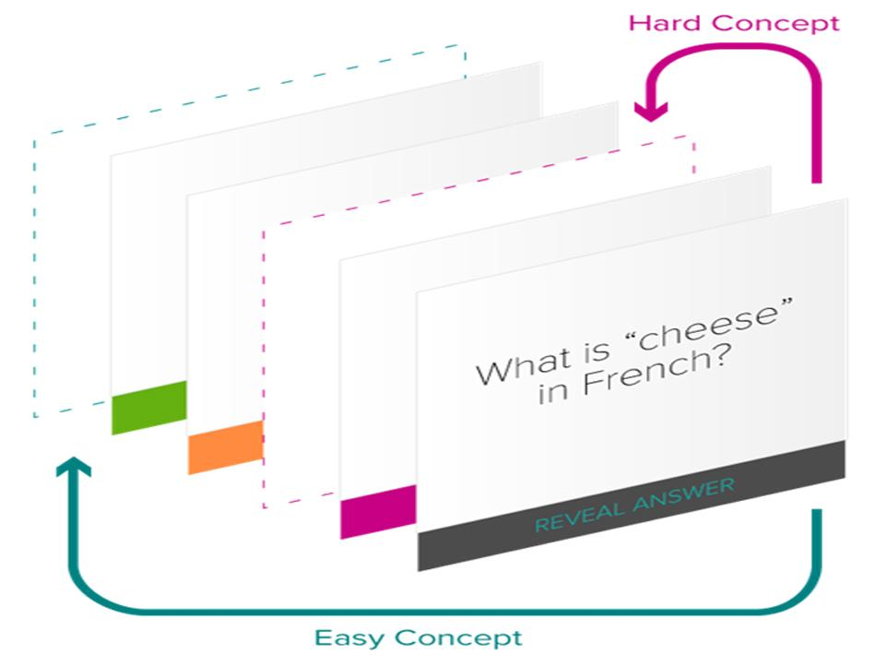
Brainscape’s method
Brainscape uses a “smart flashcards” algorithm rooted in cognitive science
Key Scientific Principles:
Retrieval practice
Active recall
Metacognition
Spaced repetition
Interleaving study
Limiting hyperbolic discounting
Notes:
These are all aspects we recognise as valuable and look to build into our teaching and the learning activities that our students undertake – Brainscape is leveraging these principles in the background

Slide 7
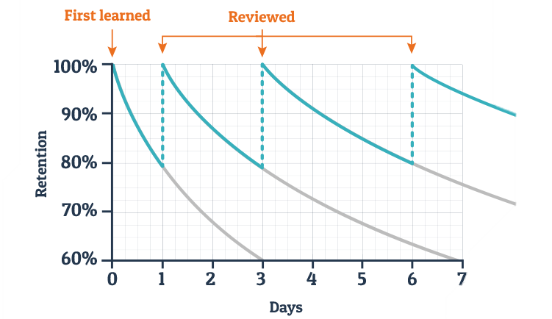
The Research
Started with Hermann Ebbinghaus’ research into the nature of forgetting (1885).
Notes:
The earliest significant research into this was carried out in 1885 by Hernan Ebbinghaus. He charted how quickly facts were forgotten by humans – almost 50% of what is said is forgotten 3 days after hearing it. He noted that regular reviewing of these facts led to a delay in forgetting time.
You’ll see variations on the exact rate of retention etc and while modern cognitive science as gone far beyond this, the basic principle remains sound and it is useful way to appreciate the impact of retrieval practice and spaced repetition.
We would say now forgetting depends on what was learned, how it was learned, how it is later cued, what competes with it, and whether retrieval is practised over time.
For education, the practical takeaway is still very robust: teach once and move on = fragile memory; space it, retrieve it, and connect it meaningfully = much stronger memory.

Slide 8
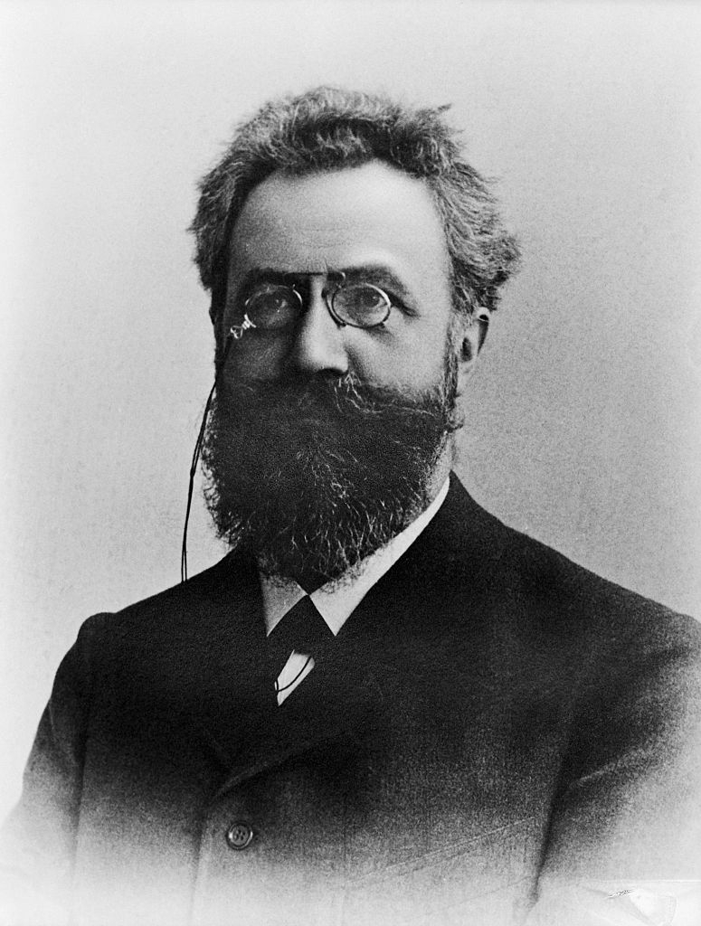
The Research
Started with Hermann Ebbinghaus’ research into the nature of forgetting (1885).
Effective teachers often interrupt the forgetting of their students.
Students can use Brainscape to regularly revisit ideas and interrupt forgetting.
Notes:
To put it simply - Effective teachers often interrupt the forgetting of their students – Brainscape is a useful tool to facilitate this.

Slide 9
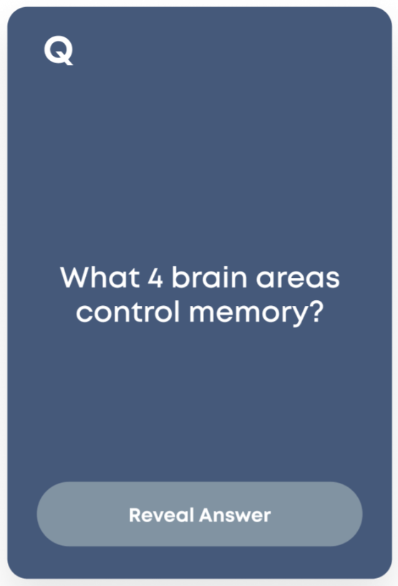
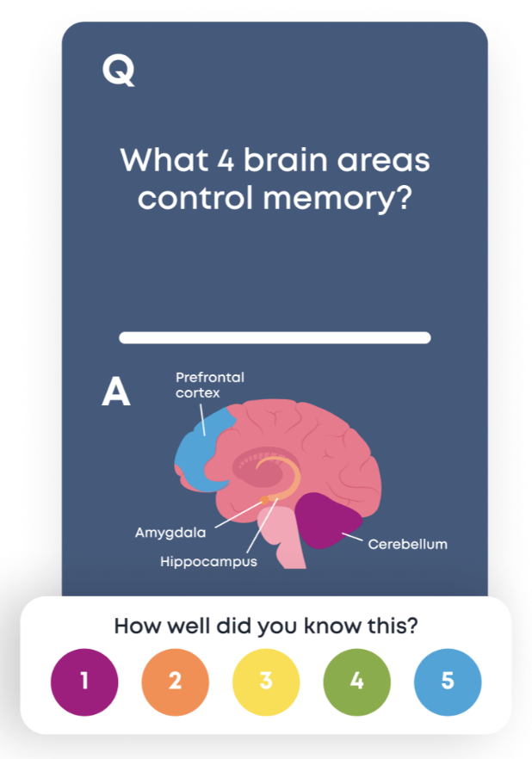
How studying in Brainscape works in practice
2. Metacognition
3. Spaced Repetition
1. Active Recall
Think of the answer in your head
Rate your
confidence
Continue a personalized repetition stream

Slide 10

Brainscape helps develop better learners
1. The card's border color shows your previous confidence rating (in this case, "high")
2. Realizing you've now forgotten it makes you reevaluate your overconfidence
3. You calibrate your future confidence ratings as you understand your own pace of learning better

Slide 11
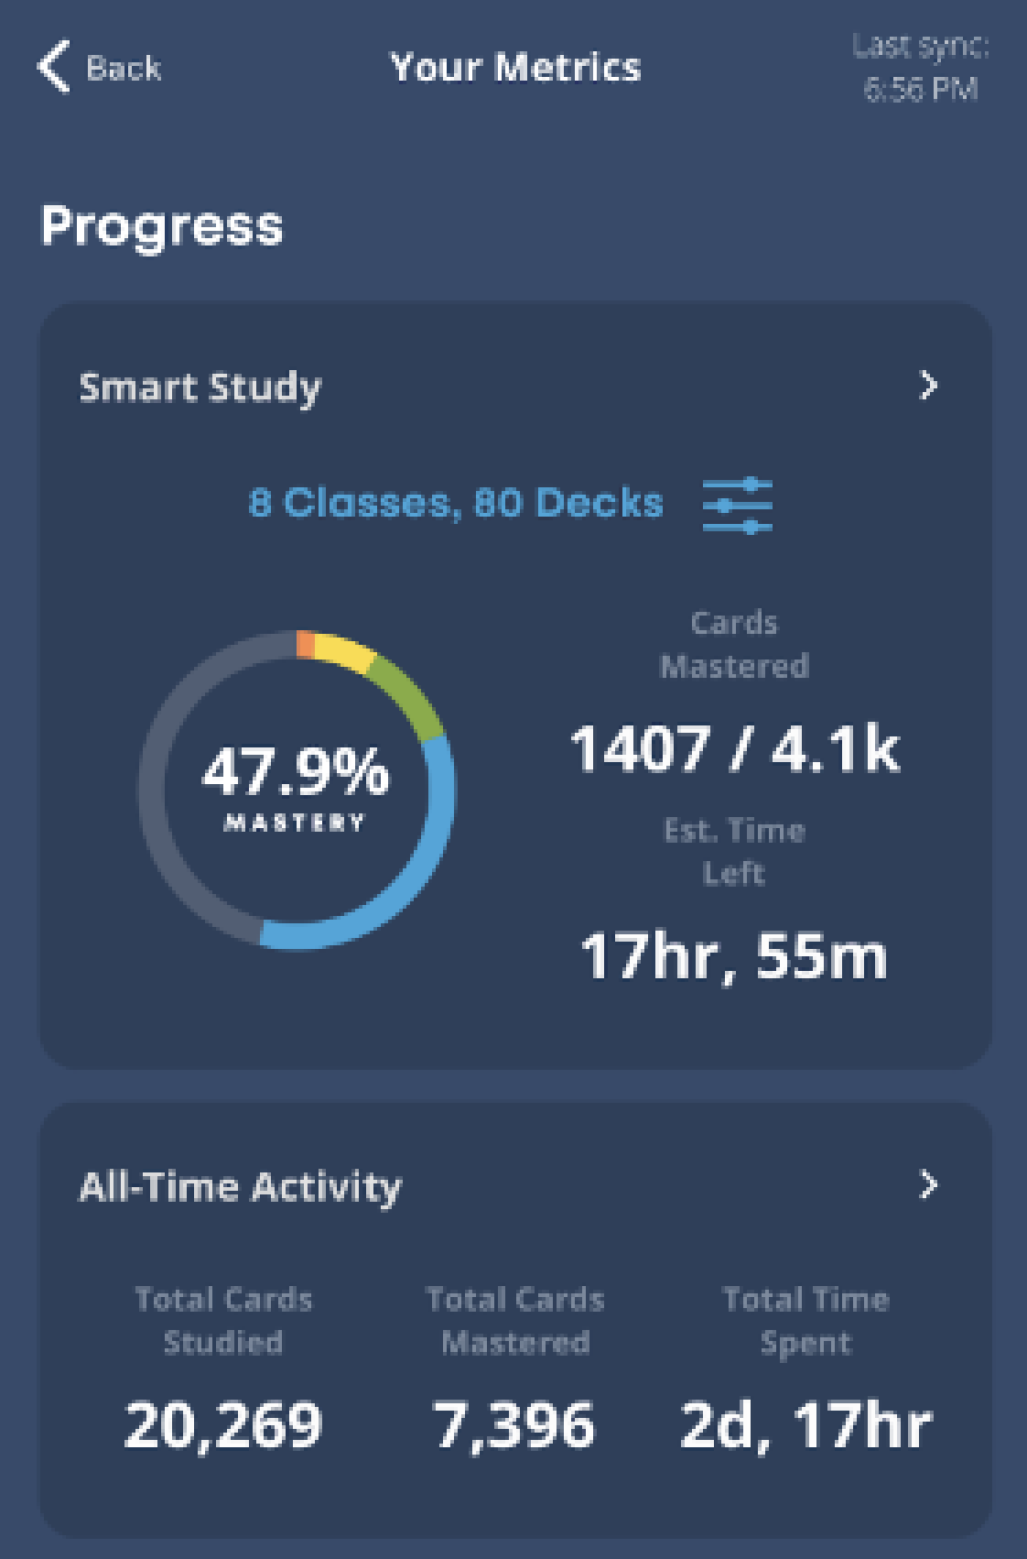
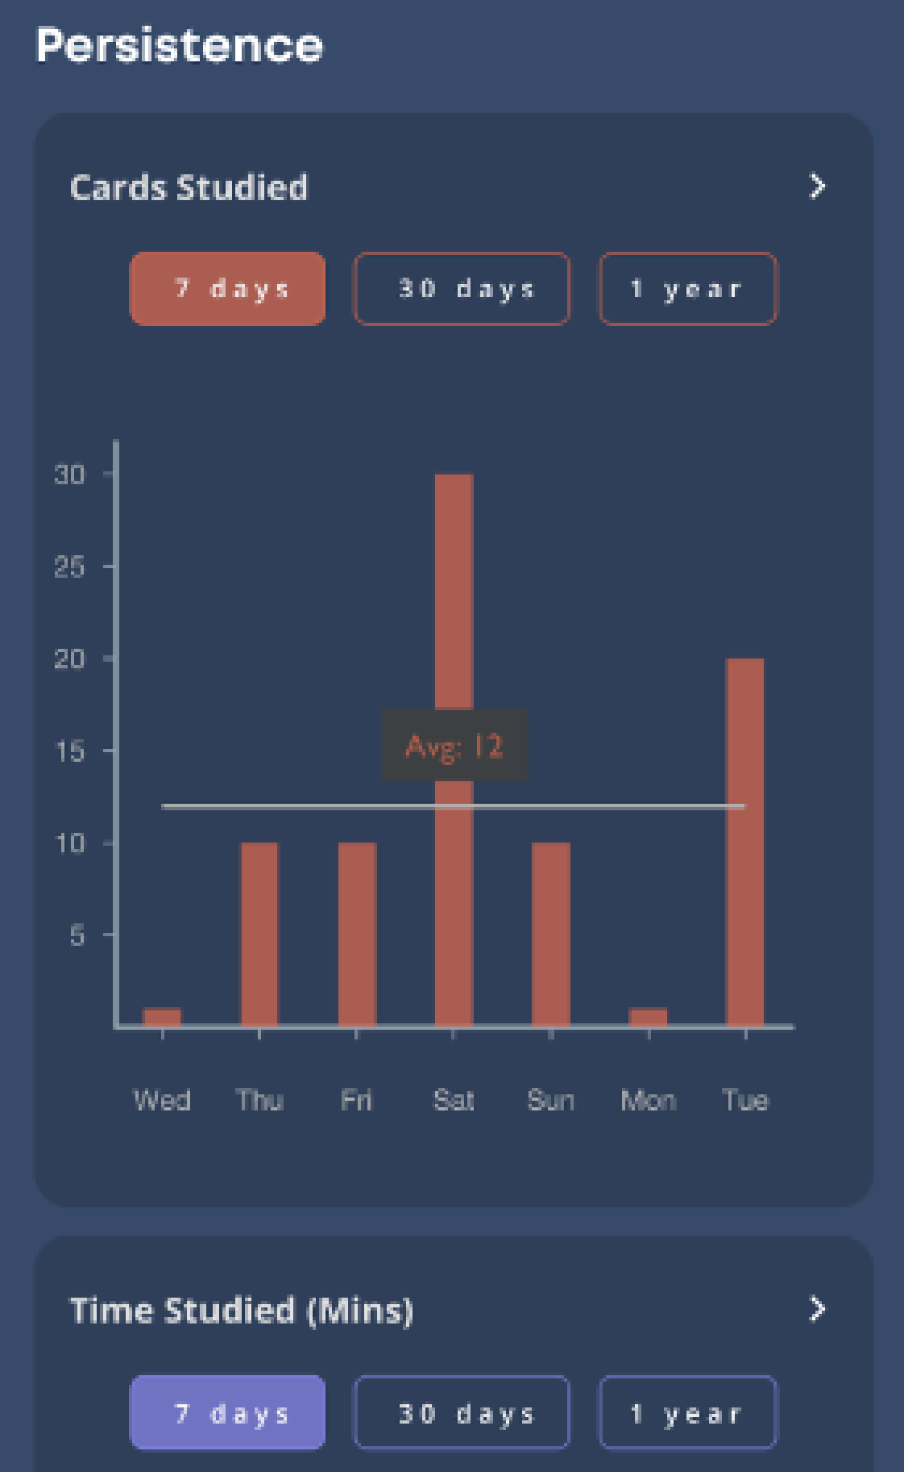
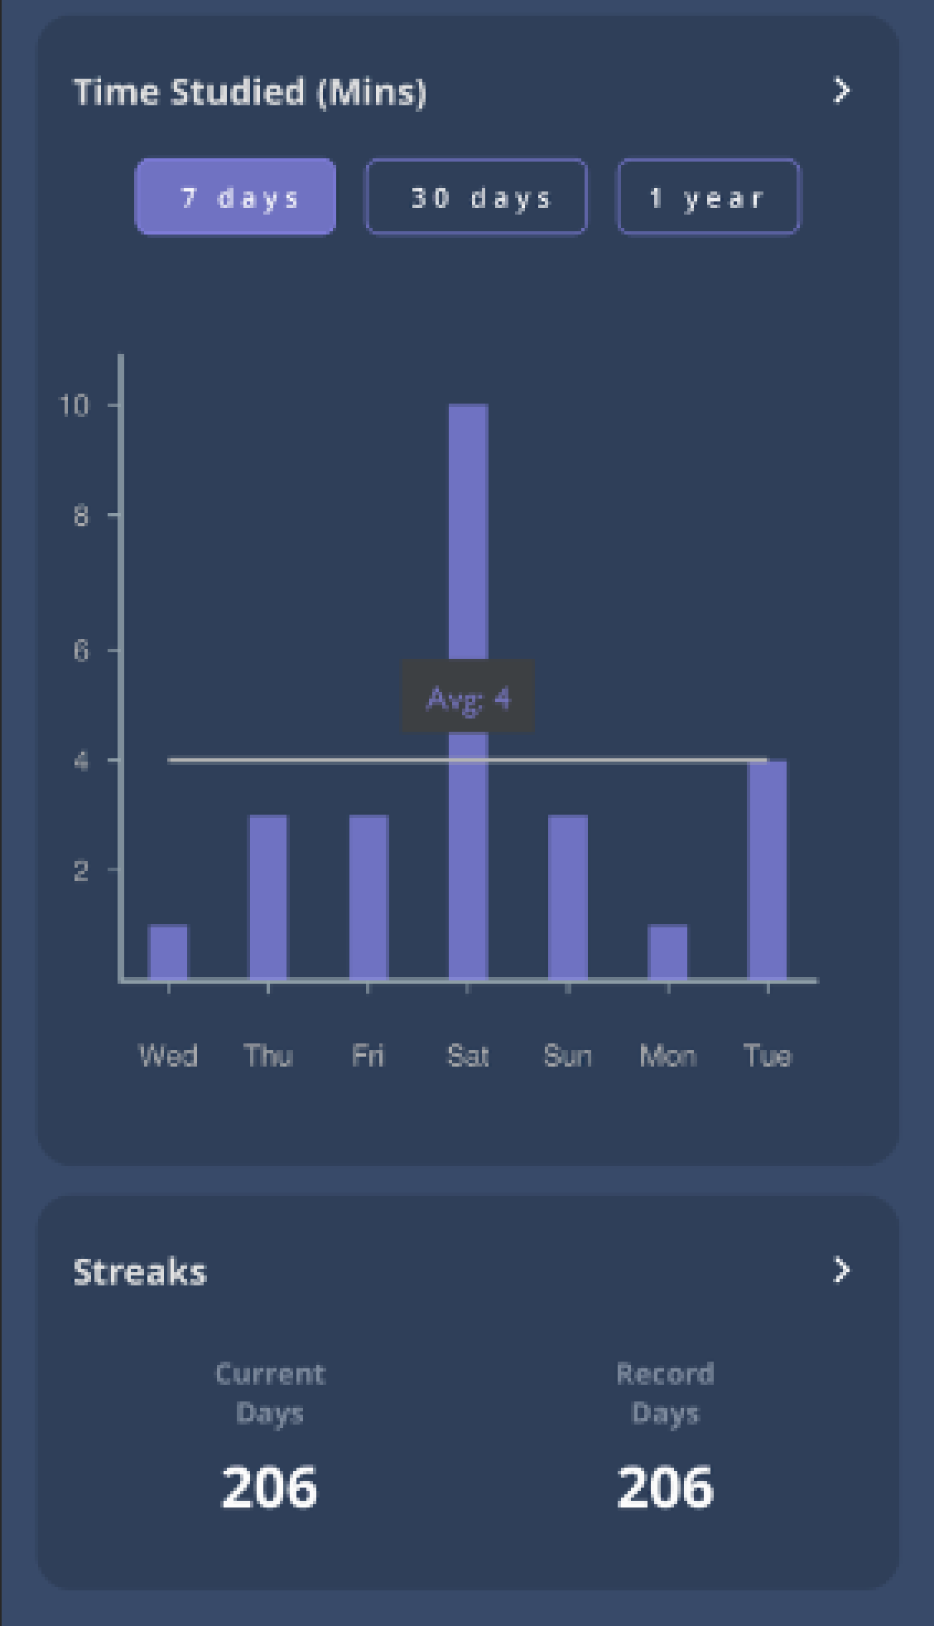
Brainscape Gives Students Deep Learning Analytics
Brainscape also helps students better understand their personal rates of progress, so that they can better allocate their study time throughout the semester or even over many years

Slide 12
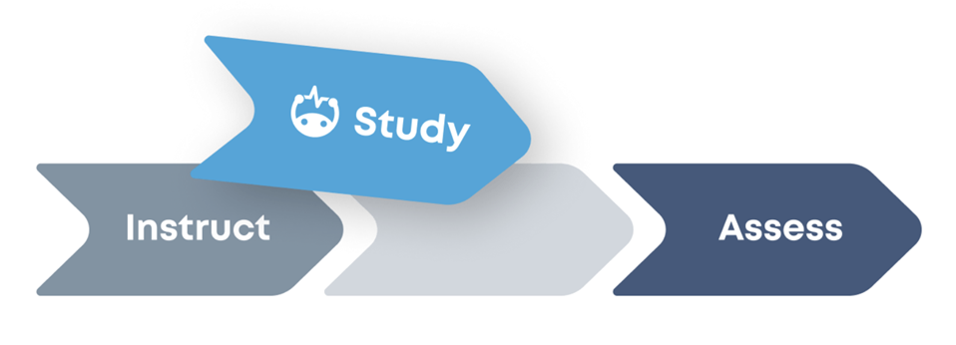
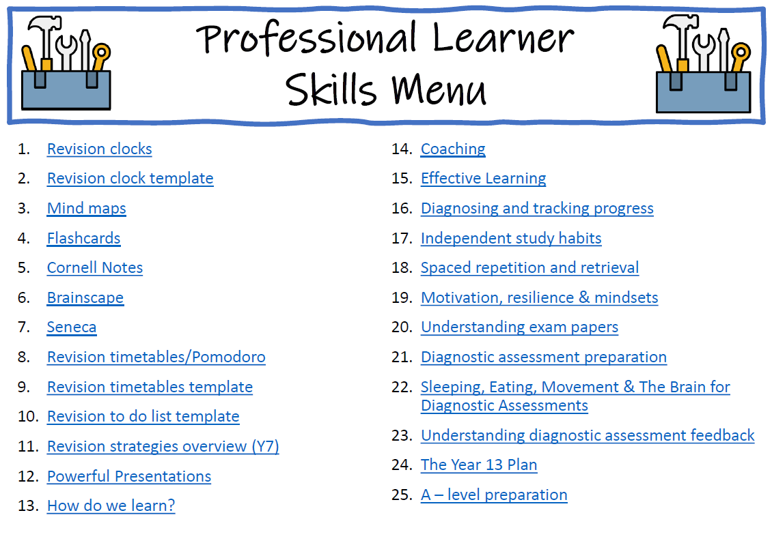
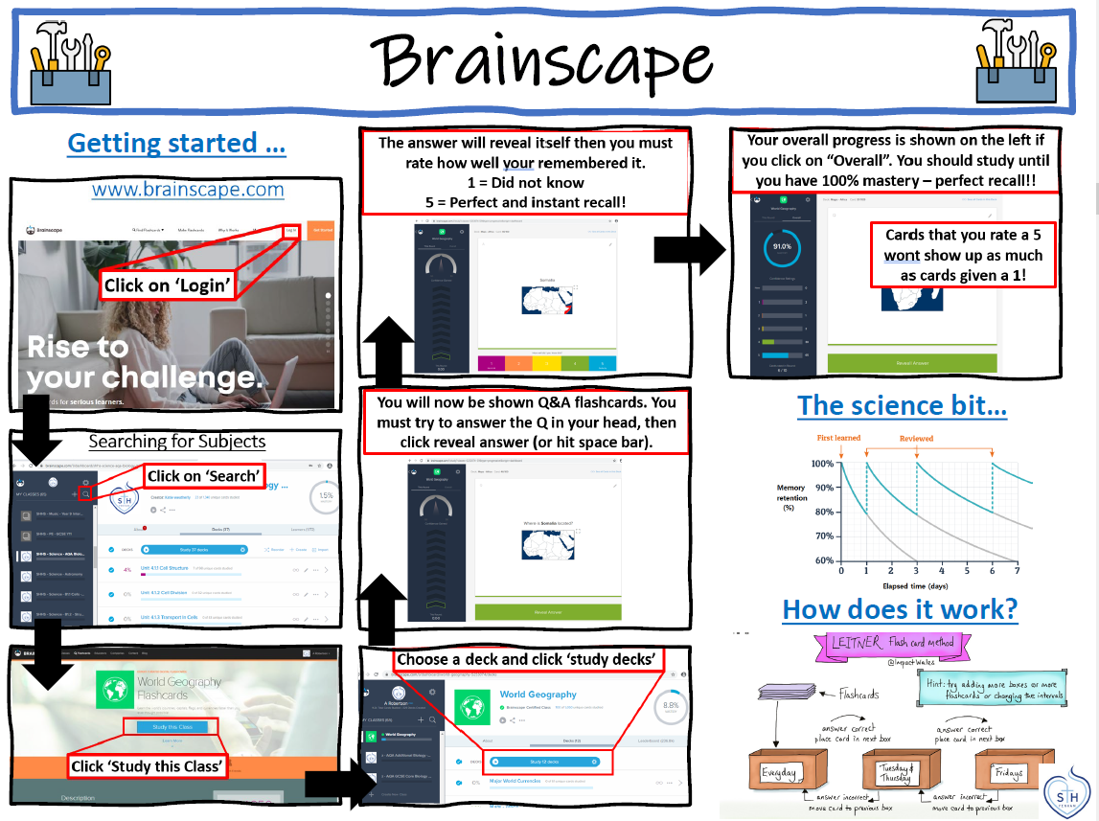
Brainscape at Sacred Heart
Professional Learner Toolkit - Brainscape is part of a suite of tools and strategies students are encouraged to use

Slide 13
Brainscape Sacred Heart Implementation Snapshot
Brainscape is a long-standing tool at Sacred Heart – supported through CPD and lessons but with a generally ‘hands off’ approach
Benefits are seen in raw engagement data and anecdotally through student feedback to teachers
Snapshot in April 2026 highlighted further opportunities:
  emphasise the importance of short, regular sessions (integrating into study routines rather than solely for revision)
  pausing before flipping
  build consistency with confidence ratings

Slide 14
Confidence Rating
Why You Rate: Brainscape makes you rate your confidence (1-5) so its smart, adaptive algorithm knows exactly when to show you the flashcard again. It's all about helping you learn faster and remember for the long haul.
Rating Rules of Thumb:
  Use a "5" ONLY if you're 100% sure you'll never forget it. Seriously, don't cheat yourself by giving 5s just to hit 100% mastery. There are no rewards for it!
  Go with a "3" or "4" if you know it well now, but you're not totally sold on remembering it forever.
  Mark a "1" if you're clueless. The algorithm loves 1s—it'll bring those cards (or new ones) back fast, about 60% of the time.
  Pro Tip: If you're seeing too many new concepts and want to focus, rate more of your current cards as a "1."
Notes:
Keep in Mind: Don't stress if you don't rate perfectly—Brainscape figures out your pace. The actual interval also depends on how much you study and how "stale" your cards are (stale cards repeat more often).
You’ll see low rated cards more frequently and higher rates cards less frequently….

Slide 15
Frequency of repetition
As you continue studying, Brainscape constantly fine-tunes how often each card appears. This depends on more than just your last rating.
Your repetition pattern is influenced by things like:
How many decks or classes are in your study mix
How often you’ve studied recently
How long it’s been since you last saw each card
How many cards currently sit in each confidence bucket (1 to 5)
Cards that haven’t been reviewed in a while become “stale,” which makes them more likely to resurface. Fresh cards take a back seat until they need attention again.
Notes:
Brainscape is careful about two things:
Not overwhelming you with too much new material before you’ve built confidence in what you’re already studying
Not repeating cards too quickly while they’re still fresh in your mind
This balance is intentional. Repeating a card too soon wastes time. Waiting too long lets it fade. Our algorithm aims for the sweet spot where your learning is at its fastest, and your retention is strongest.
Under the hood, this system combines decades of cognitive science research, human judgment, and software that adapts as you change. The more you study, the better it gets at predicting what you need next.

Slide 16
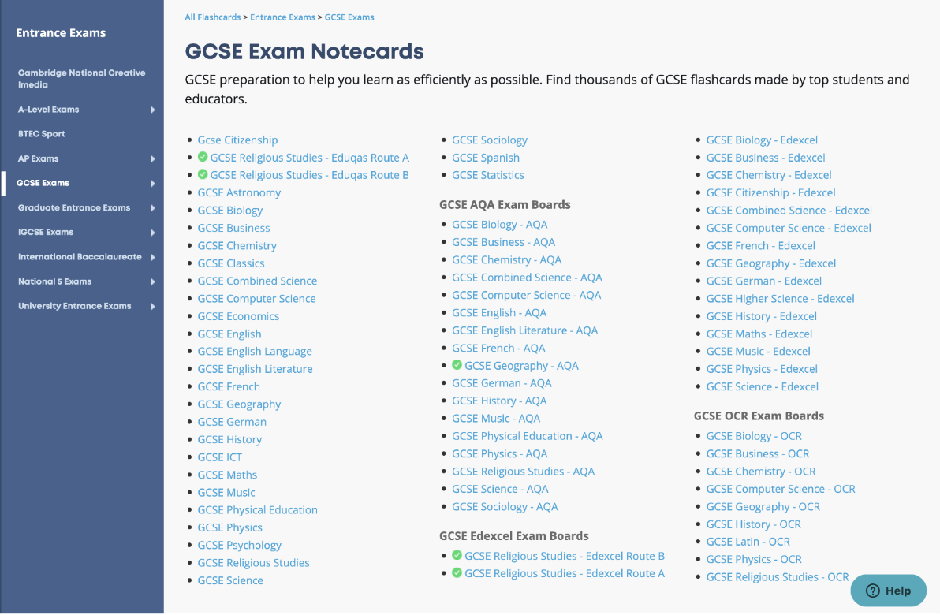
Find Great Flashcards on the "Knowledge Genome"
Tens of thousands of educators have shared Brainscape flashcards covering virtually every subject.
For major exams, Brainscape partners with leading educators and publishers to provide "Brainscape-Certified" flashcards that are 100% trustworthy
Schools can unlock all user-generated and certified flashcards for students with a single license
A cross-section of flashcard offerings for GCSE exams, one of thousands of subjects available. Look for the ✅to denote Brainscape-Certified collections
Notes:
To find and study the full, students would need paid for accounts, but you can facilitate Brainscape by encouraging student creation of cards or create cards within your department and share them with students.

Slide 17
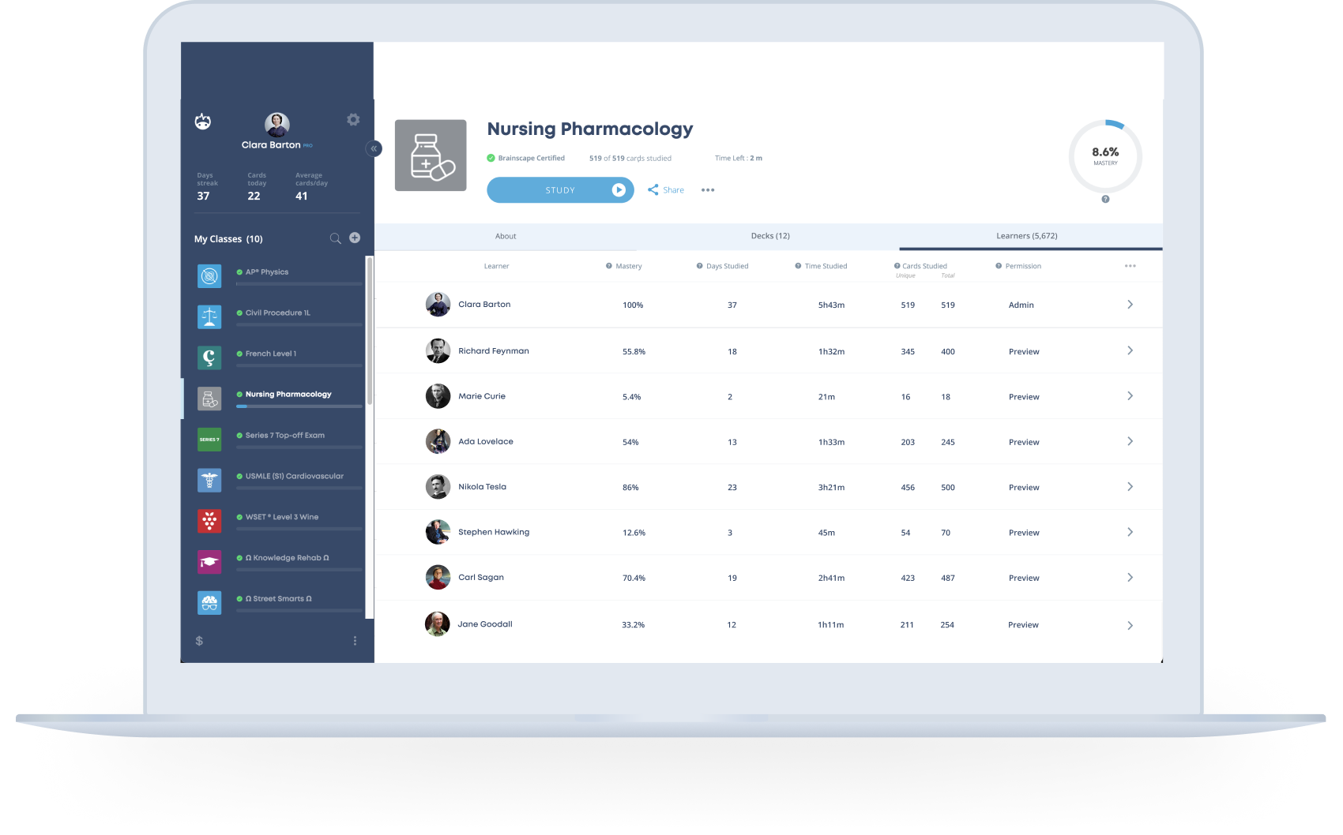
Analyze Detailed Learning Data in Brainscape
Easily track students' study time, spacing, confidence, and specific areas of weakness
Export to XLS!

Slide 18
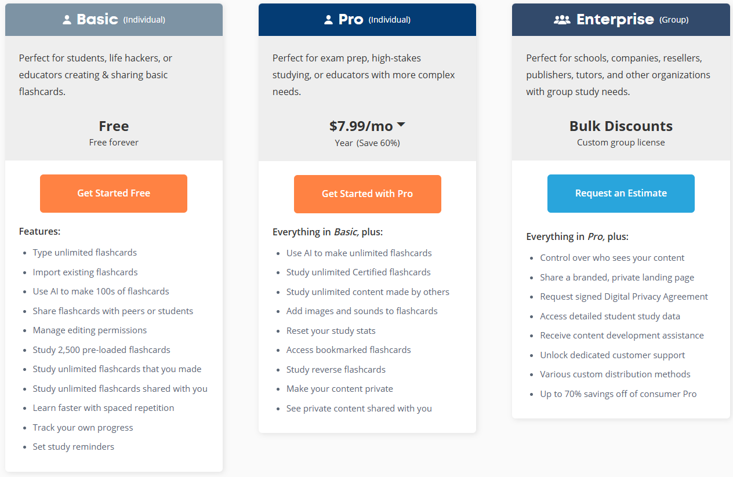
Enterprise is much more competitive than ‘Pro (Individual)’ pricing

Slide 19
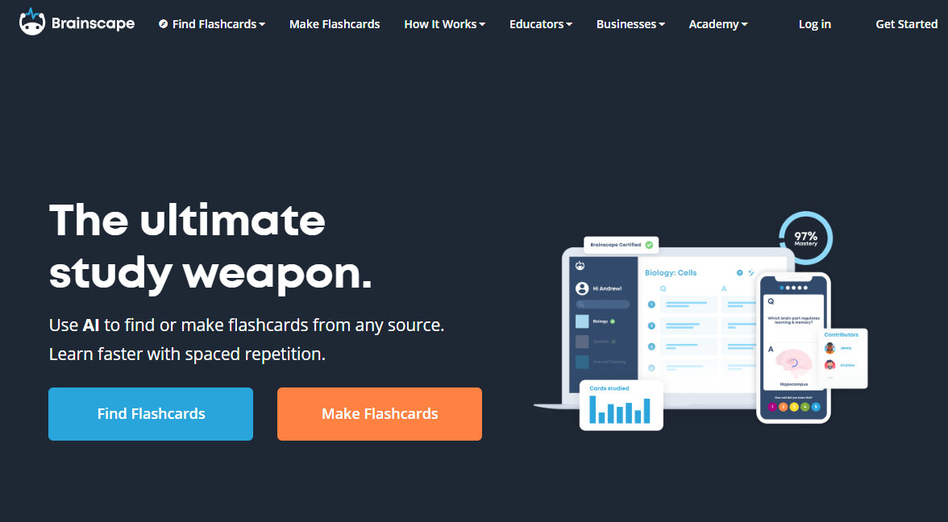
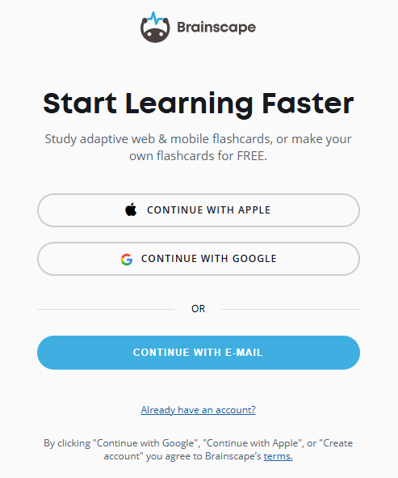

Slide 20
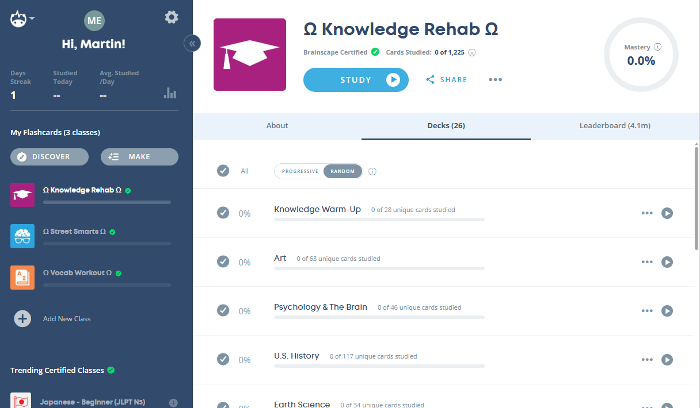
Organisation within Brainscape
Classes
Decks
Cards

Slide 21
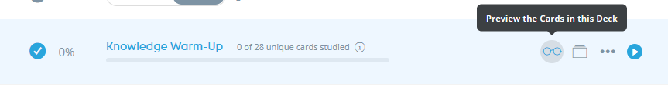
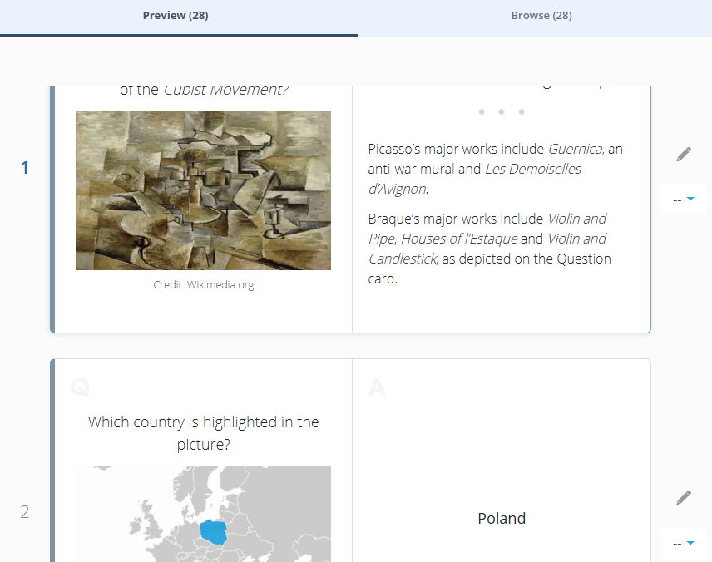

Slide 22
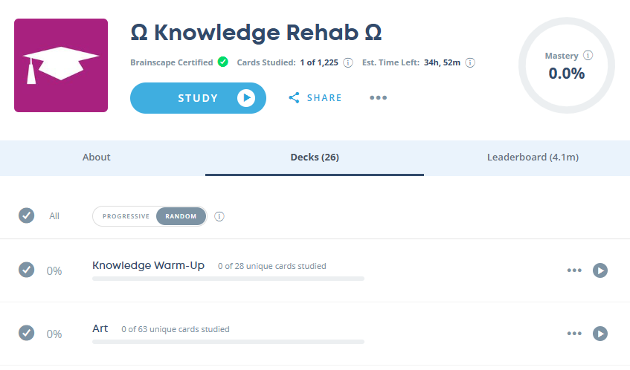
Options when studying
Study cards from the selected decks
Random – includes cards from any deck
Progressive – Master cards from 1st deck before cards from 2nd appear etc
Study only cards from this deck

Slide 23
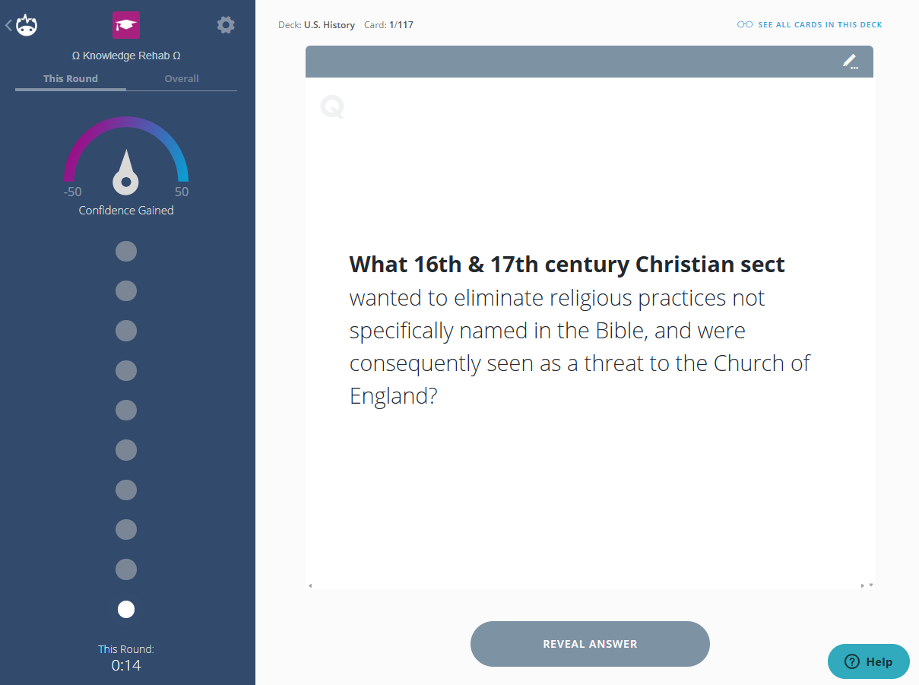
Students must take their time and consider their confidence before flipping to the answer

Slide 24
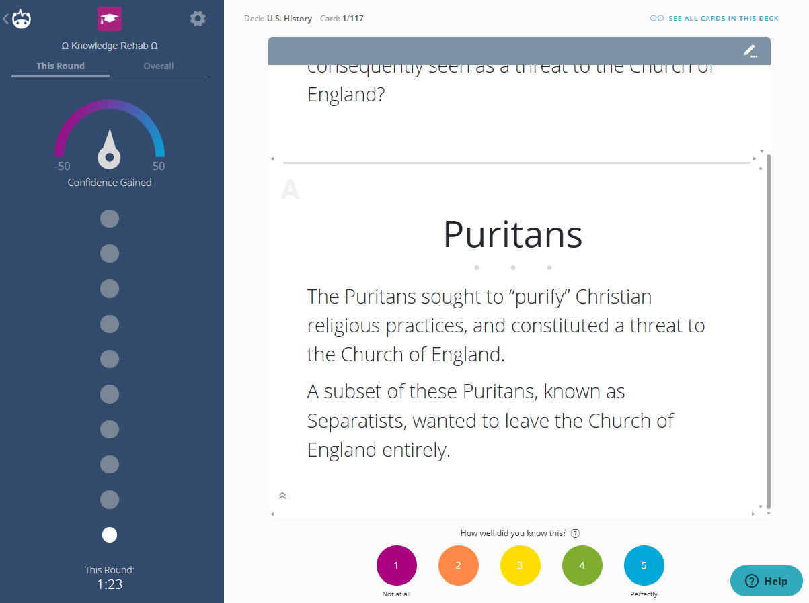
Notes:
Use a "5" ONLY if you're 100% sure you'll never forget it. Seriously, don't cheat yourself by giving 5s just to hit 100% mastery. There are no rewards for it!
Go with a "3" or "4" if you know it well now, but you're not totally sold on remembering it forever.
Mark a "1" if you're clueless. The algorithm loves 1s—it'll bring those cards (or new ones) back fast, about 60% of the time.

Slide 25
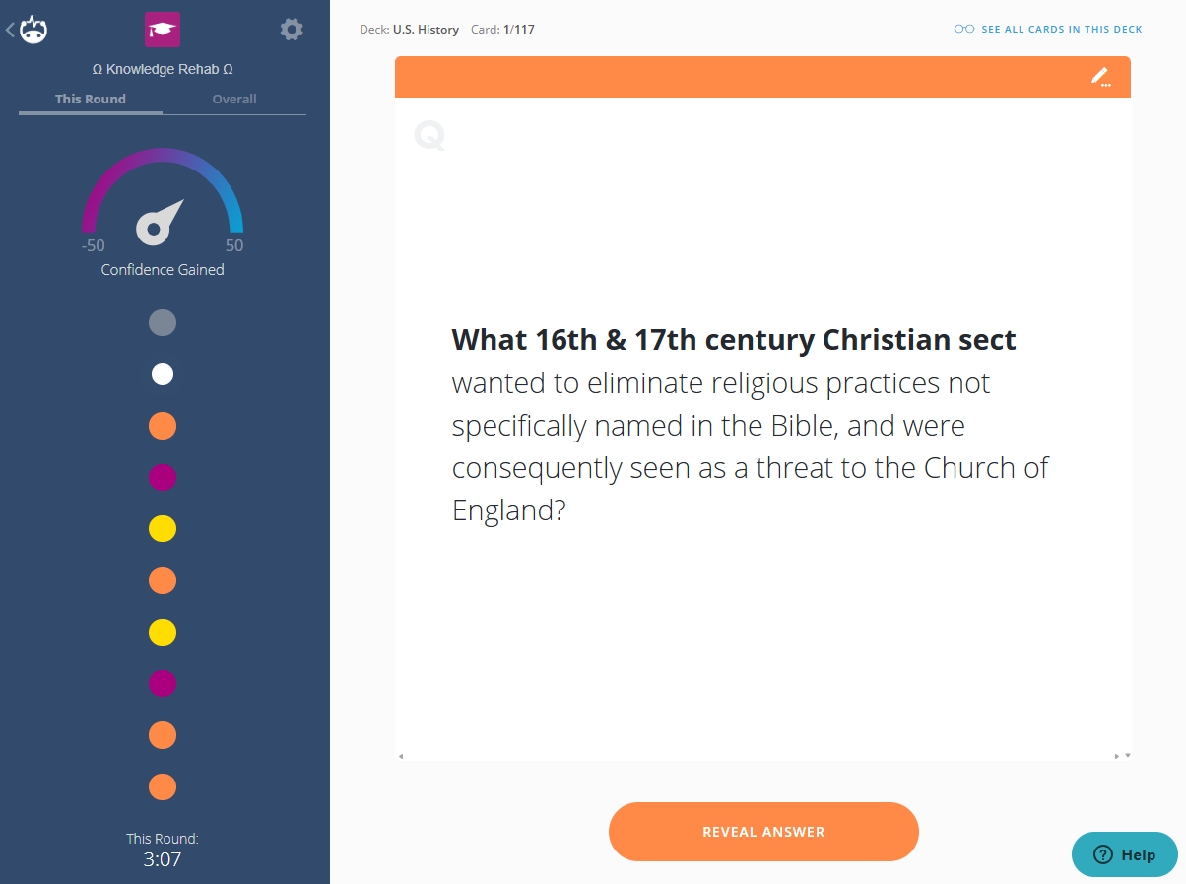
When you subsequently see a card, your previous confidence rating is indicated
(Encourage students not to ‘jump’ in confidence based on short term recall!)

Slide 26
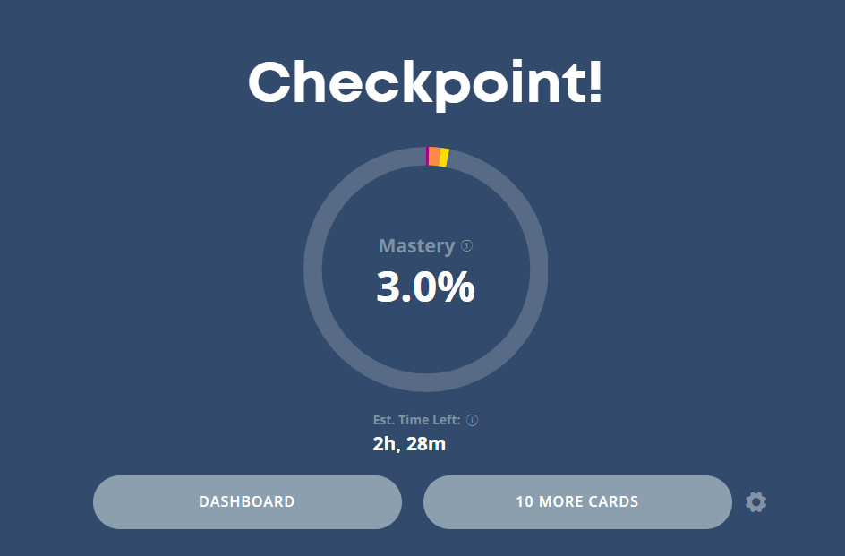

Slide 27
Task
Create a Brainscape account and start studying….

Slide 28
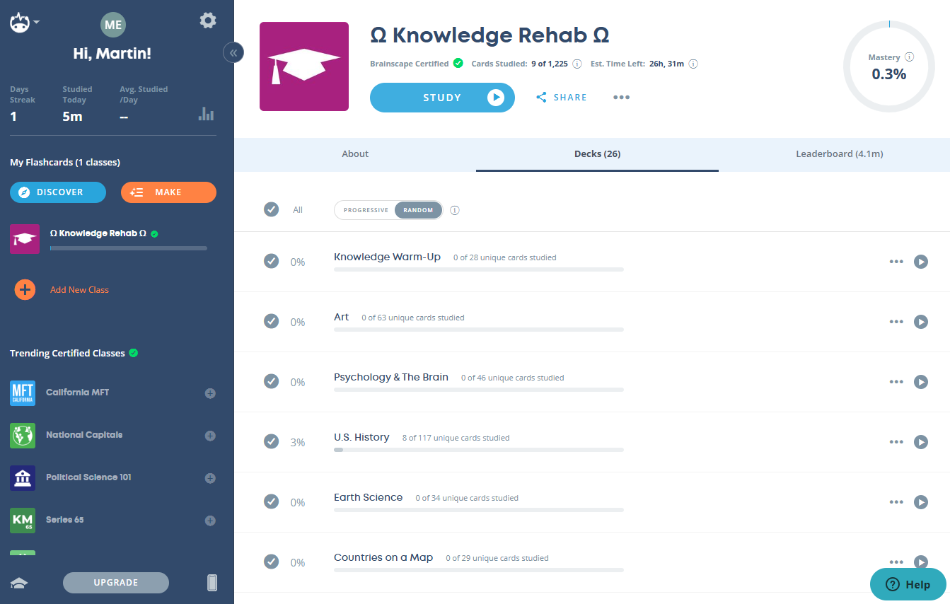
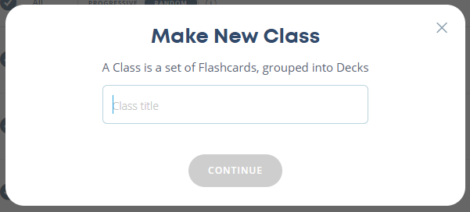

Slide 29
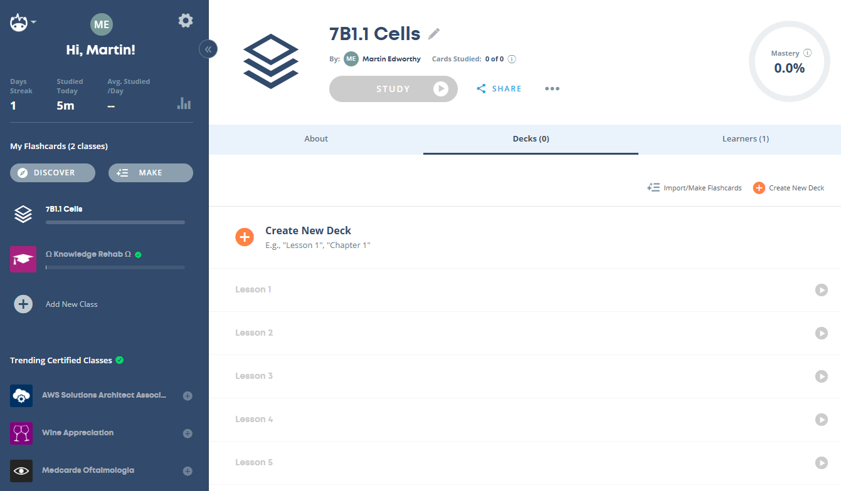
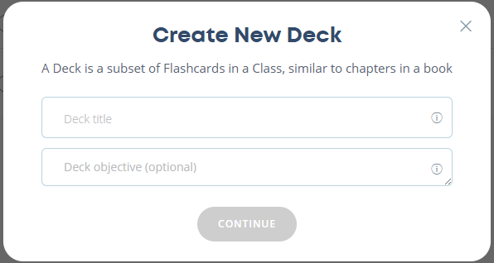

Slide 30
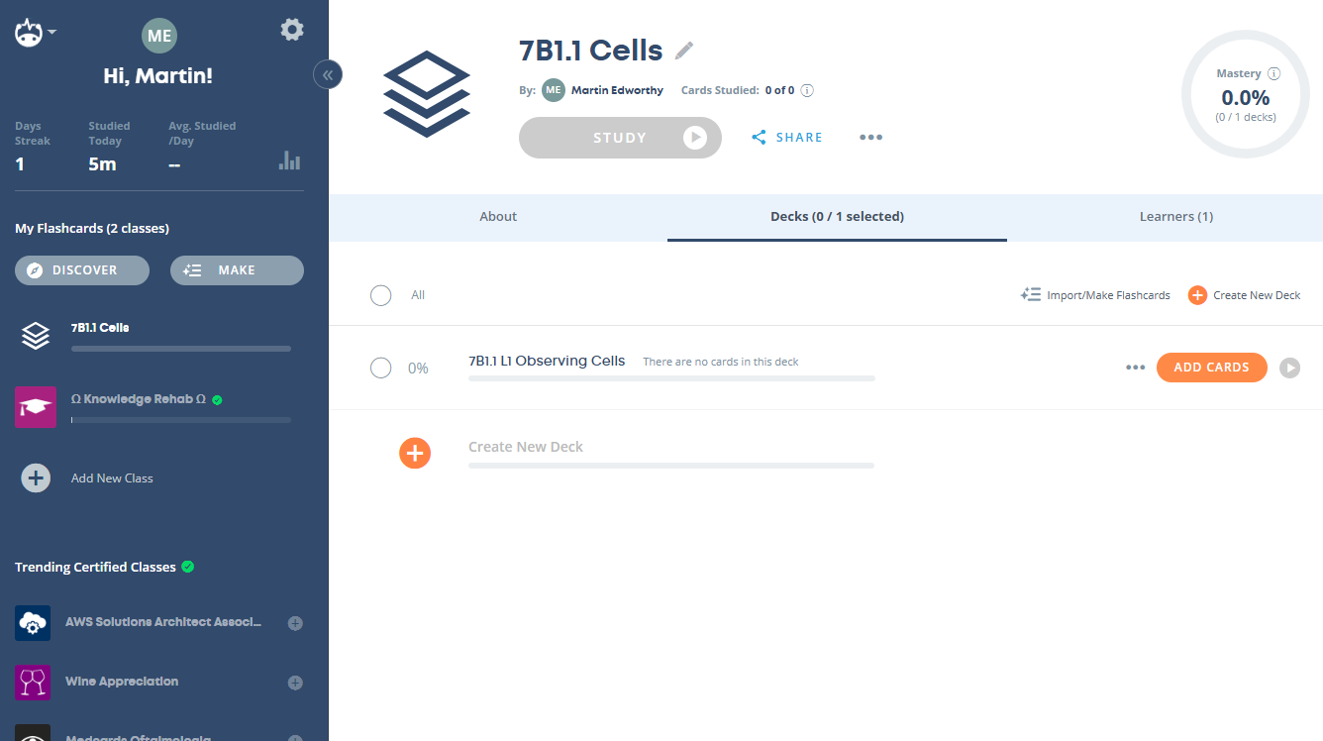
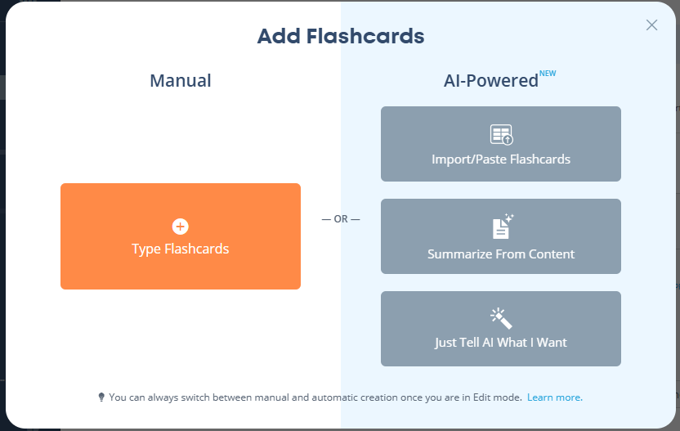

Slide 31
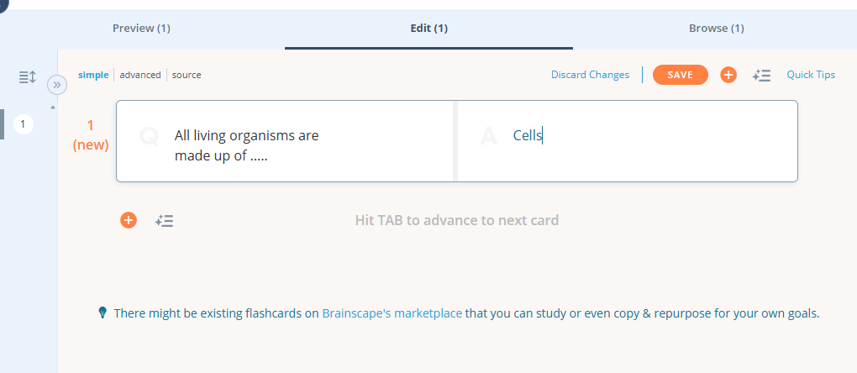
Type into the question side, tab to answer side, tab to create next card….

Slide 32
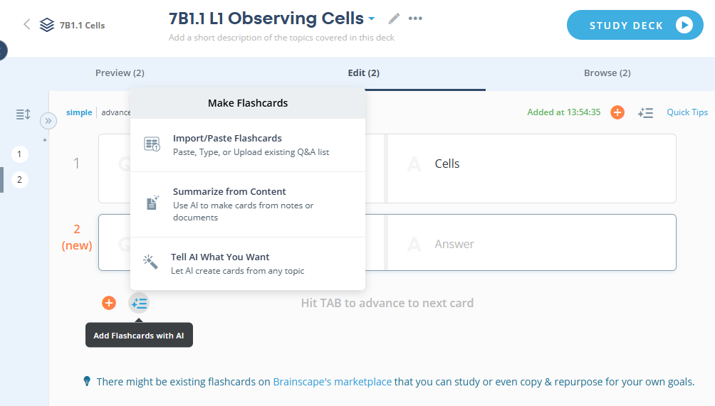

Slide 33
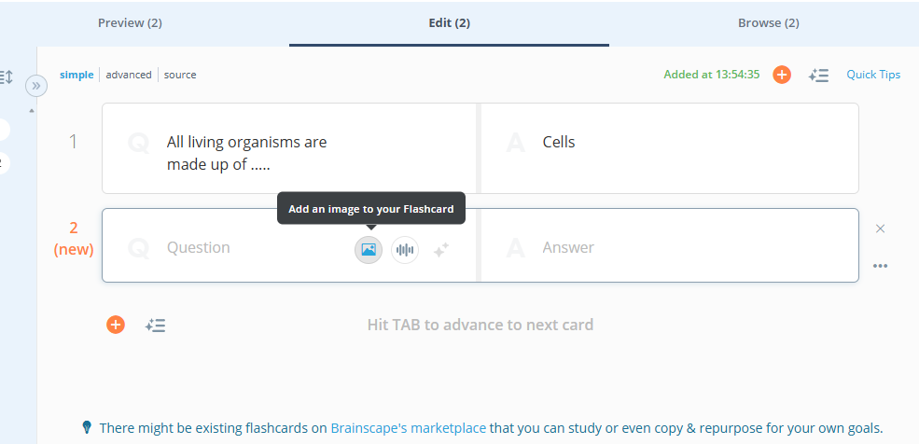

Slide 34
