Slide 2
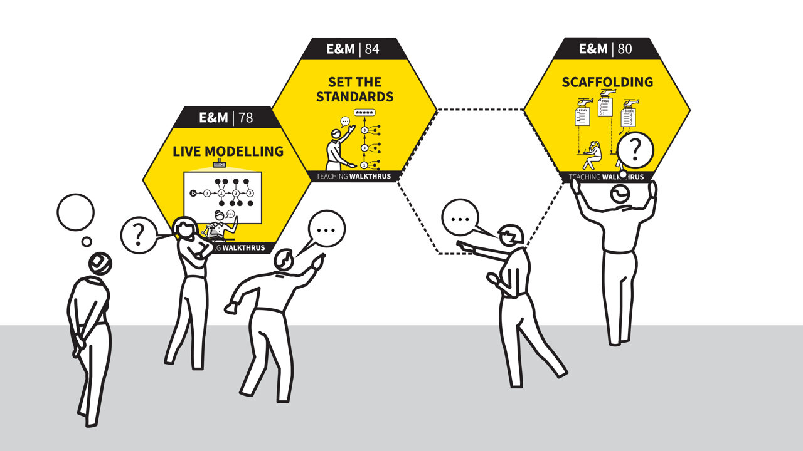
Walk Thrus

Slide 3
Agenda
Welcome and introductions
Why this matters – the evidence base
Our journey: implementation in practice
Why we started our T&L Walk Thrus programme
What are Walk Thrus?
Interactive – Bringing Walk Thrus to life
Impact and key lessons learnt
Reflection and takeaways

Slide 4


Slide 5

Why this matters – the evidence base

Slide 6

Why we started Walk Thrus
Our journey

Slide 7

Why this matters – the evidence base

Slide 8
Why this matters – the evidence base
EEF / 5-a-day principle | WalkThru example
Explicit instruction | “Explaining”, “I do, we do, you do”
Scaffolding | “Live modelling”, “Worked examples”
Metacognition | “Thinking aloud”
Feedback | “Check for understanding”, “Cold calling”
Cognitive load | “Chunking”, “Guided practice”

Slide 9


Why this matters – the evidence base

Slide 10
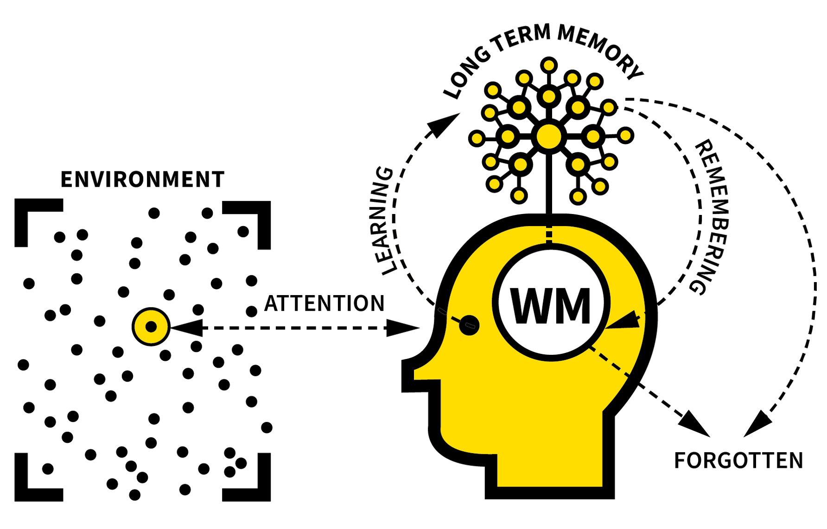

Ofsted framework
Links to T&L
1. Typical classroom experience over time
No “one-off lesson performance” pressure
Consistency > performance
2. Curriculum and teaching are now a single, central area
You can’t separate what is taught from how it is taught
3. Schools must show their teaching is based on:
“an evidence-informed understanding of how pupils learn”
Explain why teaching approaches are used
Link them to research and evidence
Leadership of teaching matters as much as teaching itself
How well leaders:
  Understand teaching quality
  Improve it over time
  Support staff development

Slide 11
Tom Sherrington
What the latest thinking emphasises:
Ensure every pupil is thinking (not just some)
Use precise, deliberate teaching techniques
Model until everyone can do it
Make learning concrete and explicit
Adapt evidence to your context
Build structured coaching and practice
Focus on a small number of high-impact strategies

Slide 12
Discussion
What does T&L currently look like at your setting? Strengths? Areas of development?
What does T&L CPD currently look like at your setting?

Slide 13
Why this matters – the evidence base
‘Improving teaching isn’t about doing more … it’s about doing the right things consistently well.’

Slide 14

What are Walk Thrus?
A set of evidence-informed teaching strategies organised into key strands to support consistent, high-quality classroom practice.
5-step instructional guides
Evidence-informed teaching strategies
Visual, simple, and easy to apply
Designed for coaching and professional development
Staff meetings & CPD
Regular instructional walkthroughs (short visits)
Coaching conversations and CPD
Focus on one strategy at a time
Builds consistency and incremental improvement

Slide 15
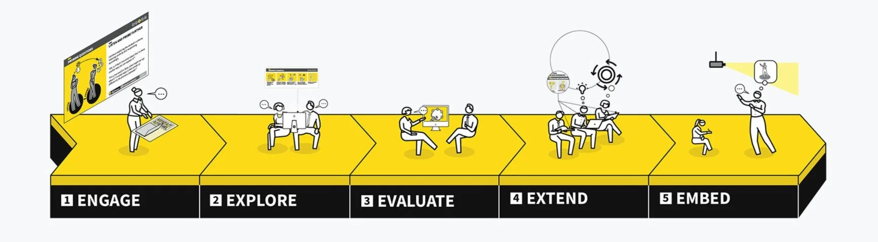
What are Walk Thrus?
Core strands
Behaviour & Relationships – routines, expectations, classroom climate
Curriculum Planning – sequencing, clarity of learning goals
Explanation & Modelling – clear instruction, worked examples
Questioning & Checking – probing thinking, formative assessment
Practice & Retrieval – rehearsal, memory, recall strategies
Feedback – responsive teaching, improving pupil work

Slide 16
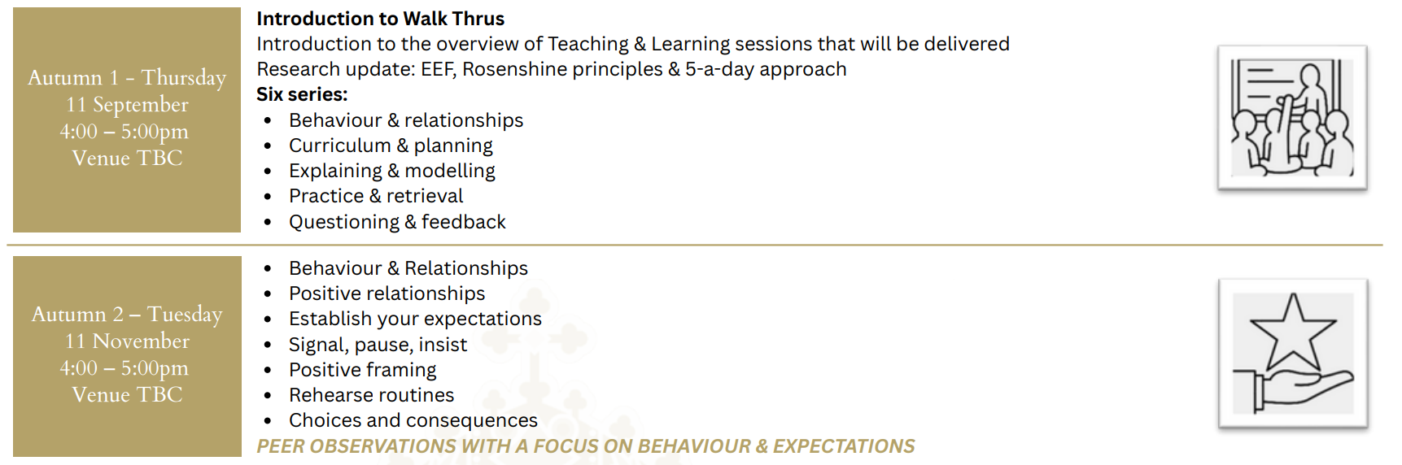
Trust Walk Thrus Project

Slide 17
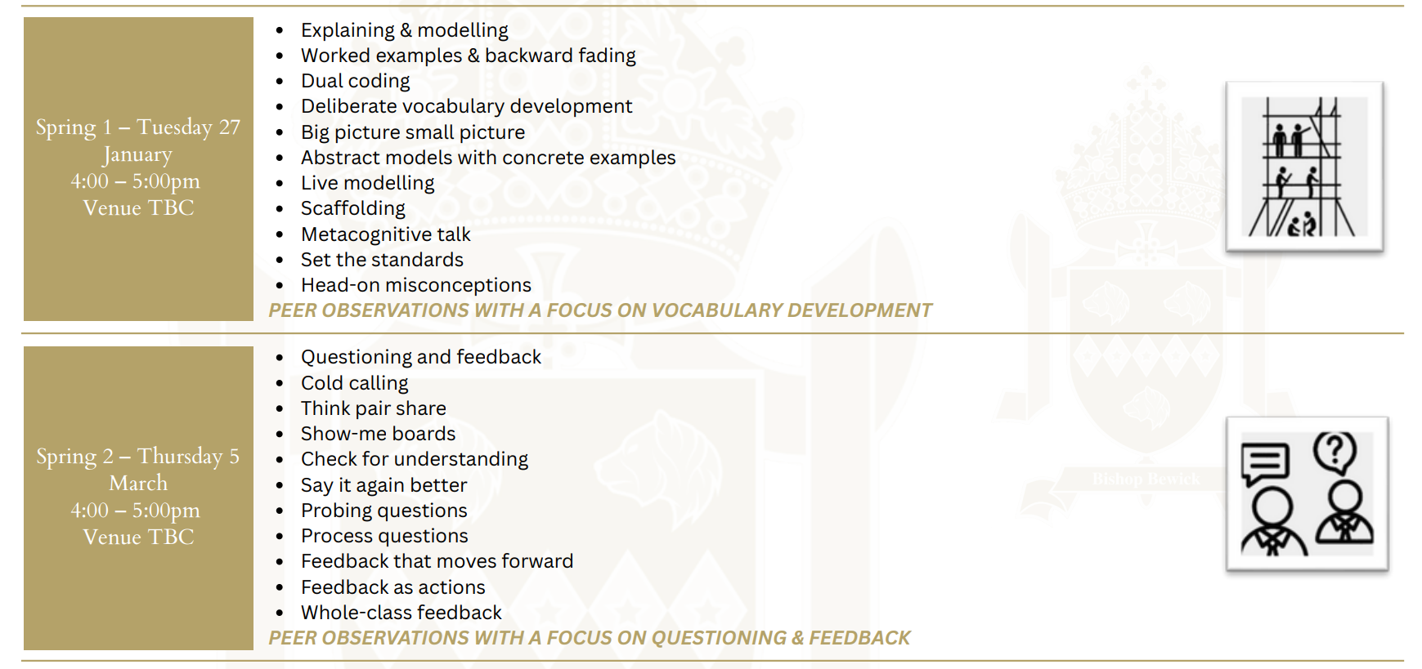
Trust Walk Thrus Project

Slide 18
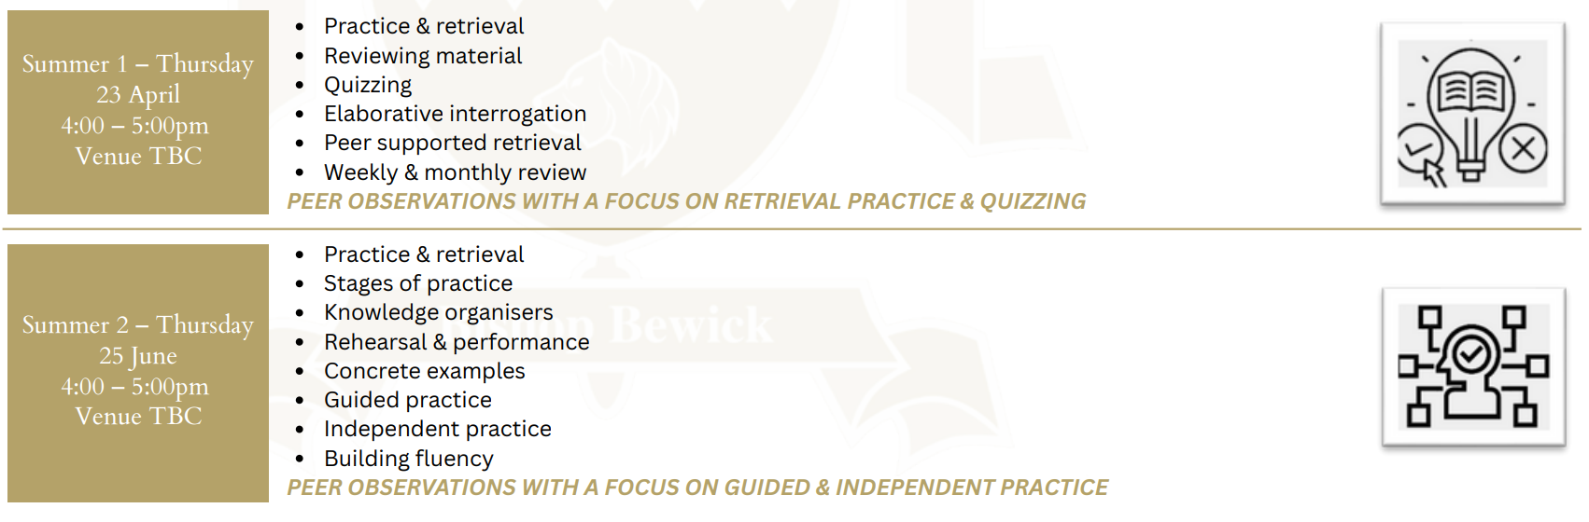
Trust Walk Thrus Project

Slide 19

Shared language

Slide 20

Shared language

Slide 21
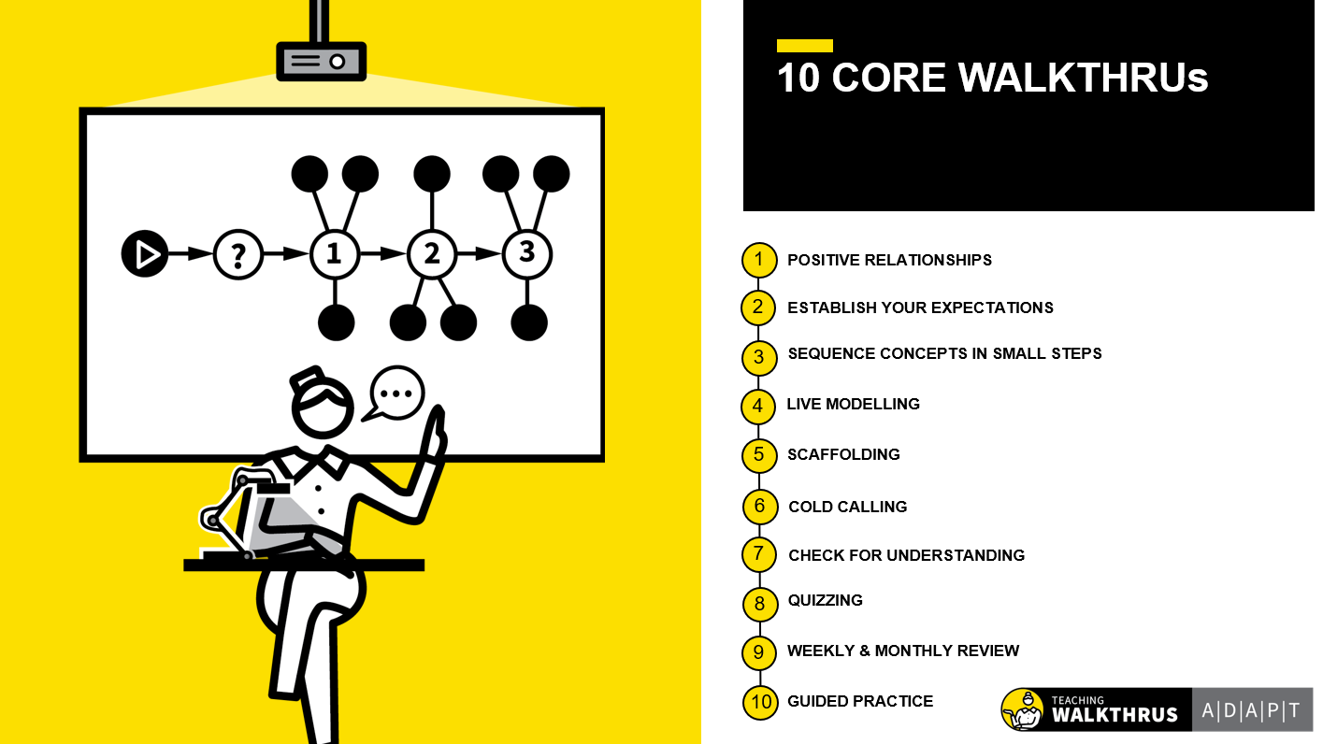
Slide decks
Slide Decks — Teaching WalkThrus | Multi-Platform Teaching Tools & Resources To Support Teachers - Primary Schools - Secondary Schools - Further Education - Coaching Tools - Webinars | Oliver Cavigioli - Tom Sherrington | UK

Slide 22
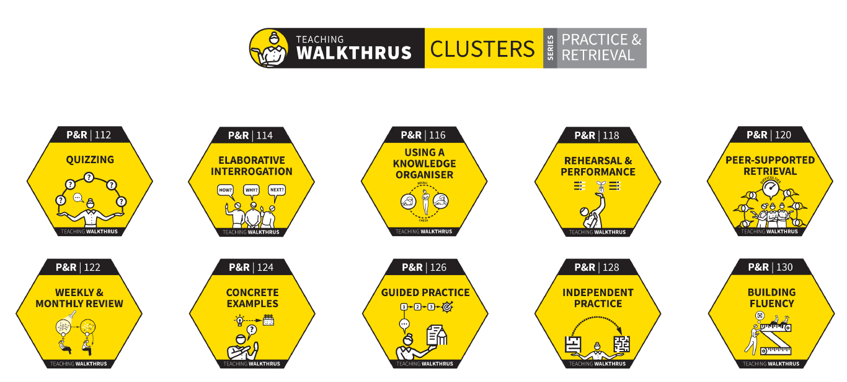
Clusters

Slide 23
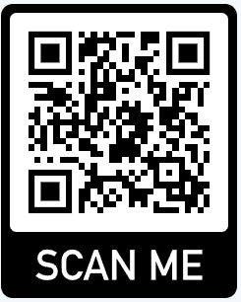
Interactive – Bringing Walk Thrus to life

Slide 24
Impact and key lessons learnt
Consistency improved across classrooms
Coaching replaced one-off CPD
Staff confidence and clarity increased with a shared language
Improved assessment for learning
More thinking and engagement
Start small: focus on a few high-impact strategies at a time.
Build in regular practice and coaching not just delivery.
Adapt approaches to context while maintaining fidelity to the core principles.

Slide 25

Reflections and takeaways
Any questions?

Slide 26

Feedback

