Slide 1
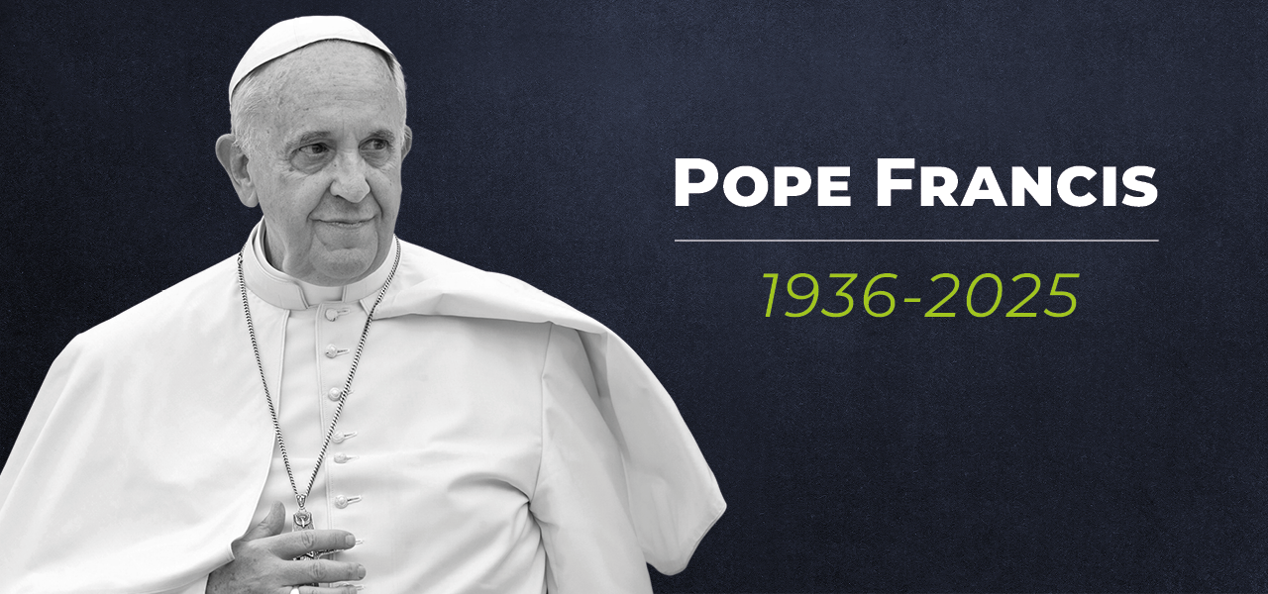
Pope Francis
A reflection for schools
Remembering Pope Francis: a reflection for schools

Slide 2
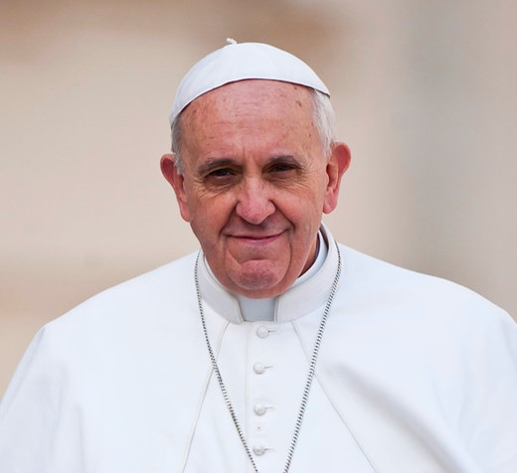
As the world reacts to the sad news of the death of Pope Francis, we come together in prayer to give thanks for the life of such a special leader.
Pope Francis believed in the power of children and young people, calling them the ‘joy and hope of the Church and the world!’
Notes:
(Spes Non Confundit, #12).

Slide 3
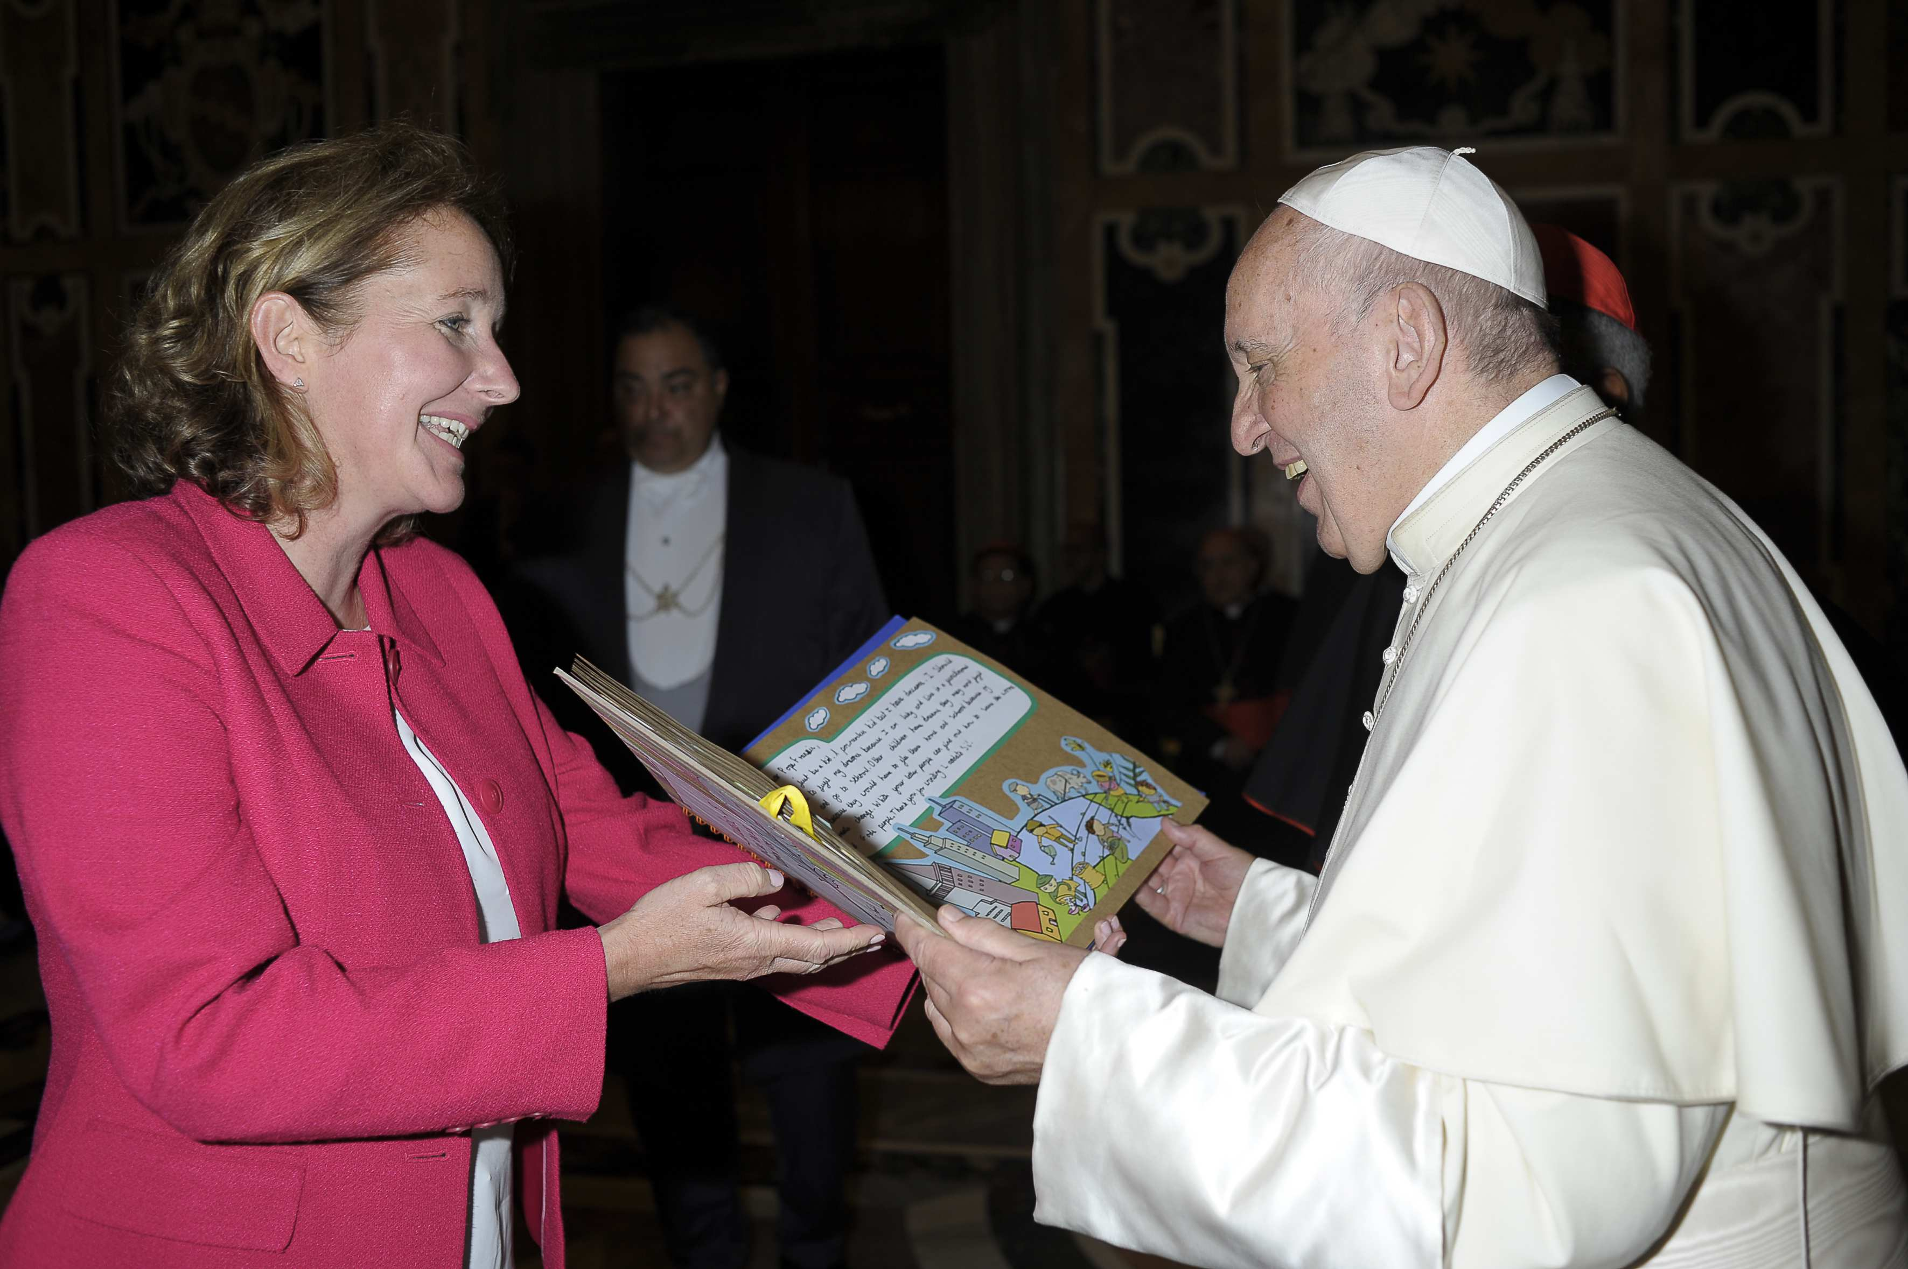
Pope Francis was presented with messages from children and young people in England and Wales who had passionately embraced and responded to the message of Laudato Si’, to care for our world and for those in greatest need.

Slide 4
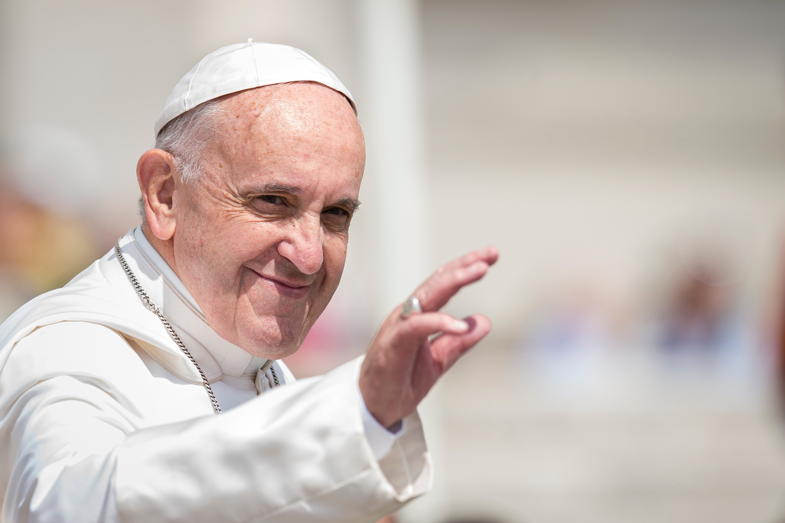
Pope Francis said that his own life story was a journey of hope.
He understood that in a world that can feel scary or divided, God’s love and the hope it brings is needed more than ever.
In fact, he made hope the theme of this Jubilee Year.
Pope Francis has inspired us all to work for a better world.

Slide 5
Let us now watch this reflection on Pope Francis.
Notes:
Remembering Pope Francis for Schools | CAFOD - YouTube

