Slide 2
Beyond the Curriculum: Raising Aspiration and Building Skills Through Super-Curricular
JAMES TURNBULL

Slide 3
Super-Curricular Opportunities
A strong super-curricular opportunity should help pupils:
Experience academic challenge in a positive way;
Apply knowledge beyond curriculum content;
Work with pupils beyond their normal way of working;
Develop communication, teamwork and problem-solving;
See themselves as capable of higher-level study or employment;
Build confidence, aspiration and subject identity.

Slide 4
Super-Curricular Opportunities
What makes a super-curricular opportunity meaningful rather than another thing for students to do?
Consider:
What does it do for pupils that normal lessons may not always do?
How does it raise aspiration?
How does it develop skills beyond subject knowledge?
What makes pupils want to take part?

Slide 5
Super-Curricular Opportunities
Super-curricular opportunities pose a unique challenge for leaders.
How do we raise aspiration consistently across varied schools?
How do we make academic challenge visible and celebrated?
How do we create opportunities that are ambitious but manageable?
How do we avoid enrichment only reaching the same small group of pupils?
How do we make collaboration across the Trust practical and sustainable?

Slide 6

BBCET Science Olympiad
Separate Olympiads for Biology, Chemistry and Physics in A-Level subjects.
Written by members of science departments across the Trust.
Designed to mimic the ambition and style of national Science Olympiads.
Questions require pupils to apply knowledge in unfamiliar contexts.
Pupils are awarded Gold, Silver and Bronze certificates.
The aim is to stretch pupils and encourage them to think beyond the specification.

Slide 7
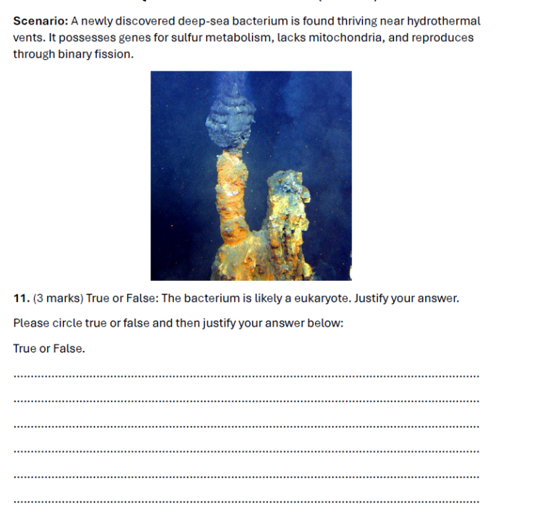
BBCET Science Olympiad
Make academic challenge visible
Give pupils experience of unfamiliar and demanding questions.
Celebrate intellectual curiosity.
Identify pupils with strong potential in different areas.
Encourage pupils to think like biologists, chemists and physicists
Create a shared standard of ambition across the Trust.
Support collaboration between subject specialists across schools.

Slide 8
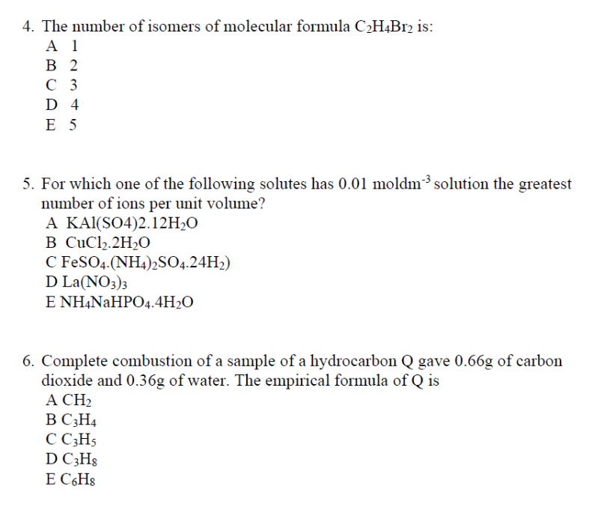
BBCET Science Olympiad
Strong competition questions often ask pupils to:
Interpret unfamiliar data.
Explain an unexpected result.
Apply a familiar concept in a new context.
Evaluate evidence or a method.
Make links between different parts of the subject.
Reason carefully from limited information.
Justify a conclusion.

Slide 9
Activity
Choose your subject or area of leadership.
Discuss and design one small challenge that would take pupils beyond activities found in the curriculum.
Consider:
What knowledge or skill would pupils start with?
What unfamiliar context could they apply it to?
What would make them think, reason or justify?
How could success be recognised?

Slide 10
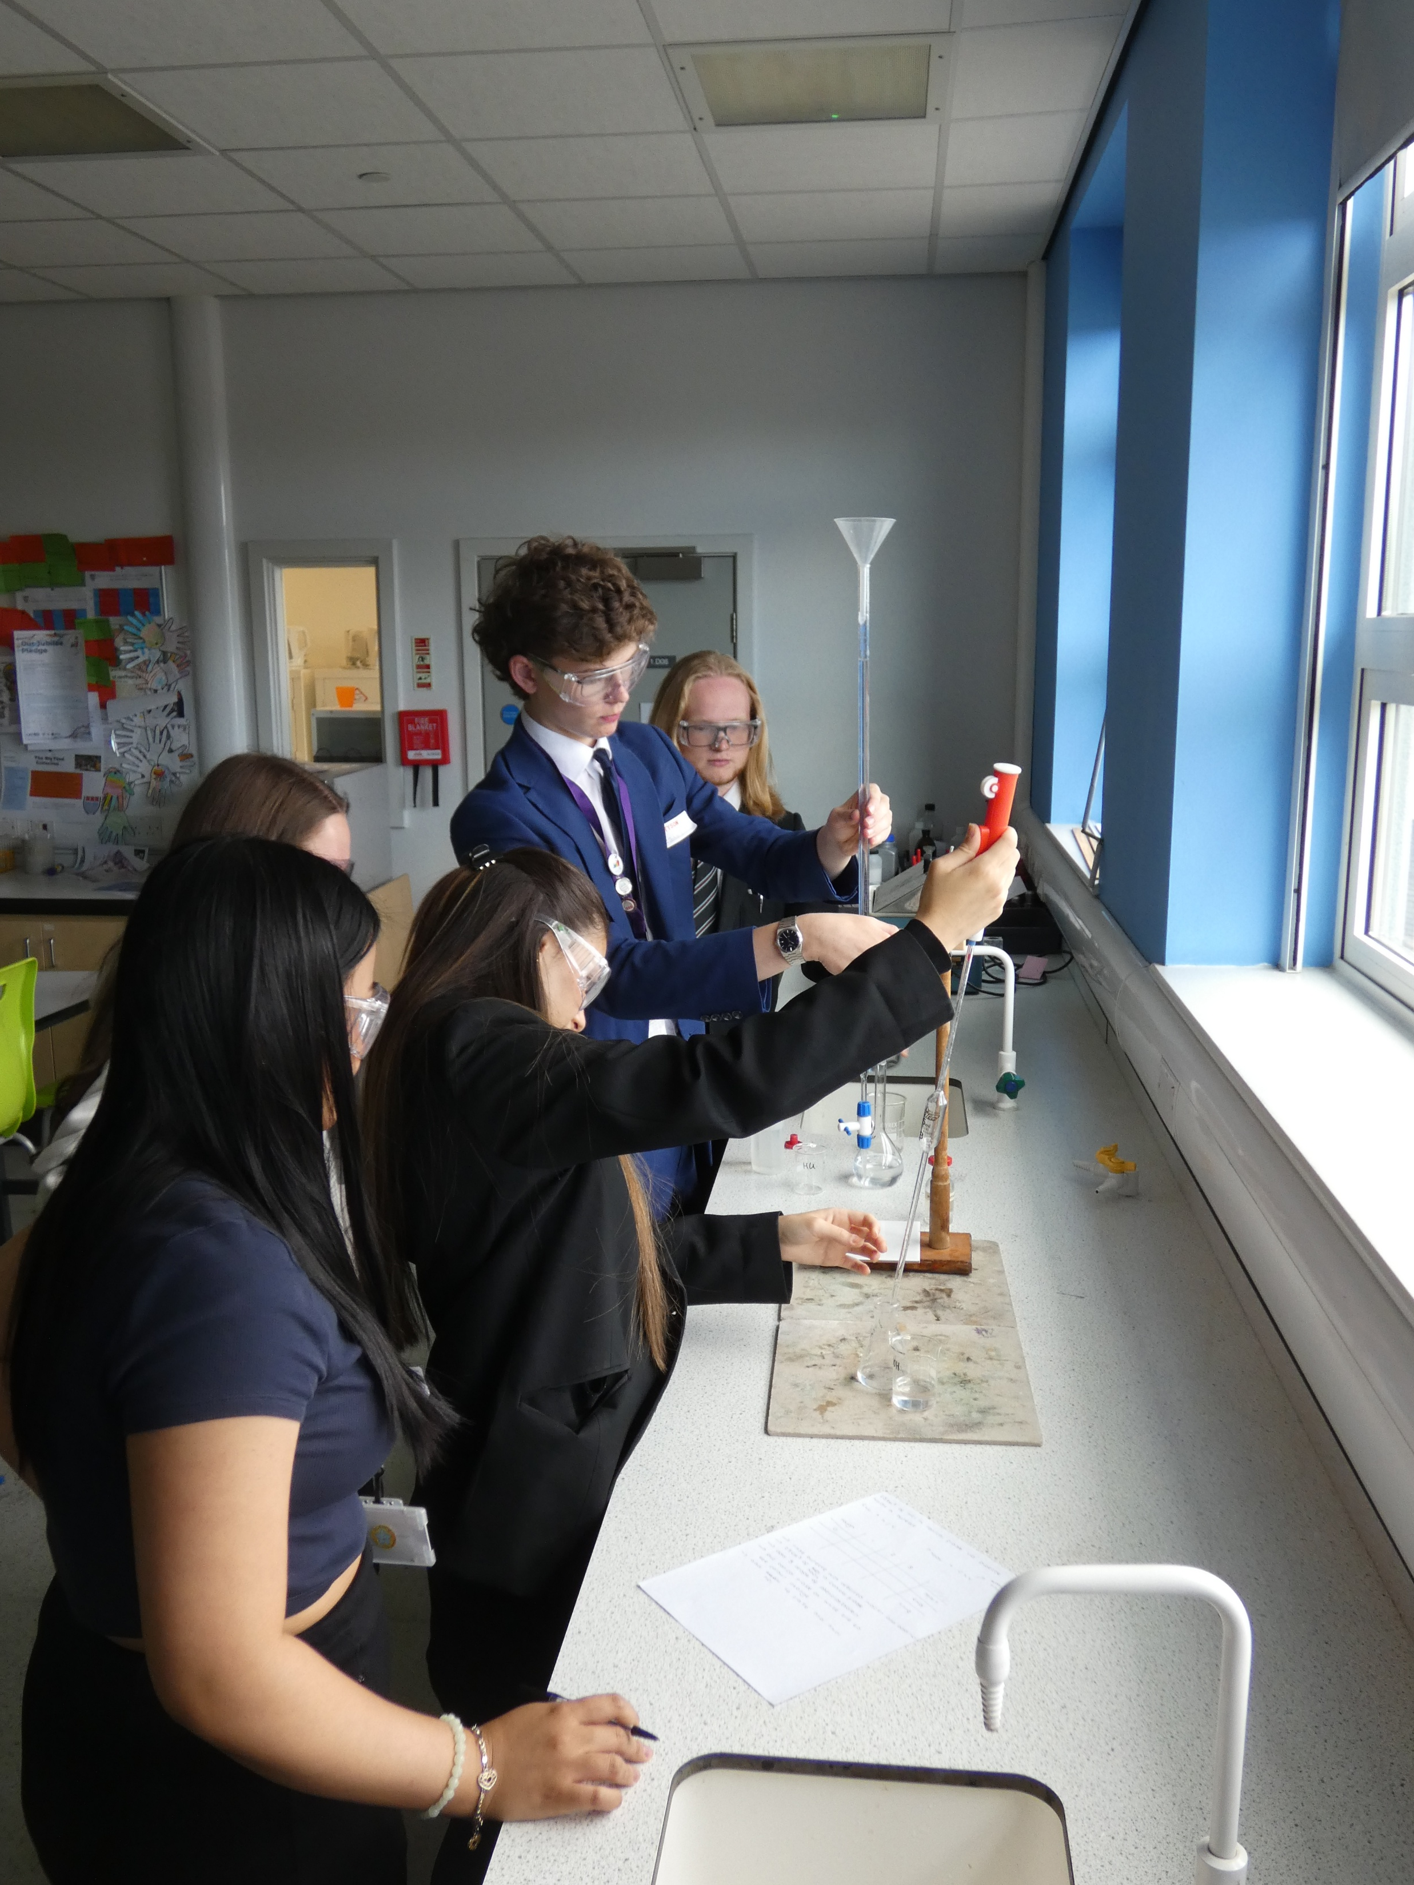
BBCET Science Competition
The competition brings pupils together from across the Trust to complete a carousel of challenges, including:
Practical science;
Presenting;
Quizzing;
Team-building;
Problem-solving;
Applied STEM challenges.
Pupils work in mixed teams, encouraging collaboration beyond their own school.

Slide 11
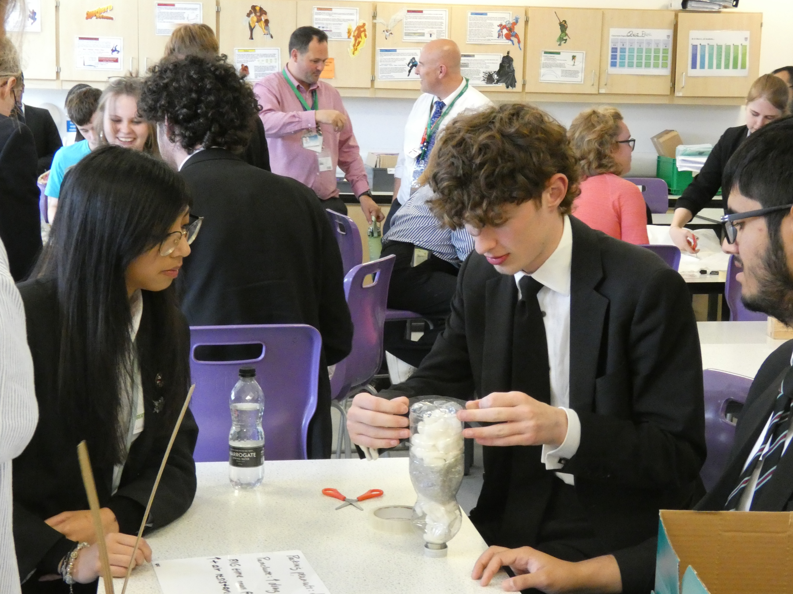
BBCET Science Competition
Mixed teams help pupils to:
Work with people they do not already know.
Communicate quickly and effectively.
Take on different roles.
Listen to alternative approaches.
Build confidence outside their normal peer group.
Experience the Trust as a wider learning community.
Frame this as collaboration not competition.

Slide 12
BBCET Science Competition
Problem-solving
Tackling unfamiliar challenges
Communication
Explaining and presenting ideas
Leadership
Organising roles and making decisions
Key Skills Developed
Collaboration
Working in mixed-school teams
Resilience
Adapting when things do not work first time
Practical confidence
Applying knowledge through hands-on tasks

Slide 13
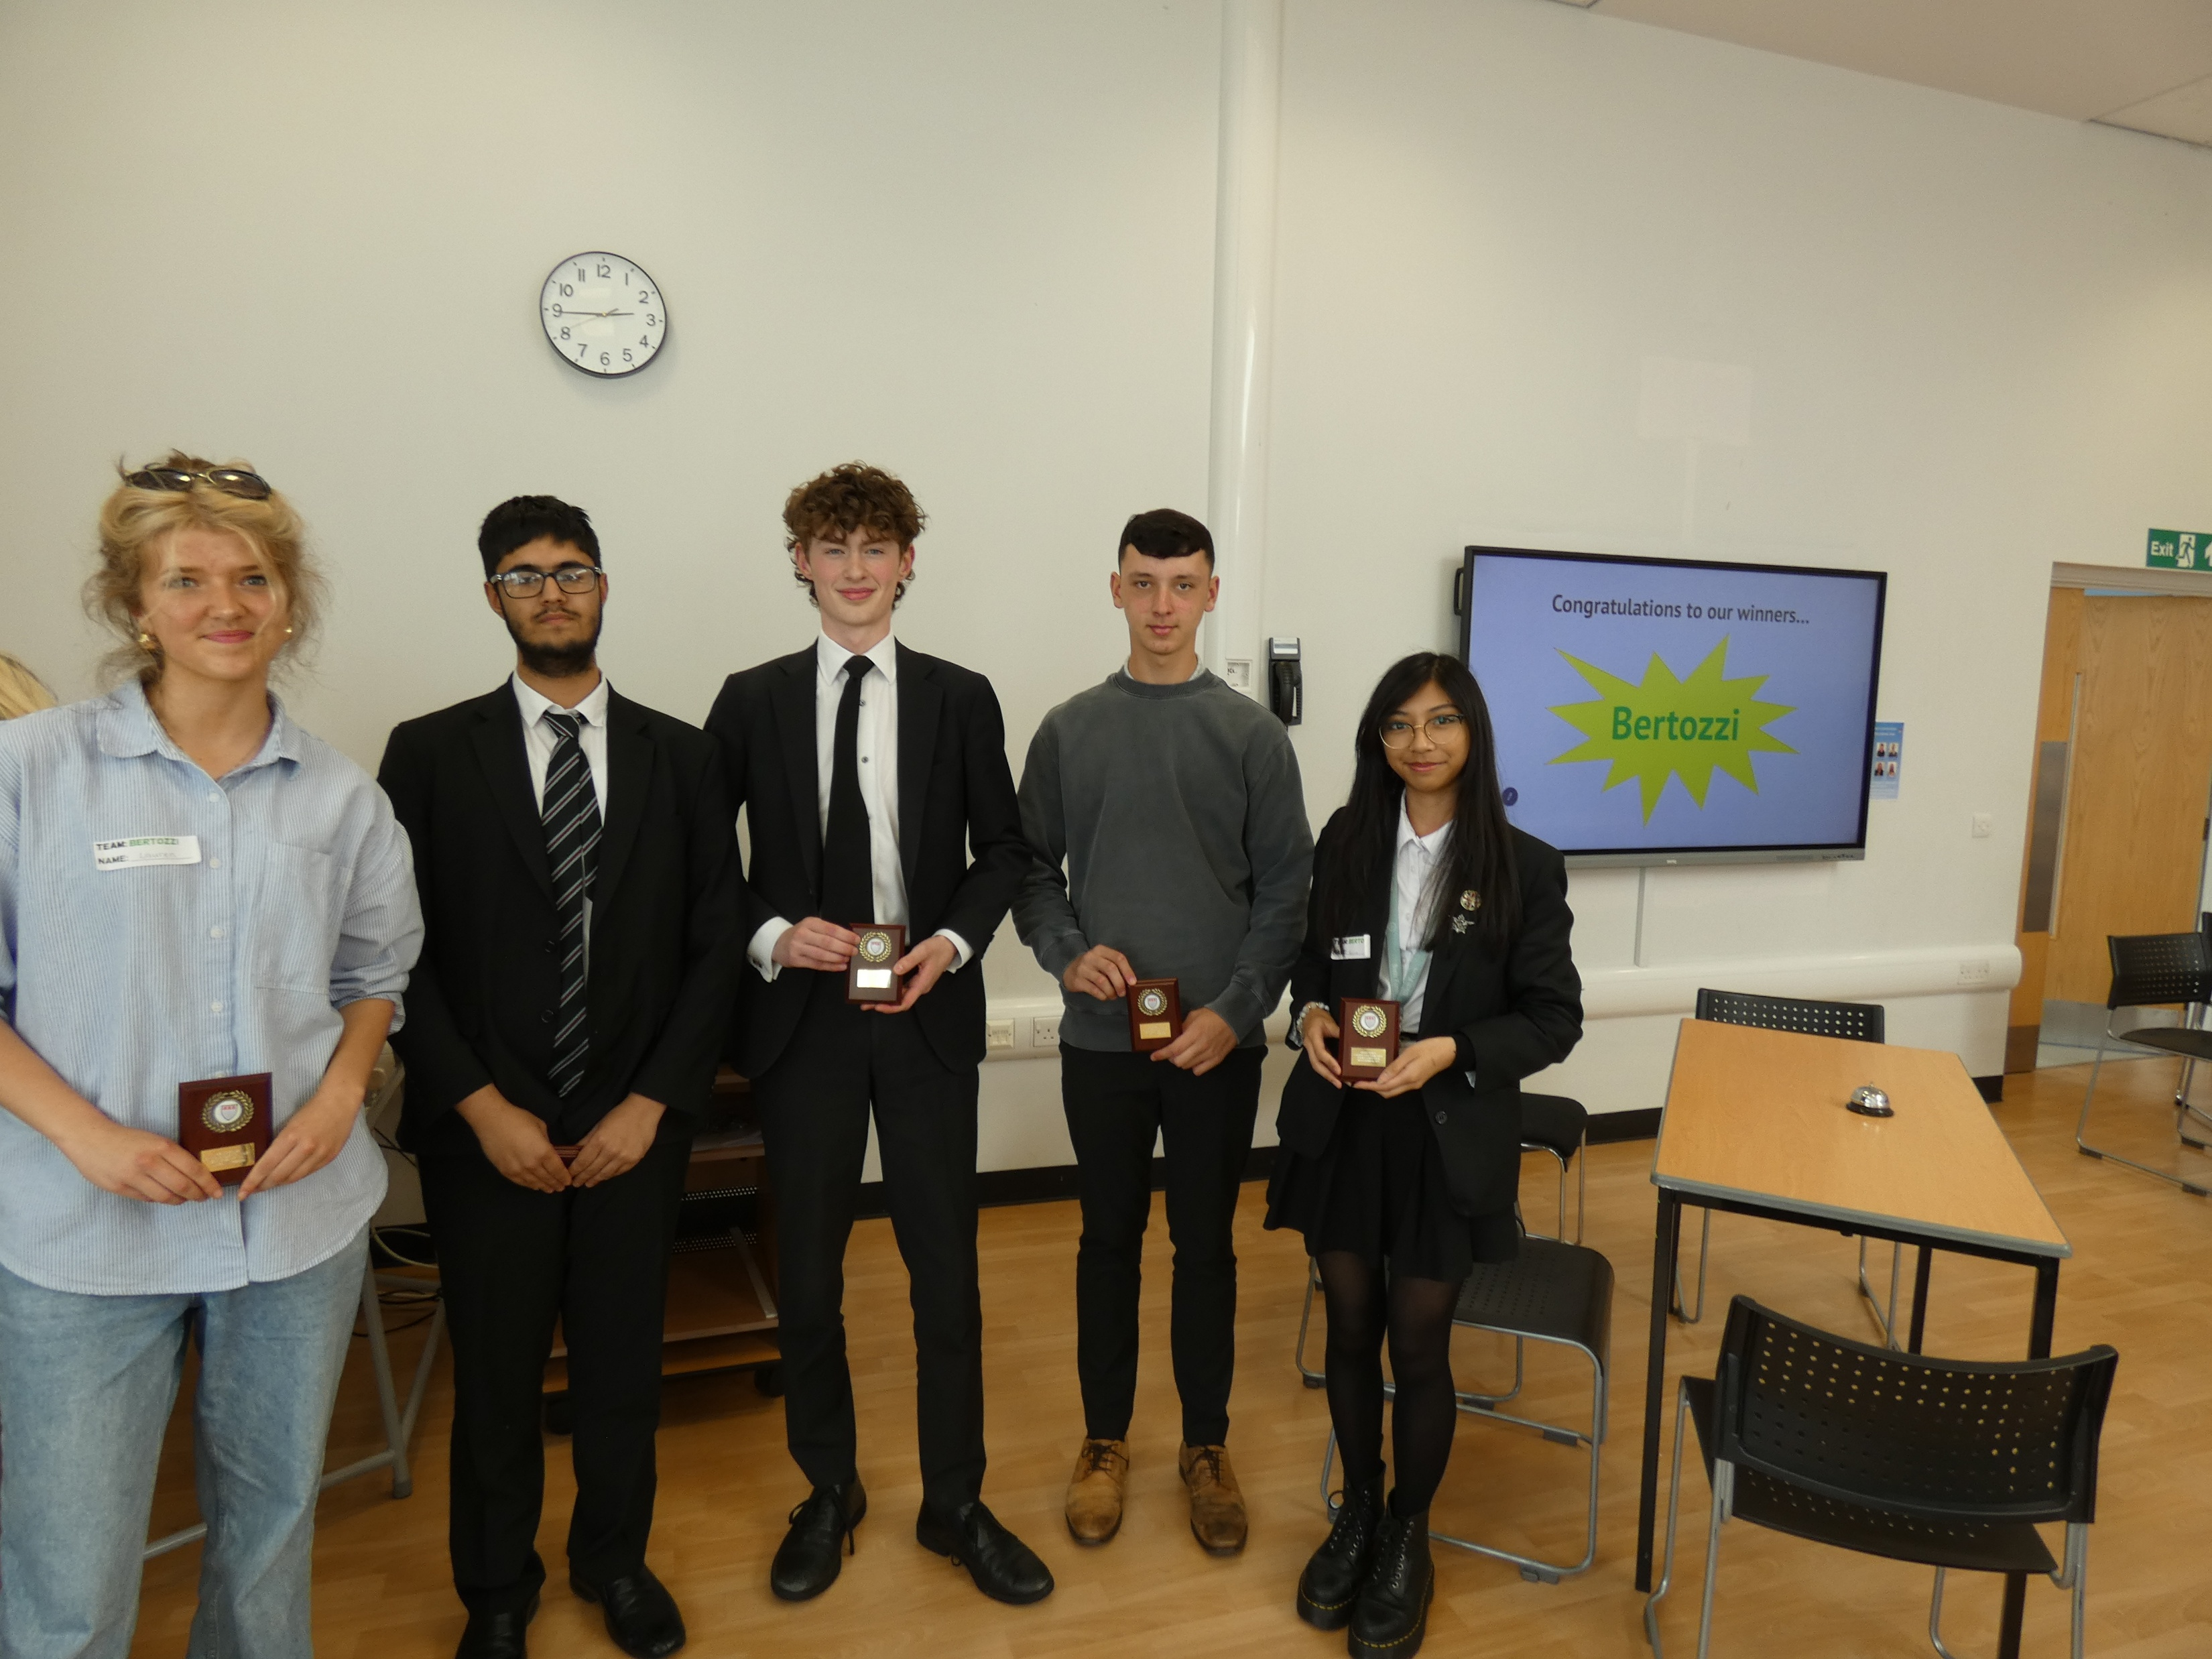
BBCET Science Competition
Awards
Best teamwork.
Best practical problem-solving.
Best communication.
Most creative.
Overall winning team.
To keep the model inclusive:
Use different types of challenge.
Recognise different forms of success.
It is not just individual scores.
Select pupils for curiosity, effort and potential, not just attainment.
Build in roles where different pupils can contribute.
Celebrate participation, progress and achievement.

Slide 14
Trust Wide Opportunities
A strong Trust-wide super-curricular opportunity needs five things:
Purpose
What are we trying to develop?
Challenge
How will pupils think beyond the taught curriculum?
Access
How will a range of pupils be able to participate and succeed?
Collaboration
How will schools, staff and pupils work together?
Recognition
How will effort, achievement and skill development be celebrated?

Slide 15
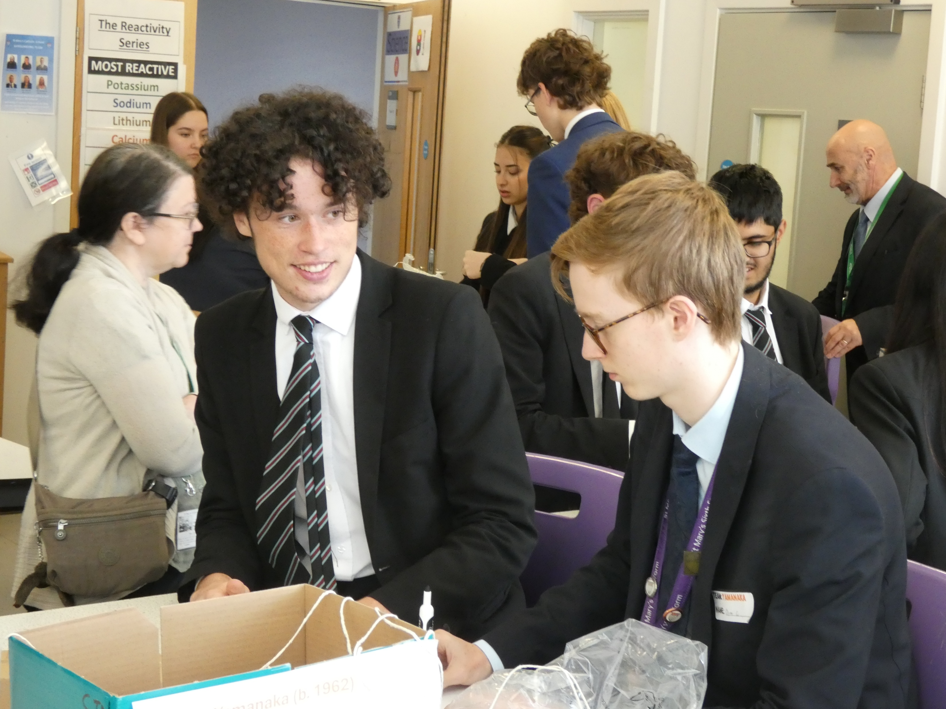
Activity
Working in pairs or small groups, design a super-curricular opportunity that could work in your area of responsibility.
Consider:
What would be the purpose?
What would pupils actually do?
How would it go beyond the taught curriculum?
How would it develop wider skills?
How would it remain inclusive?
How could schools share the workload?
How would pupils be recognised?
How could it be repeated next year?

Slide 16
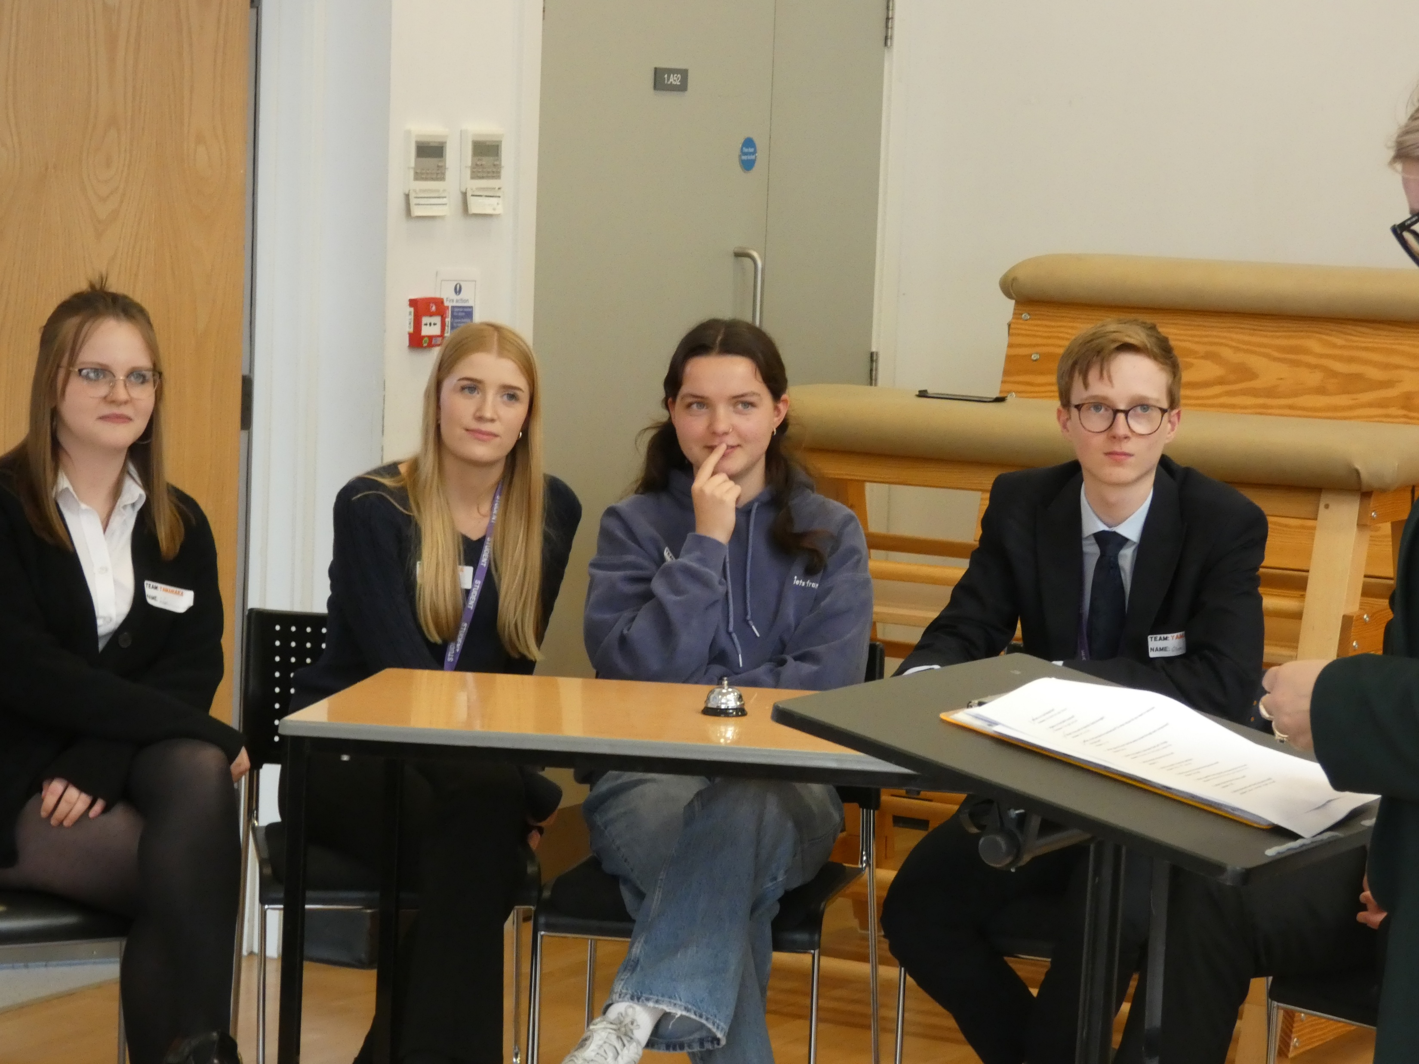
Trust Wide Opportunities
For a sustainable opportunity, we need:
A clear annual calendar slot.
A lead, but also shared ownership.
Simple planning templates.
Reusable resources/structure.
Manageable marking or judging.
Shared workload across schools.
Visible celebration of pupils.
Evaluation.
Gradual improvement rather than over-designing.

Slide 17
Activity
What might get in the way of developing this kind of opportunity, and how could we reduce that issue?
Issues
Solutions

Slide 18
Activity
Booklet Reflection
Question 1
What is the one idea from this session that would make the biggest difference to learning in my context?
Question 2
What would I expect to see teachers, pupils or leaders doing differently?
Question 3
How might this need to be adapted for my phase, subject, year group or school context?
Question 4
What is one realistic action I could take in the next two weeks?
Question 5
What might get in the way, and how could we reduce that barrier?

Slide 19
Super-Curricular: Ambition and Aspiration
The aim is not simply to run more competitions.
The aim is to create opportunities where pupils:
Think beyond the taught curriculum.
Experience academic challenge.
Work with others beyond their usual classroom.
Develop confidence, communication and problem-solving by being pushed beyond their comfort zone.
See ambition and aspiration as something that belongs to them.
Feel part of a wider Trust.

