Slide 2
Learning Through Talk
cfeeney@stmacademy.org.uk

Slide 3
Aims
Learn how to:
Use talk to elevate learning in your classroom.
Create a classroom culture that supports students to participate in, and benefit from, talk opportunities.

Slide 4

Introductions
A:
Hello I’m _
My school is _
My motivations are _
I hope that _
B:
So, are you hoping that _?
You are here because _

Slide 5
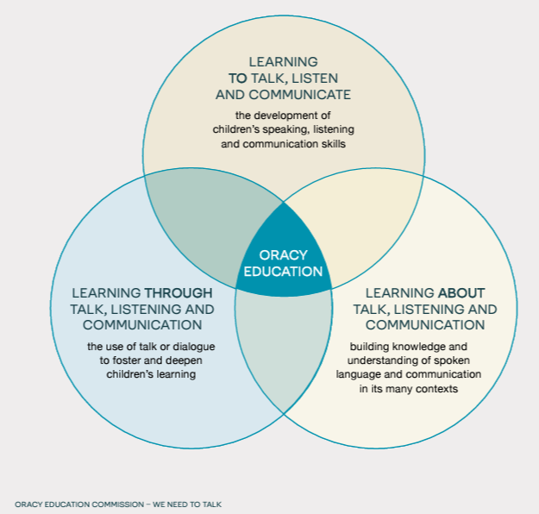

Notes:
Theory

Slide 6
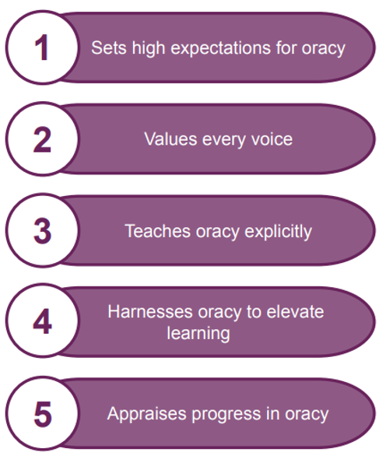
Teacher
Benchmarks
What excellent classroom practice looks like.
Notes:
What excellent classroom practice looks like - 5 core elements

Slide 7
How might we ‘hit’ these benchmarks?
What does/could it look like in your classroom?
What ‘good talk’ looks and sounds like is made clear to students.
Teachers and students listen well to each other and respect each others’ contributions. Scaffolds and structures support all students to contribute and access talk activities.
Specific oracy skills are identified, modelled, supported and discussed.
Oracy tasks are purposeful and develop students’ thinking and understanding and are supported by thoughtful questioning and facilitation by the teacher.
Teachers give specific feedback against oracy skills and monitor progress over time.

Slide 8
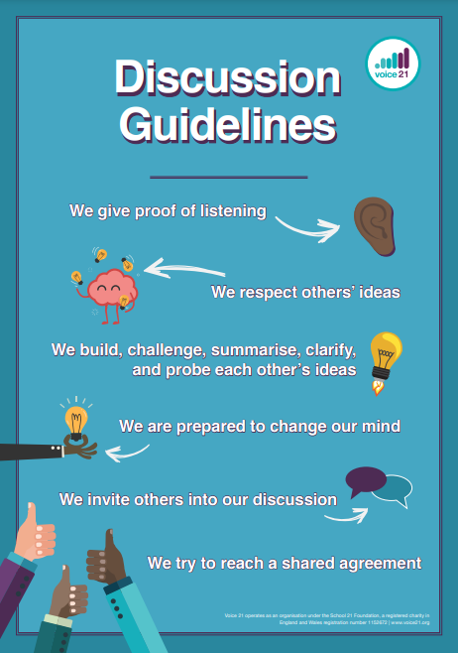
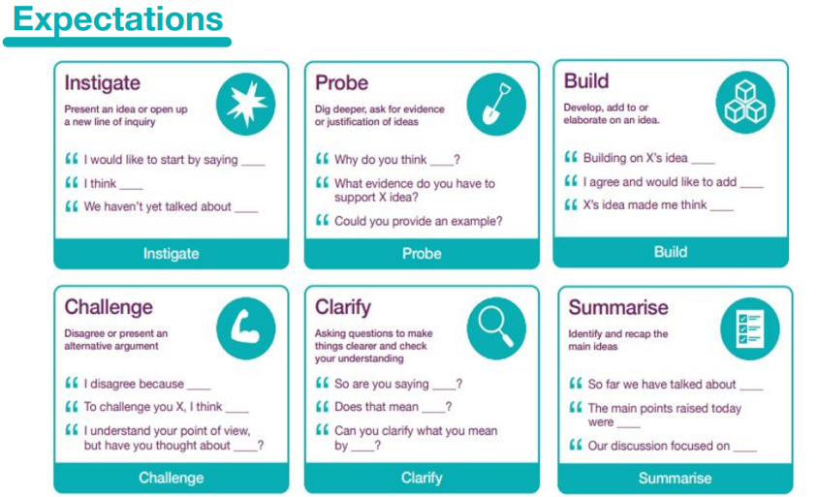
Creating a culture for high quality talk
Notes:
Whole school approach STM - everything I talk about is in this context.
Oracy leads have editable copies of this - talk tactics

Slide 9
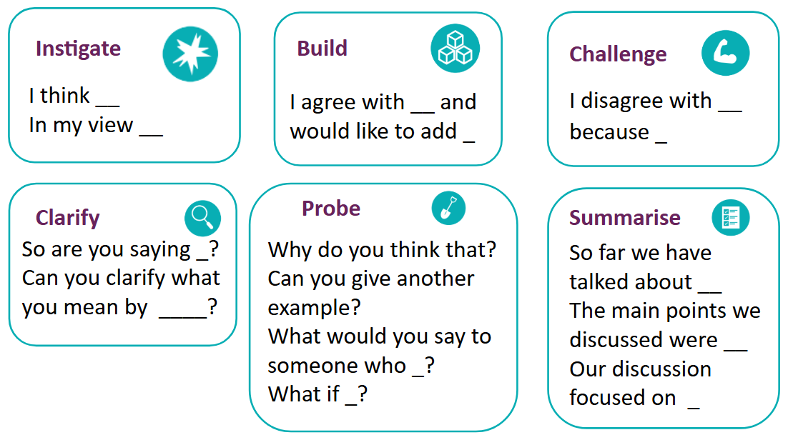

Slide 10






Concept cartoon
Oracy is about being able to stand up in front of an audience and speak with confidence.
Oracy is about teaching people to speak like a posh person.
Erika
What is oracy?
Karl
Oracy is just as much about listening as it is speaking.
Oracy is about being able to articulate what you are learning and using speaking to help you.
Tom
Tamana
Notes:
Concept cartoon - how might you use this in your classroom to elevate learning?

Slide 11
What is Exploratory Talk?
‘Exploratory talk (__) is typical of the early stages of approaching new ideas (__) Exploratory talk is hesitant and incomplete because it enables the speaker to try out ideas, to hear how they sound, to see what others make of them, to arrange information and ideas into different patterns.’ D Barnes 1992
This means it involves:
Pauses
Hesitations
Filler words eg ‘um’ ‘err’ ‘like’
Rephrasing or repetition
‘A lack of fluency can be a good sign of hard thinking going on.’ Oracy Cambridge

Slide 12




The Oracy Framework
1
TBM
3
TBM
We have divided oracy skills into four strands:
Cognitive
The deliberate application of thought to what you’re saying
Linguistic
Knowing which words and phrases to use, and using them
Physical
Making yourself heard, using your voice and body as an instrument
Social & Emotional
Engaging with the people around you; knowing you have the right to speak
Notes:
The Oracy Framework was developed in conjunction with Voice 21 and Cambridge University as part of an EEF pilot project.
It provides a framework through which we can understand what constitutes good speaking and listening in different contexts.
It breaks down the skills within oracy into four distinct but interlinked strands: physical, linguistic, cognitive and social emotional.
Share the strand definitions.

Slide 13


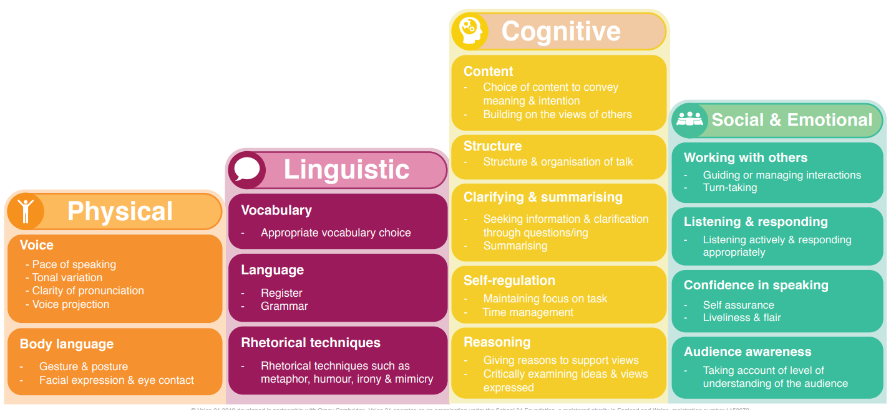
The Oracy Framework
Notes:
Explain there are many ways in which the framework can be used, some of which is explored in this training and some in the training around learning to and through talk.

Slide 14
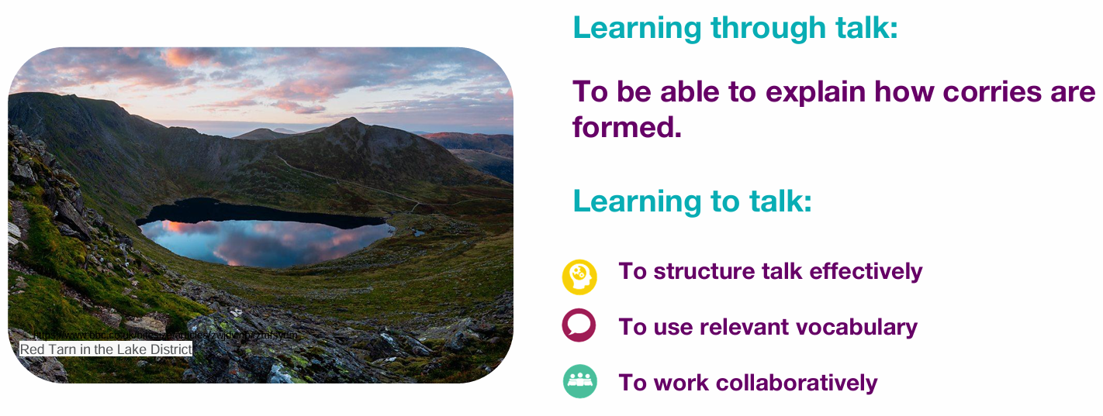
Creating a culture of high quality talk

Slide 15
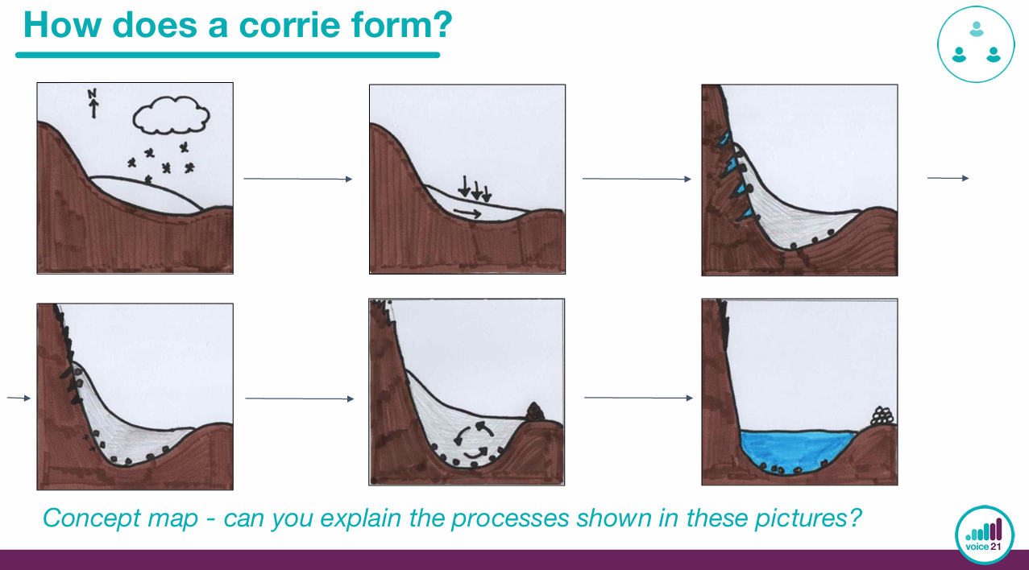
Concept Maps

Slide 16
Talk Triad
1 - offers a definition
2 - agrees and builds on this
‘I agree with X and would like to add…’
3 - builds/challenges on the previous definitions
‘I agree with…/disagree because…’
Everyone: co-construct a final definition

Slide 17
Talk Triad
1 - offers a definition
What is active listening?
2 - agrees and builds on this
‘I agree with X and would like to add…’
3 - builds/challenges on the previous definitions
‘I agree with…/disagree because…’
Everyone: co-construct a final definition
Notes:
What is respiration? What is interval training?

Slide 18
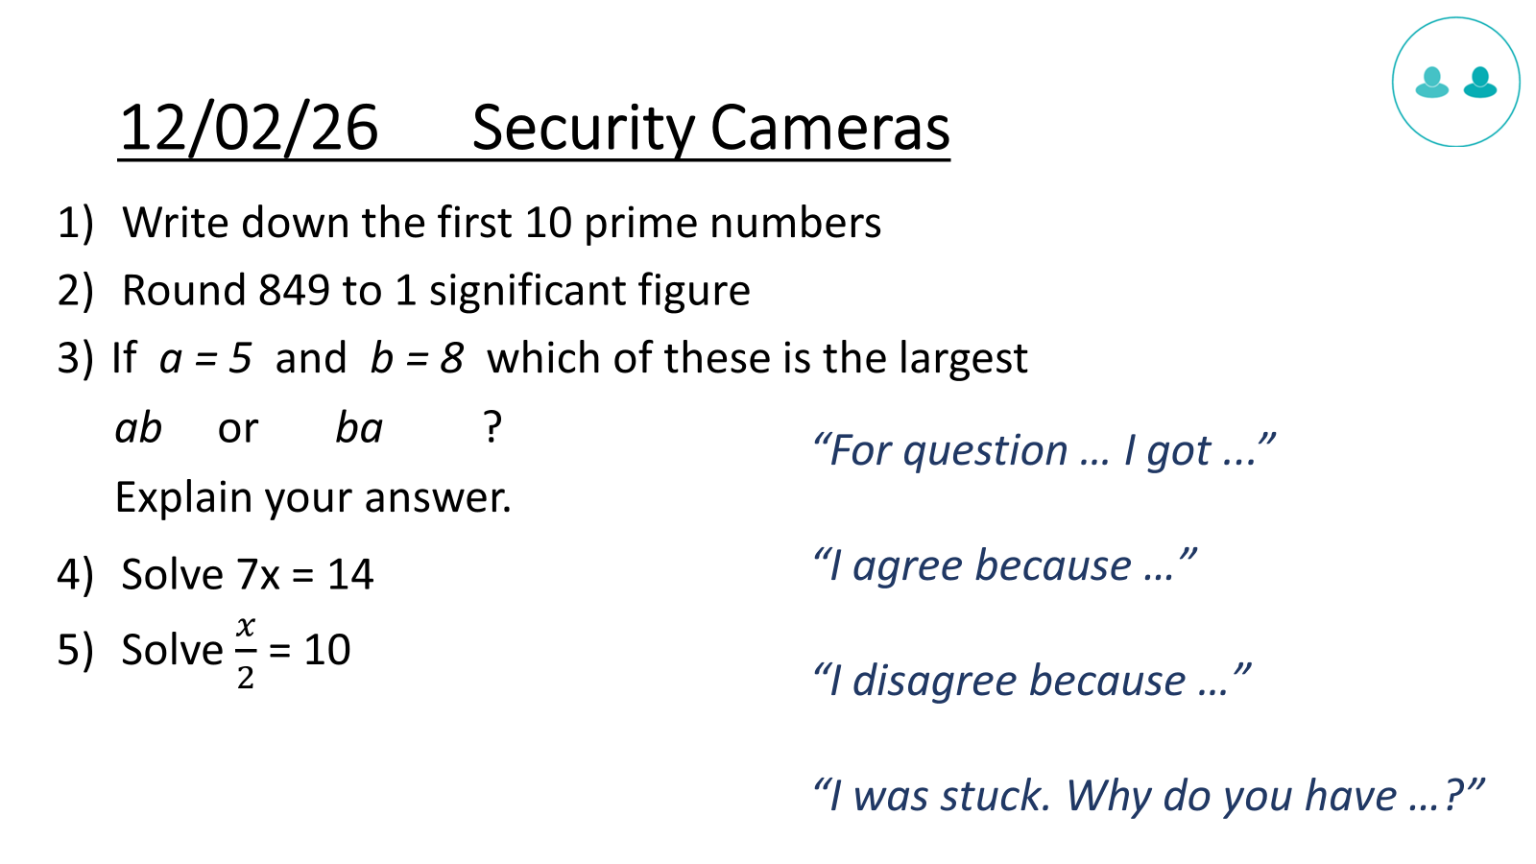
Problem-solving in Maths
Notes:
Vectors explain why something is wrong…

Slide 19
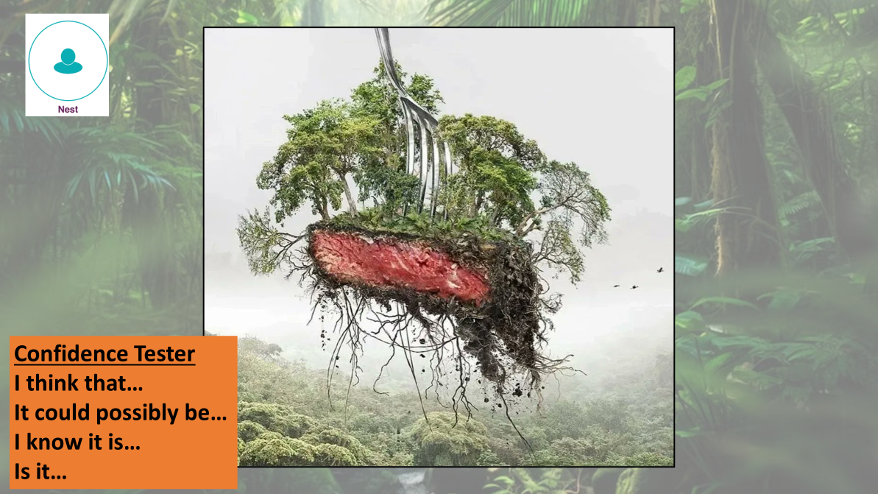
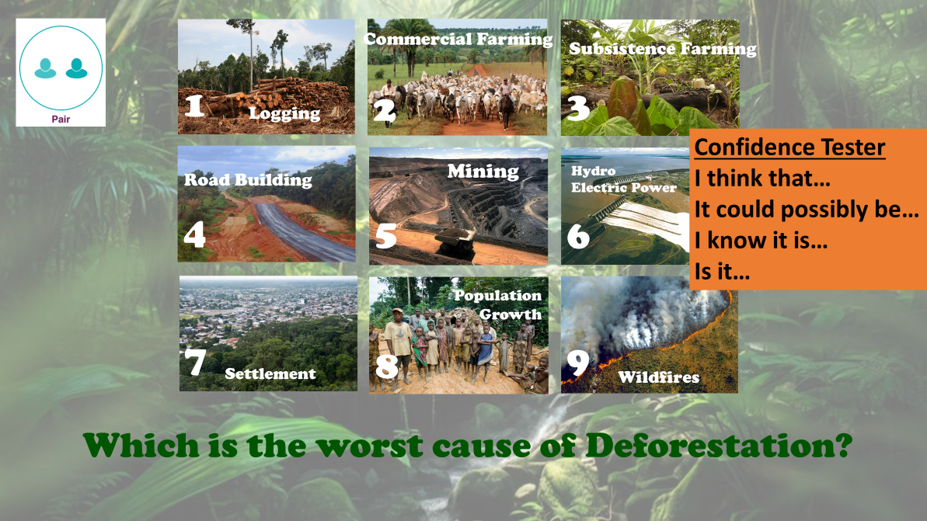

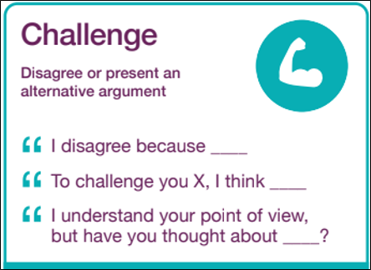
Notes:
1s - 2s - 4s - 8s

Slide 20
Talk to develop disciplinary thinking
Would you rather?
Use weight training or circuit training to improve your javelin throwing?
Receive compound interest or simple interest?
Agree or disagree?
Fartlek training is a useful training method for shot put athletes.
The battle of Dunkirk was a disaster.
Notes:
Talk is sticky - helps cognition
Add one example of your own

Slide 21
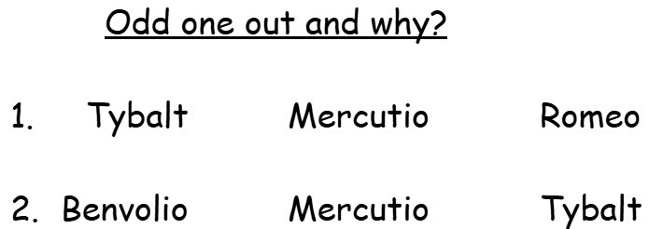
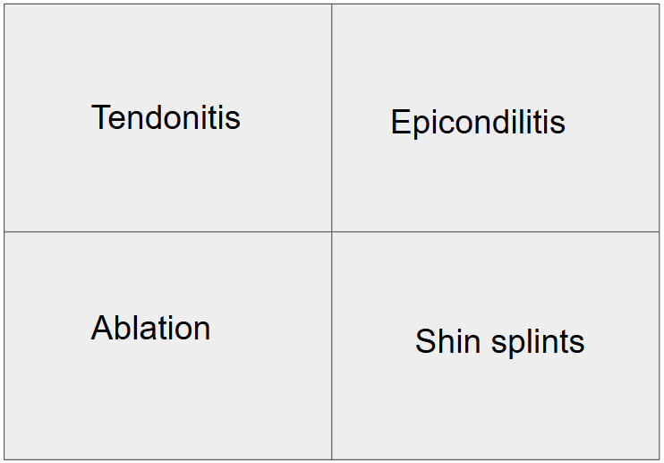
Odd One Out
Notes:
RE images / Maths - images and numbers etc

Slide 22
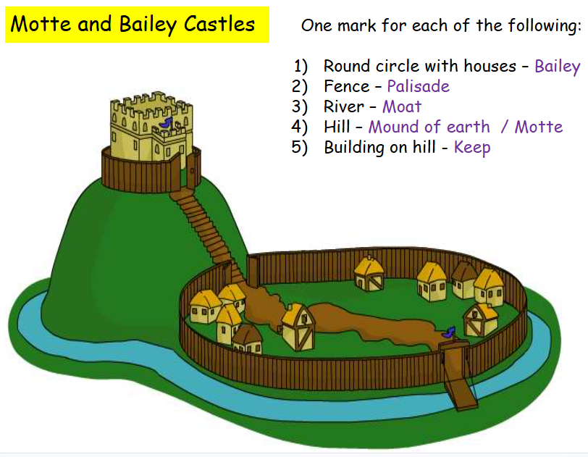
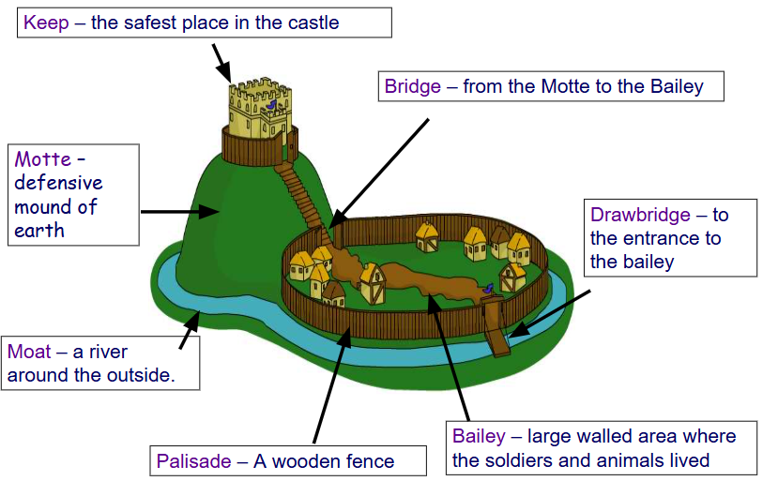
Describe and Draw

Slide 23
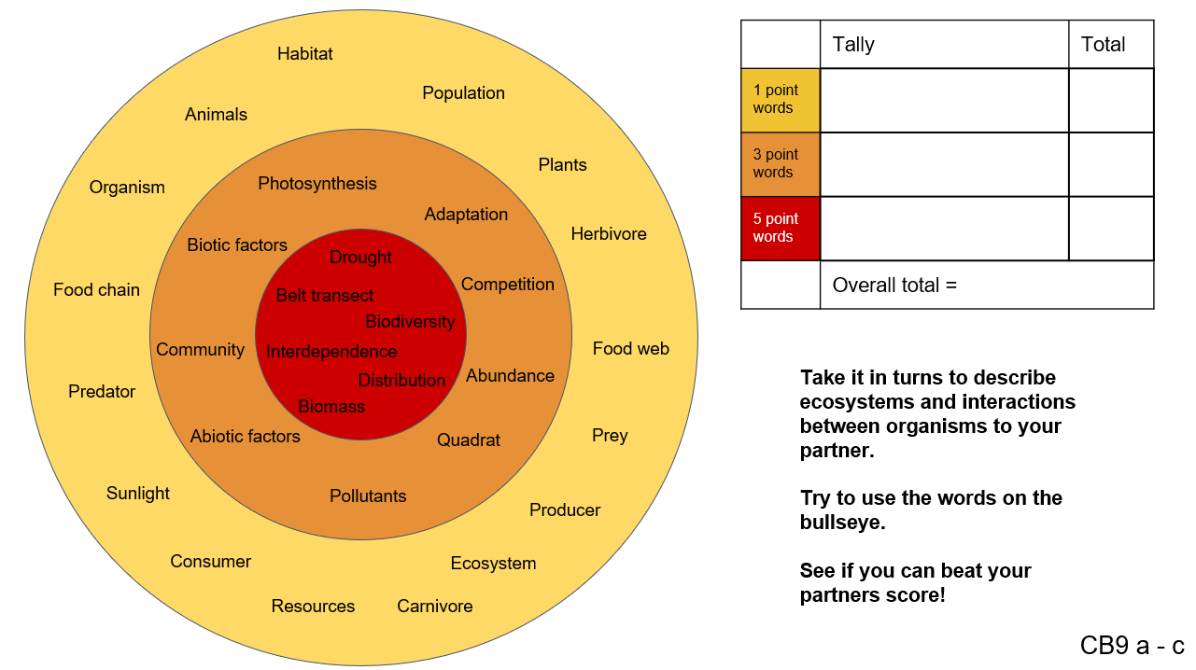
Vocabulary Bullseye
Notes:
Model first / add additional scaffolds / reduce amount - may need to adapt this

Slide 24
Vocabulary games - Taboo
Follow up questions:
Which were the easiest terms to describe? Why?
Was any term hard to describe? Why?
Did anyone give a really good description of a word? Why was it good?
type 1 muscle fibre | anaerobic activities
stroke volume | diffusion
vasodilation | lactate accumulation
Notes:
EAL learners

Slide 25
Vocabulary games - Taboo
Instructions
Create a grid with key topic words.
Give it to the ‘describer.’ They describe the key term without using it.
Their partner has to guess as many of the words as possible in a time limit.
Teacher can model initially.
Notes:
EAL learners

Slide 26
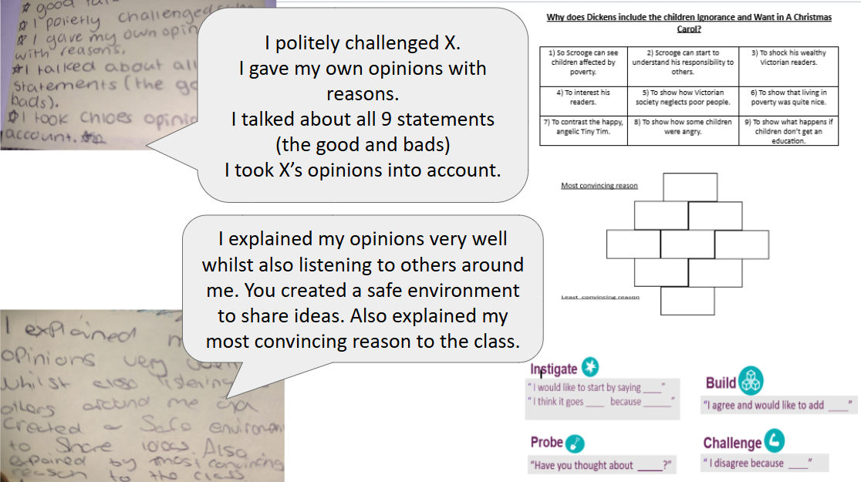

Slide 27
Next steps
A:
In my classroom I’d like to try __
This session has made me consider __
B:
My thoughts are similar/different because __

Slide 28
Further Reading and Listening
Supporting the Development of Oracy: Project Evaluation
We need to talk, 2024 – Oracy Commission
How to teach oracy skills in the secondary school classroom - SecEd
Listen – Oracy Commission
Dialogic Teaching | EEF
Welcome - ORACY CAMBRIDGE

